Slide 1
Today
We will:
acknowledge The Land
acknowledge each other and create a safe space for our exchanges
look at the basic principles of Universal Design for Learning (UDL)
briefly discuss the purpose of instructions from the instructor and learner perspectives
explore an example of assignment instructions. This assignment aims to be a model in honour of the TRC Call to Action sections 62 ii and 63 ii, iii, iv.
practice revising instructions using UDL

Slide 2
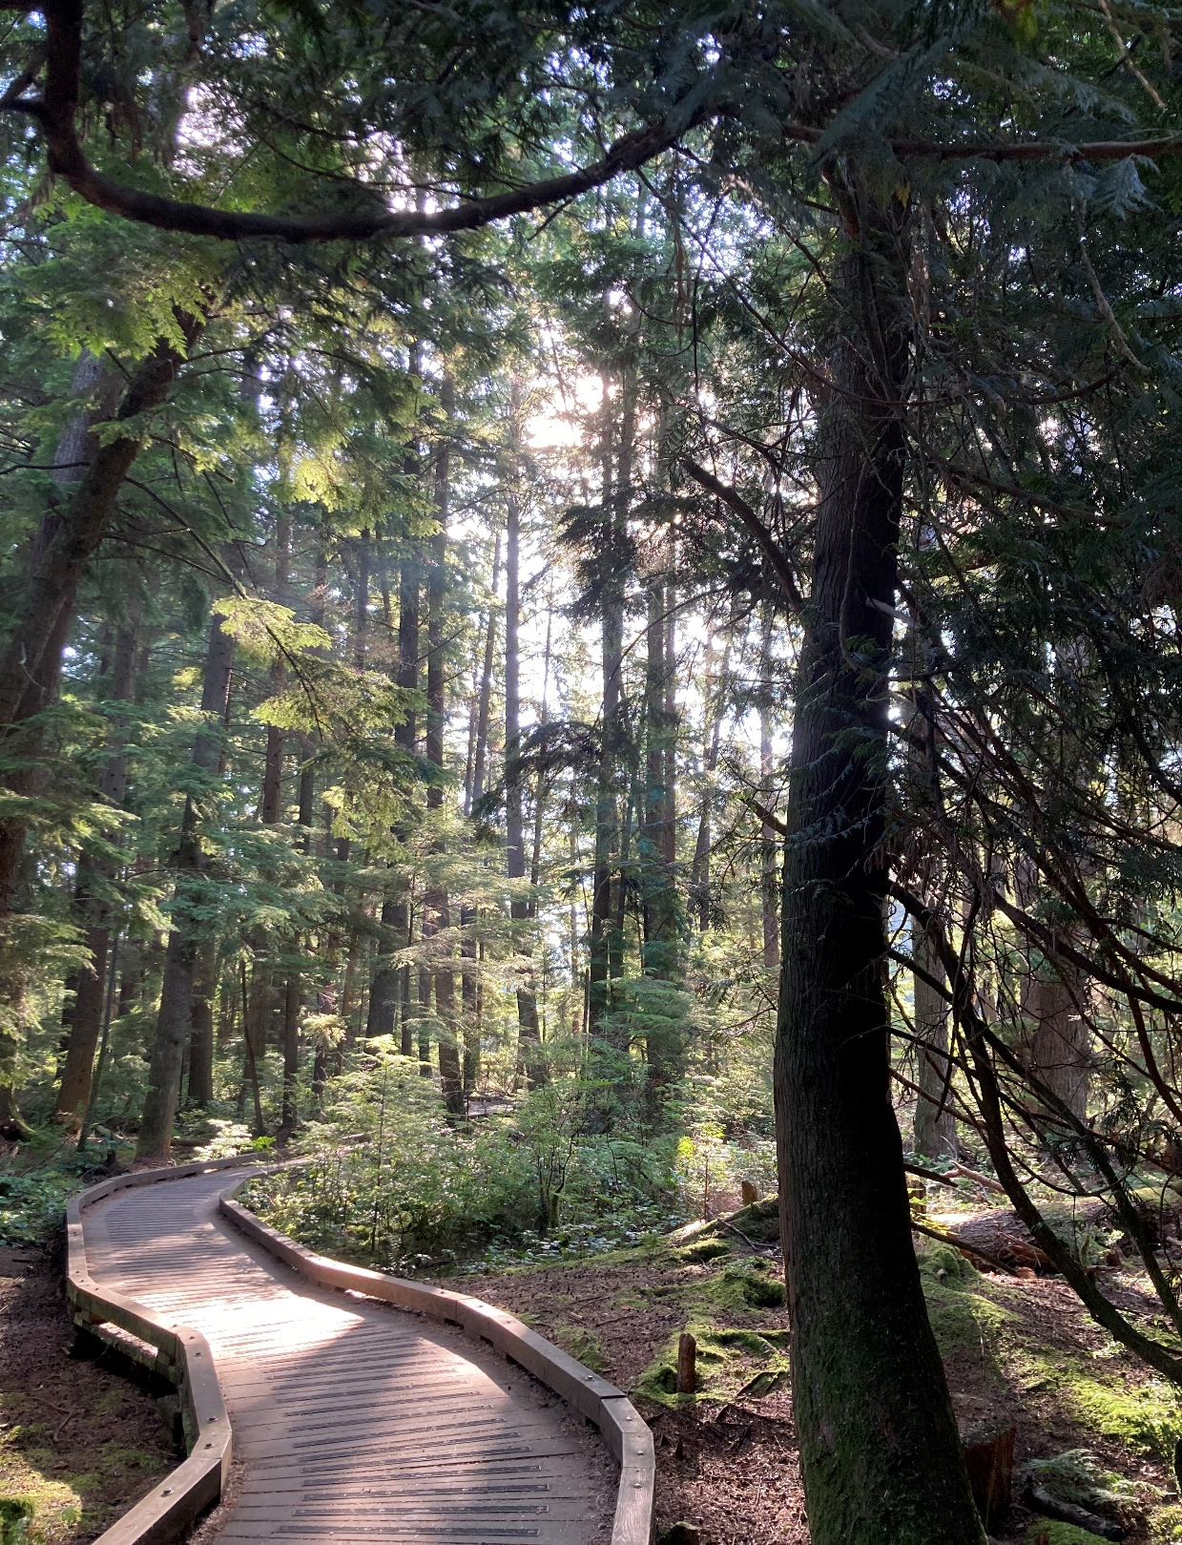
Land Acknowledgement
It is with deep gratitude that I acknowledge The Peoples, The Energies, and The Ways of Being and Knowing that have and continue to caretake This Land. I am humbled and honoured for the opportunity to live and be on the traditional, ancestral, and unceded territories of the ʷməθkʷəy̓əm (Musqueam), sḵwx̱wú7mesh (Squamish), and sel̓íl̓witulh (Tsleil-Waututh) First Nations.

Slide 3
I would like to personally acknowledge that I was born and educated on the traditional lands of the Powhatan People.
Teacher, Writer, Advocate, Indigenous Ally, Mum, Volunteer, Vegan Foodie, Lover of Co-ops, Local Farms, Fair Wages, Science (Fiction), Queer Pride, and My Dog.
Weaver (Amber) Shaw (She/Herself)
UBC Vantage English Program
amber.shaw@ubc.ca

Slide 4
Chat Invitation
I invite you to add to the chat one or two of the following:
Your Land Acknowledgment (https://native-land.ca/)
Your Name
Your Favourite Winter Thing
Any Other Type of Short Introduction

Slide 5
Welcome to our Safe Space
Respect
Encouragement
Empathy
Support
Open Minds
Assume Positive Intent

Slide 6
Workshop Requests:
Please only take away from this workshop what resonates with you in your context
Leave behind anything that does not intuitively seem helpful at this time
Worthwhile Considerations:
There is no “right” or “correct” way to do UDL
We all have different tools, resources, experiences, gifts, and contexts
Not all is to be accepted (n)or applied
This is an attempt to serve our students, colleagues, and selves well
My Main Goal:
To provide enough UDL background for an experience of designing more accessible instructions
In the end, please evaluate which pieces are of value to you in your own practice

Slide 7
Poll
What is your teaching context?
Pre/Beginner
Intermediate
Higher Intermediate
Other

Slide 8
Accessibility
Accommodation
Inclusion

Slide 9
What We Know:
most students who identify as needing an accommodation - do not ask for one
students with disabilities often struggle to meet course outcomes (Parsons et al., 2021)
students who request accommodations can suffer from “access fatigue” (Konrad, 2021)
What We Don’t Know:
how well do accommodations work?
do individual student accommodations really help the student? (Parsons et al., 2021)

Slide 10
Poll
How familiar are you with Universal Design for Learning (UDL)?
Not at all (0)
I’ve heard about it (1)
I know a little bit (2)
Very familiar (3)

Slide 11
Basic Principles of Universal Design for Learning (UDL)
UDL has three core principles
Incorporate Multiple Means of:
Representation
Expression
Engagement

Slide 12
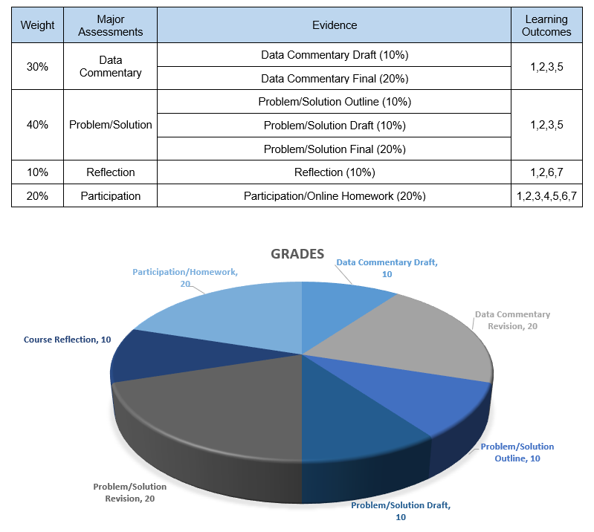
Multiple Means of Representation

Slide 13
Multiple Means of Expression

Slide 14
POLL
Multiple Means of Engagement
What are some different ways learners engage in your context?
A) Group Discussions/Debates
B) Role Play/Dialogues
C) Games/Problem Solving Tasks
D) Storytelling/Presentations
E) Writing Workshops/Activities
F) Fieldtrips

Slide 15
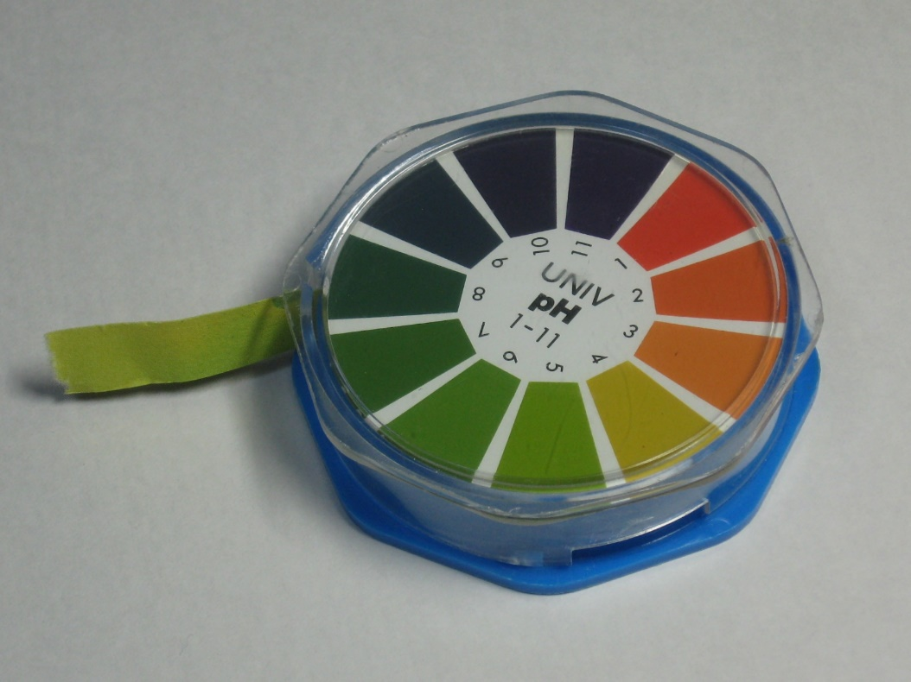
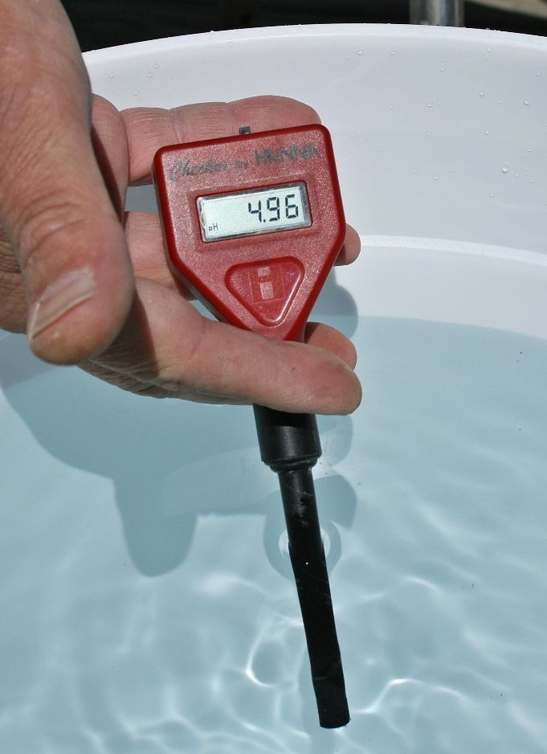
Some Examples of Common Accessibility Issues
Sight
Photo by: Kiyok, CC BY-SA 3.0 <http://creativecommons.org/licenses/by-sa/3.0/>, via Wikimedia Commons
Photo by: Ildar Sagdejev

Slide 16
Some Examples of Common Accessibility Issues
Spaces (Physical/Virtual)
Hearing
Mental Health

Slide 17
Strategies for Better Accessibility
Including Closed Captioning
Flexible Deadlines
Structuring Documents with Headers and Alternative Text for Pictures (Easier for Screen Readers)
Dropping the Lowest Course Mark
How do these help everyone?

Slide 18
Poll
Which of these are you already doing?
A) Use Visual Aids (Graphs, Pictures, Charts)
B) Provide practice spaces for digital tools
C) Seat students according to needs
D) Provide transcripts if appropriate
E) Encourage participation through positive reinforcement

Slide 19
More Accessible Instructions
When do you use instructions?
In-class tasks
Out of class tasks (homework)
Assessments
When do some students use instructions?
When the assessment/project/assignment is first given
The night before it is due ☺

Slide 20
Top Ten For Instructions
Provide clear and concise instructions
Use direct and straightforward language
Support/scaffold any technical or difficult language (that is necessary)
Use multiple formats
Offer choices (if possible)
Be flexible (if possible) - Decolonize
Provide examples
Separate the Instructions from the Teaching Materials
Are the instructions where the students are going to look for them or where you think they “should” go?
Clearly label them Instructions

Slide 21
Revise for Accessibility
Find a partner or form a group of 3-4 students.
Each group will receive a list of everyday conversation topics.
Take turns having conversations based on the given topics. Use the vocabulary and expressions we've learned in class.
Focus on both speaking and listening. Make sure everyone in your group has a chance to speak and be heard.
Help and support each other during the conversations. Be patient and respectful of each other's language learning process.
I will walk around and provide assistance if needed. Feel free to ask questions or seek clarification from me.
After the conversation practice, we'll come back together as a class.
Volunteers will have an opportunity to share their conversations with the rest of the class. Remember to use gestures, expressions, and speak clearly.
We'll have a class discussion related to the shared conversations. I'll ask follow-up questions and encourage everyone to participate.
Listen carefully to your classmates and share your own thoughts and experiences.
I will provide feedback and guidance throughout the activity to help you improve your language skills.

Slide 22
Revise for Accessibility
Find a partner or group.
Use the list of topics I give you.
Take turns talking about the topics.
Listen and speak together.
Help each other.
Ask me if you need help.
We'll share our conversations with the class.
We'll talk more as a class.
Try your best and enjoy!

Slide 23
Revise for Accessibility
Instructions:
1. Find a partner or group
2. Talk together about our topics
3. Ask me if you have questions
4. We will share as a class

Slide 24
Top Ten For Instructions
Provide clear and concise instructions
Use direct and straightforward language
Support/scaffold any technical or difficult language (that is necessary)
Use multiple formats
Offer choices (if possible)
Be flexible (if possible) - Decolonize
Provide examples
Separate the Instructions from the Teaching Materials
Are the instructions where the students are going to look for them or where you think they “should” go?
Clearly label them Instructions

Slide 25
AI for UDL
Prompting AI for UDL help: ChatGPT or Bing Copilot
Sample Prompts:
Accessible Instruction:
“Please give me feedback on making these instructions more accessible using a UDL framework [upload draft instructions].”
Engagement Strategies:
"What are some strategies I can use to engage students with diverse interests and motivation levels in a topic like [specific subject]?"

Slide 26
Multiple Means of Expression

Slide 27
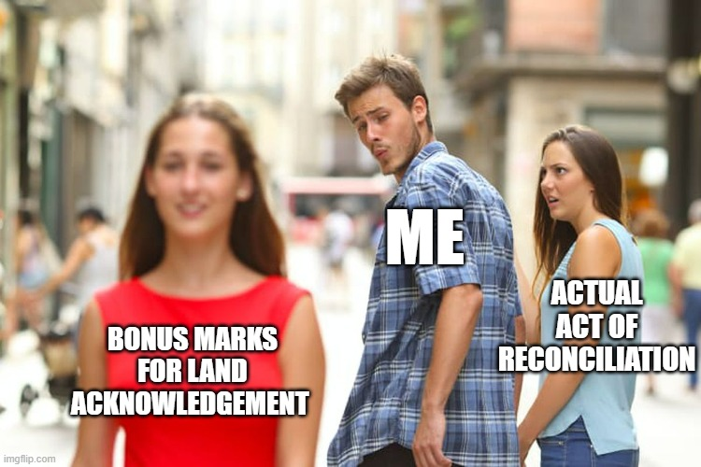
Student Reflection Example

Slide 28
Additional Online Resources (Among Many)
CAST: The Center for Applied Special Technology (CAST) is a nonprofit education research and development organization that focuses on expanding learning opportunities for all individuals, especially those with disabilities, through UDL. Their website has many resources, including an introduction to UDL, implementation strategies, and professional development opportunities.
UDL Implementation and Research Network: This is a community of researchers and educators who are interested in promoting and implementing UDL in their classrooms and schools. They offer a variety of resources and opportunities for collaboration, including online discussions, webinars, and research projects.
UDL Exchange: This is a free online resource for educators to share and access UDL lesson plans, activities, and assessments. It was created by CAST and has a large collection of resources that can be searched by subject, grade level, and UDL principle.
UDL on Campus: This is a website that focuses on applying UDL principles to higher education. It offers resources for faculty and staff on how to create accessible and engaging learning environments for all students.
Teach Access: This organization focuses on increasing the accessibility of technology and has resources and training programs for educators, developers, and designers. They offer webinars, online courses, and a certification program.

Slide 29
References
Konrad, A. M. (2021). Access fatigue: The rhetorical work of disability in everyday life. College English, 83(3), 179-199. https://doi.org/10.58680/ce202131093
Parsons, J., McColl, M. A., Martin, A. K., & Rynard, D. W. (2021). Accommodations and academic performance: First-year university students with disabilities. Canadian Journal of Higher Education 51(1), 41-56. https://doi.org/10.47678/cjhe.vi0.188985

