Slide 1
CANADIAN WORKPLACE PRAGMATICS
Anjum Karimi
OCELT
anjum.karimi@gmail.com
Author: An ELT Experience

Slide 2
What We Will Cover Today
The Concept of Workplace Pragmatism
The Four C’s of Canadian Communication
3. Miscommunication
Cultural Elements of Pragmatism in the Workplace
Conclusion
Helpful Resources

Slide 3
Ice-Breaker Poll
Is the term “Pragmatism” familiar to you?
  Yes
  No

Slide 4
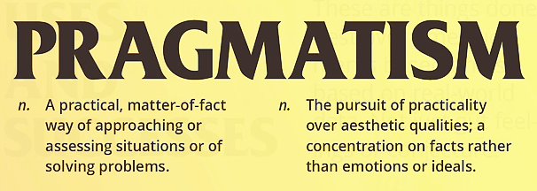
What is Pragmatism?
This photo, by Unknown Author, is licensed under CC-BY-SA
How can pragmatism be practically applied?
By using it as a communication tool!
    Using appropriate language in a situation
    As a practical approach for effective communication

Slide 5
Why is Pragmatism Important to Newcomers to Canada?
Because it provides functional and socio-linguistic
knowledge for:
Integration into Communities
Competence in Communication
Cultural Knowledge
Interpersonal Skills and Norms

Slide 6
The Different Components of Pragmatism
Socio-Pragmatics | Pragma-Linguistics
Socially-relevant pragmatism It is culture-focused speech or acts | Communication-relevant pragmatism It is language-focused speech or acts

Slide 7
Socio-Pragmatics
What affects the culture-focused speech or acts?
Social Status
&
Social Distance
Age, Sex
&
Physical Setting
Degree
of
Formality
Directness
versus
Politeness

Slide 8
Pragma-Linguistics
What are the language-focused speech or acts?
Requests
Apologies
Excuses
&
Complaints
Invitations
&
Refusals
Notes:
What does Revised CLB mean? Please explain and modify in the spoken narrative.

Slide 9
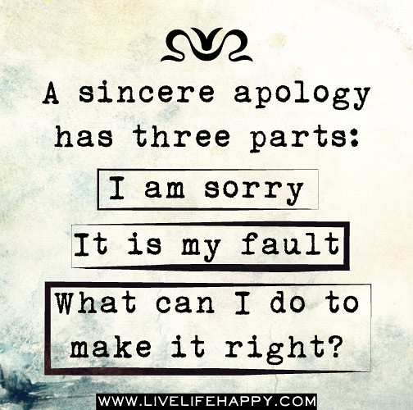
How to Deal with a Situation Using a Pragmatic Approach?
An example where an apology
is required:
Express your sincere apology
Acknowledge your responsibility
Show accountability
Offer to make amends and repair the situation
Assure that it will not re-occur
This Photo by Unknown Author is licensed under CC BY-SA-NC
Notes:
Oral Apology and the Steps Involved:
An Expression of Apology - “ I’m sorry”.
An Acknowledgment of Responsibility
An Explanation or Account
An Offer of Repair
A Promise of Non-Recurrence

Slide 10
Please Tell Us in the Chat
Please share your understanding of
“Canadian Workplace Pragmatics”
in the chat box

Slide 11
The Four “C’s” of Canadian Communication
Clarity | I am looking for a more effective way of implementing PBLA.
Conciseness | Could you please explain the process briefly in point form?
Coherence | We have run this process three times with consistent results. Here are the stats.
Consensus | I am hoping this report meets your expectations. Please feel free to add your comments.
Notes:
Coherence- logical sequence with evidence
Consensus- including others in the decision making
Clarity-Look in the eye, make your point clear

Slide 12
Using Diplomatic Language 1
In order to integrate fully in the Canadian workplace environment, we need to focus on and pay attention to these important elements of speech acts:
Softeners = language used for diplomatic approach. It invites the other person to disagree or to add on – e.g. I’m not sure I understand… /
Do you mind explaining it further… / Do you want to give it a try?
Polite Modal Verbs = would / could / may – e.g. Would you be able to..? Could you please? May I suggest…?…

Slide 13
Using Diplomatic Language 2
We also need to adjust our level of directness and
our style of disagreeing:
Replace strong words like ‘We should’ ‘We must’ with ‘We could probably…’ or ‘Shouldn’t we…?
When you disagree, don’t be too direct. You could say, ‘Is there another way we could look at it?’ OR ‘Is it possible to look at some other options?’

Slide 14
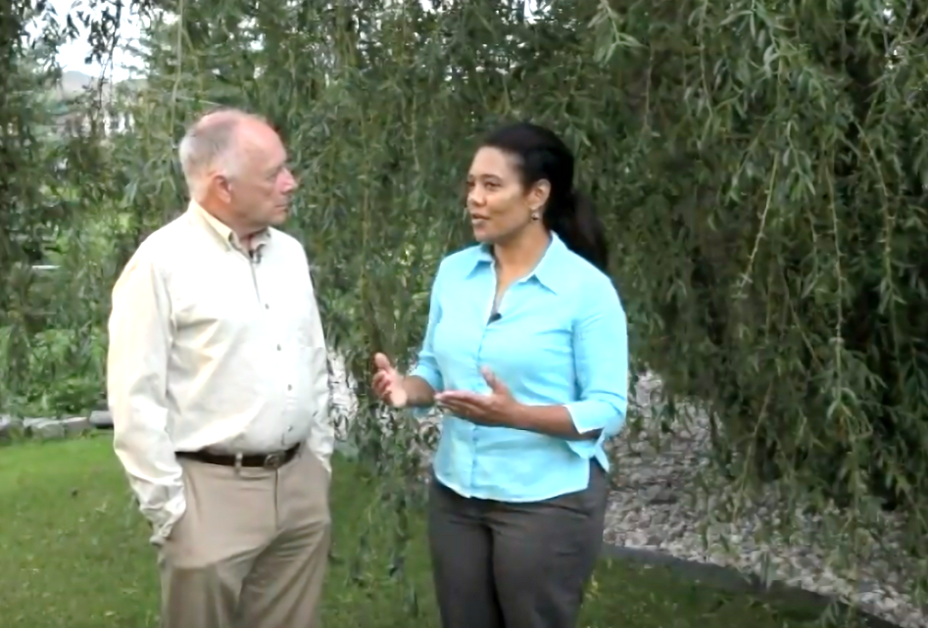
Now we are going to watch a video: Canadian communications softeners
Classroom Activity
After watching various segments of the video, try to rephrase
with a more polite version using Canadian Workplace Pragmatics.
Please type your responses in the chat box.
https://www.youtube.com/watch?v=SqDK4o4kWus
Notes:
https://www.youtube.com/watch?v=SqDK4o4kWus&t=2s

Slide 15
Do the activity in the video – then ask for volunteers (students) to try and give the “softer” version of each phrase.
Incorporate the Activity into your Teaching!
Notes:
https://www.youtube.com/watch?v=SqDK4o4kWus&t=2s

Slide 16
Miscommunication 1
Let us do a few exercises in pragma-linguistics together!
Identify the communication errors (why does it not “sound right”?).
Write the appropriate language use for each of the identified errors.
Please type in the chat box.
Dear Ms. X
Send me the time and date for the meeting ASAP. I need to report to my manager.
XYZ

Slide 17
Miscommunication – Correction 1
I hope this message finds you well. I am writing to kindly request the time and date for our upcoming meeting. It would be greatly appreciated if you could provide this information
as soon as possible as I need to inform my manager.
Thank you. I look forward to our meeting.
Best regards, [Your Name]

Slide 18
Miscommunication 2
Identify the communication errors (why does it not “sound right”?).
Write the appropriate language use for each of the identified errors.
Please type in the chat box.
Hello Ms. X
I will send my assignment after the due date. Please check it and return it to me.
XYZ

Slide 19
Miscommunication – Correction 2
I hope this message finds you well. I am writing to inform you that due to unforeseen circumstances, I will not be able to submit my assignment on the due date.
Could you kindly accept it after two days of the due date?
I apologize for any inconvenience this may cause and assure you that this will not happen in the future.
Best, [Your Name] OR
I am extremely sorry that I would not be able to submit the assignment on the due date due to some urgent issues at hand. Could you please accept it two days after
the due date? I assure you that this would not happen in the future.
Thanking in advance.
XYZ

Slide 20
Miscommunication 3
Identify the communication errors (why does it not “sound right”?).
Write the appropriate language use for each of the identified errors.
Please type in the chat box.
Dear Ms. X
I will not be able to come tomorrow. I am busy. I can come on Wednesday at 2pm. Please confirm.
Regards,
XYZ

Slide 21
Miscommunication – Correction 3
I hope this message finds you well. I am sorry to let you know that, unfortunately, I won’t be able to attend our meeting tomorrow.
I apologize for any inconvenience this may cause.
However, I would be available on Wednesday at 2 pm.
Please let me know if this new time works for you. I would appreciate it if you could confirm this with me at your earliest convenience.
Thank you very much for your understanding and I look forward to meeting with you soon.
Best regards, [Your Name]

Slide 22
Understanding Cultural Elements of Pragmatism in the Workplace

Slide 23
Cultural Elements of Pragmatism in the Workplace
Canadian communication is usually:
Direct – for information, we have a strong desire for clarity. Canadians expect a smile, direct eye contact and the appropriate greetings of the day before jumping into a conversation. They also tend to engage in a bit of small talk before jumping straight to a point.
Indirect – for avoiding conflict and softening requests. Canadians are relatively indirect communicators; they try to avoid creating conflict by taking careful measures to remain polite throughout discussion. This usually involves making hints that vaguely communicate their message without 'rocking the boat'.
Canadians are conflict averse!
Notes:
Understand the Cultural Elements in Pragmatism
Review the glossary and reflect on how it can help the students get better in their communication skills for success.

Slide 24
Cultural Elements
Canadian Workplace Culture Expectations:
Spoken language
Listening skills
Socializing skills
Familiarity of workplace etiquette for a harmonious
work environment
Understanding a range of cross-cultural differences
in the workplace

Slide 25
Pragmatics Glossary – Examples
There are a variety of tools available in the CLB Support Kit.
Disarmer | “I am sorry to inform you that…”
Grounder | “…as I need to inform my manager.”
Routine | Best regards / Regards
Softeners | Use of modals: could, would, may etc. e.g. Could you please…, I would appreciate it if…, I may like to add a few points…
Speech act | Requests, apologies, complaints e.g. I was wondering if you have a few minutes… I am extremely sorry… I was a little disappointed in the product and would like to request…

Slide 26
What We Covered Today
The Concept of Workplace Pragmatism
The Four C’s of Canadian Communication
Miscommunication
Cultural Elements of Pragmatism in the Workplace

Slide 27
Feedback, please! Q1 of 3
Please rate the value of the information, tools and ideas that you received from the presentation today:
Five-star value ☺
Four-star value
Three stars
Two stars
One star
★   
★  
★ 
★
★

Slide 28
Feedback: Q2 of 3
Which part of the webinar
was the most useful to you?
The Concept of Workplace Pragmatism
The Four C’s of Canadian Communication
Miscommunication
Cultural Elements of Pragmatism in the Workplace

Slide 29

Feedback: Q3 of 3
Please write in the chat box, the three most useful and practical things you learned that you can use in the future…
Thing 1
Thing 2
Thing 3

Slide 30


Questions?

Slide 31
Thank You and Contact Details
  Anjum Karimi
  anjum.karimi@gmail.com
  www.linkedin.com/in/anjumkarimi
  Mindfulness Coach
  https://www.youtube.com/channel/UCNsLcpscAzjjFcpvXORephg

Slide 32
Resources
Indeed: What Are Pragmatic Skills in Children?
(With 7 Examples) (2023), Jennifer Herrity
Centre for Canadian Language Benchmarks:
CLB Support Kit (2012), Anne Hajer et al
The Immigrant Education Society: Diplomatic Communication at Work: A CLB 7/8 Module with
Online & Paper Assessment Tasks (n.d.), Trina St. Jean et al
SHIFT Management: Canadian Communication:
How to Use Speech Softeners (2015), Marie Gervais

