Slide 1

Using Images for Speaking and Writing Activities
Lynn W. Zimmerman, PhD

Slide 2

Webinar outcomes
Participants will be able to
  use images as prompts for speaking activities
  use images as prompts for writing activities
  adapt activities to different proficiency levels

Slide 3
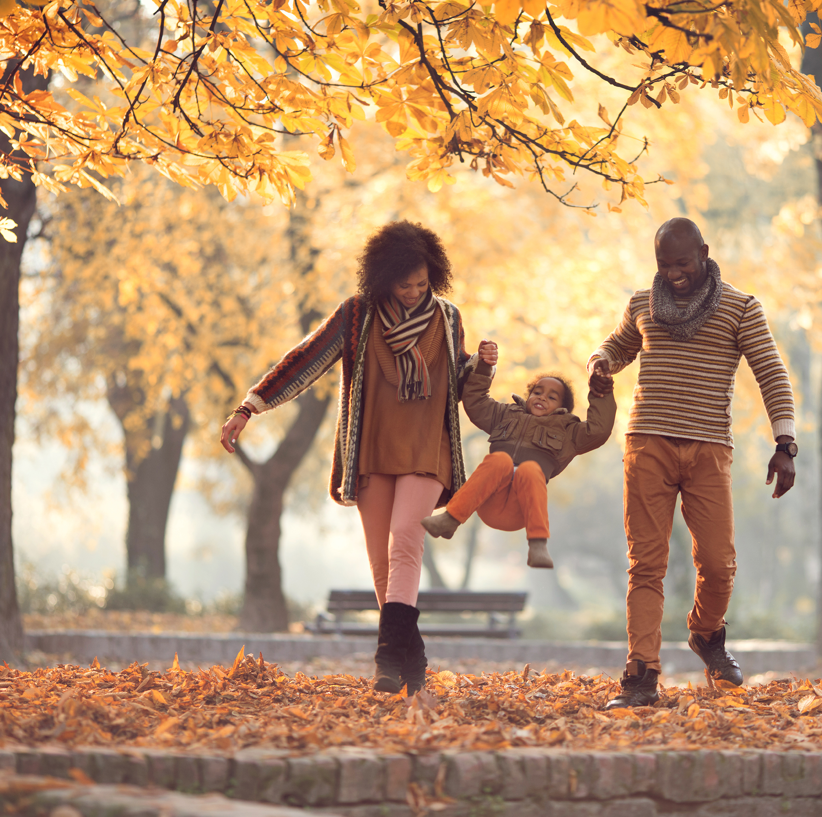
Poll 1
Do you use images in your classes?

Slide 4
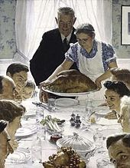
A picture is worth a 1000 words.
“If a picture paints a thousand words, then let a picture inspire a thousand words.”
― Nicholas Boyd Crutchley
Rockwell, N. (1943). Freedom from want. Norman Rockwell Museum. (Public Domain)

Slide 5
A few reasons to use images
Flexible to use
Different foci
Thanksgiving
Other holidays
Traditional food
People (families, friends)
What else?
Speaking prompt
  What is the picture about?
  What are the people talking about?
Writing prompt
  Write a story about the picture.
  Write a dialog and present.
Rockwell, N. (1943). Freedom from want.
Norman Rockwell Museum. (in Public Domain)

Slide 6
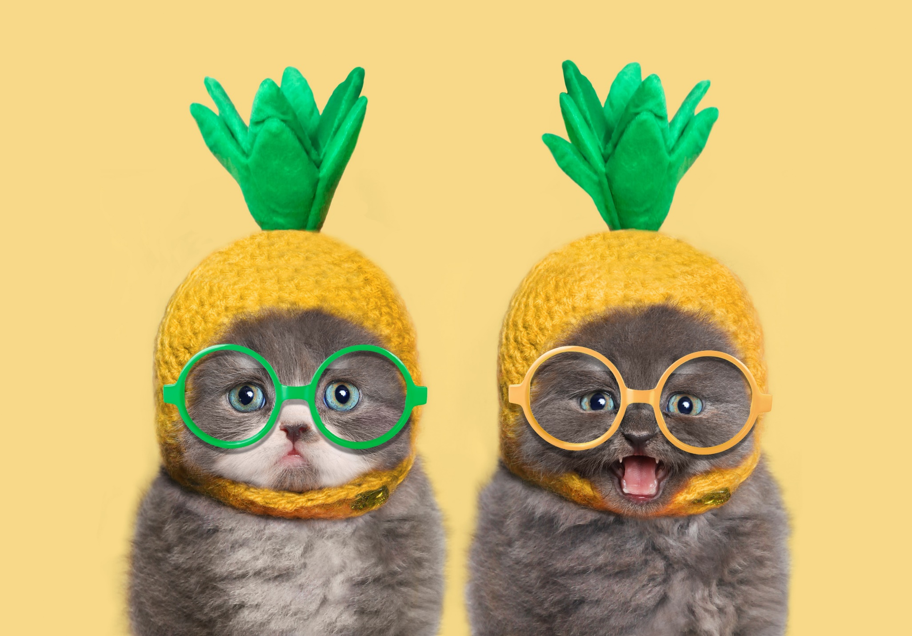
Some other reasons for using visuals
Capture students’ attention
Reduce anxiety
Provide a model
Provide scaffolding
Support comprehension
  Motivating
  Improves retention
Reduce TTT
(Image from PowerPoint collection)

Slide 7
Colors and feelings activity (speaking/writing)
Word cards
Color cards
green
blue
orange
angry
cheerful
sad
gloomy
yellow
red
amused
jumpy
afraid
jealous
happy
purple

Slide 8
Adapting for different ages/proficiency levels
Word cards
Vocabulary at an appropriate level
Beginner: sad, angry, excited, nervous, scared, surprised, tired
Intermediate: jealous, cheerful, worried, grateful, depressed, hopeless
Advanced: gloomy, jumpy, agitated, desolate, apprehensive, thrilled
Color cards
Color names at an appropriate level
Beginner: black, white, blue, green, yellow, red
Intermediate: crimson, cream, ebony, scarlet, peach
Advanced: amethyst, maroon, burgundy, beige, carmine

Slide 9
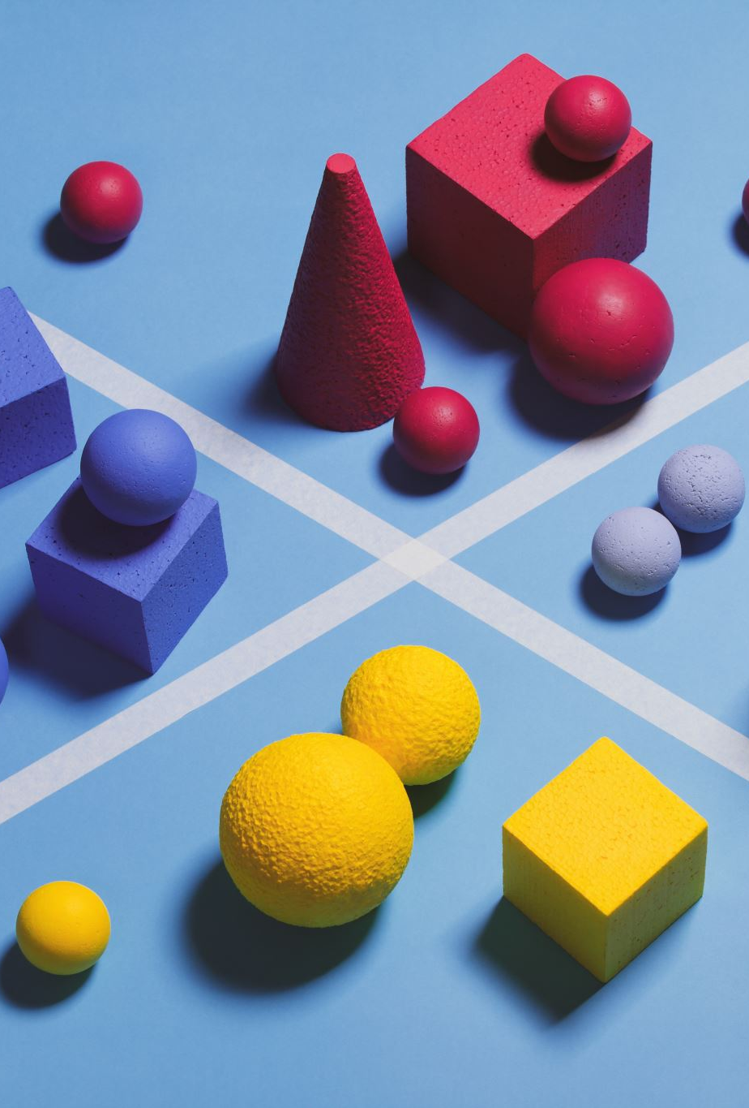
Observation activity (speaking)
Observe
  Look at a picture for 1 minute.
  Notice colors, shapes, objects.
Share
  Tell your partner 5 things you saw.

Slide 10
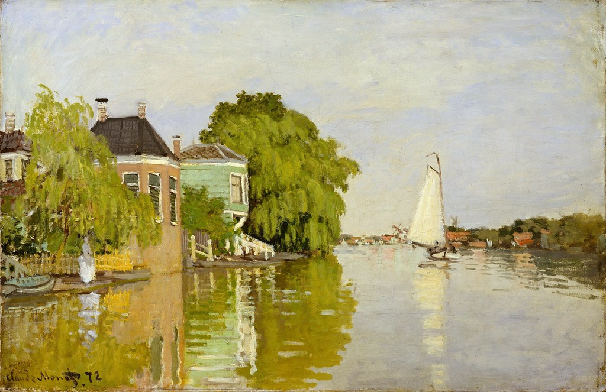
Gandalf – CC-BY-NC-SA 2.0

Slide 11
Pair-Share
Share
  2-3 minutes
  Tell your partner 5 things you saw.
Gandalf – CC-BY-NC-SA 2.0

Slide 12
What did you see?
Did you ‘see’ the same
colors
shapes
objects
Why or why not?
Gandalf – CC-BY-NC-SA 2.0

Slide 13
Observation activity (writing)
Observe
Look at a picture for 1 minute.
Notice colors, shapes, objects.
Write
Write down 3 of each that you saw.
colors
shapes
objects
Write a story about the picture.

Slide 14
Compare/Contrast (speaking/writing)
Compare
5 similarities that the pictures share
What do they have in common?
What are the connections?
Contrast
5 differences that the pictures do not share
What are the differences?
How do they contrast?

Slide 15

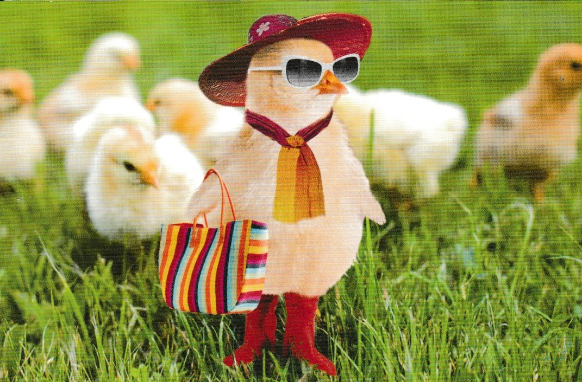

Slide 16
Question cards
What is one thing that is the same in these pictures?
What do we know about the people/things in these pictures?
How are they alike and different?
What questions would you like to ask the artist/photographers about the pictures?
How would you change these pictures?
How do you feel about the pictures?

Slide 17
Who is it?
Goal: | SWBAT describe a picture of their choosing to a partner and identify the picture that is described to them.
Language Objective(s): | speaking; listening; identifying; describing
Level: | Any age; any level
Materials: | 4-5 age-appropriate pictures with people/objects; pictures in sets should be similar so not immediately obvious which picture is being described
Time: | 15-20 minutes

Slide 18
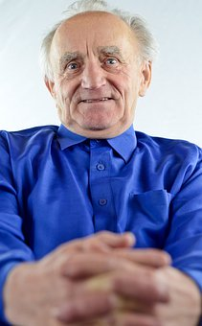
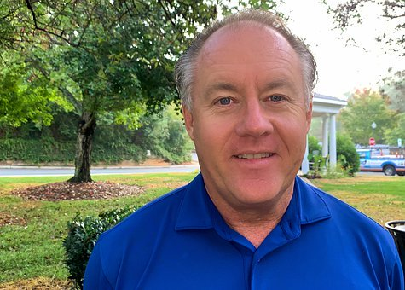
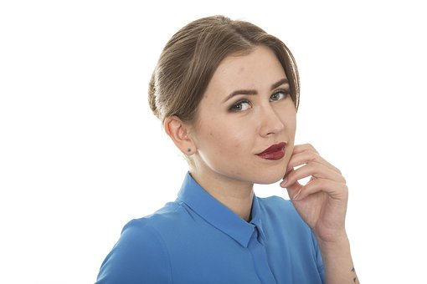

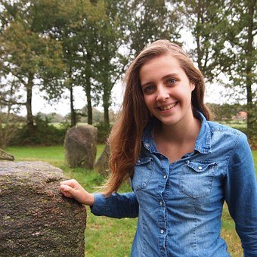
Who is it?
Choose a picture to describe. Describe with minimal detail.
Your listener must guess which picture you are talking about.
People
Notes:
Love this activity! The audience will really be engaged here with all of these great images. I think we may need to build it out a bit so that we can provide more details. I always like to explain this bit of feedback (about demonstration explanations) as considering participants who do not view the session, but do use your slides to either learn the content and/or in developing workshops in their contexts. So, try to avoid relying too much on verbal description for demonstrations. It can be a bit tricky, as we also want this to be a visual experience, as opposed to text-heavy, so I’m happy to work as closely on the suggested edits piece as is helpful. LZ: Don’t really understand what you mean here – I added an instruction.

Slide 19
Who it is? Instructions
Students individually select a picture to describe
  They do not tell which picture they chose.
Students talk in pairs while teacher monitors
  Option 1: Take turns saying one thing about their picture
  Option 2: Take turns describing and guessing
Share with class

Slide 20
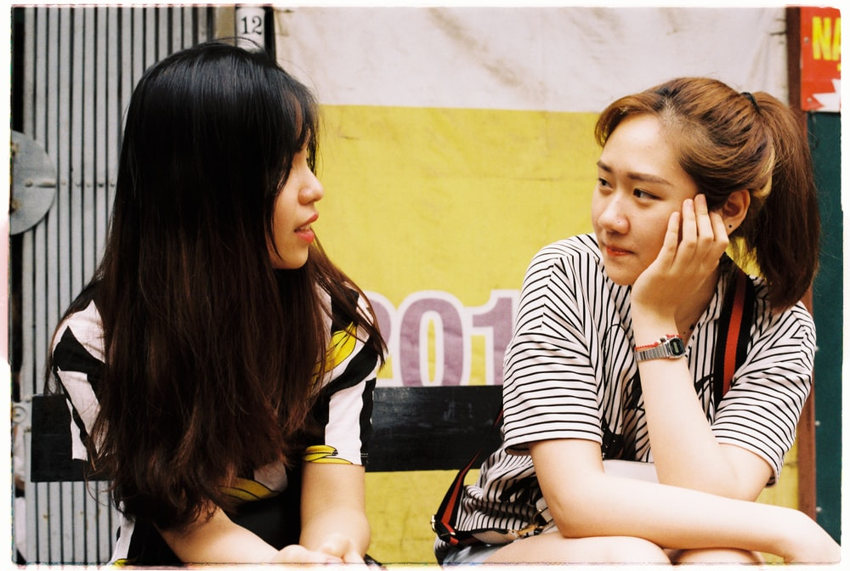
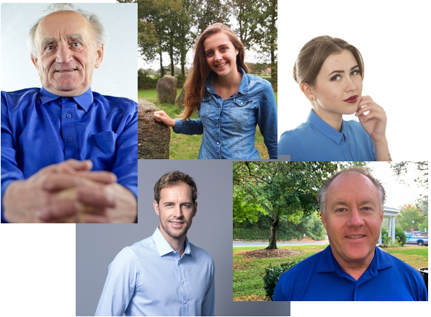
Option 1: Take turns
Say one thing about your picture
Option 2: Take turns
Describe and Guess
There is a man in my picture. He has on a blue shirt. He is slightly bald.
There is a man in my picture.
There is a woman in my picture.
There are two bald men. What else can you tell me about him?

Slide 21

Who is it?
Differentiating for different proficiency levels
Brainstorm
Before beginning the activity, brainstorm the kind of language they may need to complete this activity.
Option 1: The teacher can elicit from the class and write on the board.
Option 2: In groups of 4 or more, students brainstorm, ideally writing on a large piece of paper. Then they present 1-2 of their ideas to the class.
Option 3: The teacher can give students a word bank of descriptive adjectives, etc.

Slide 22

Who is it? Assessment
Speaking
  Informal based on monitoring by teacher
    Range of vocabulary and grammar used
    Fluency when describing picture
    Pronunciation

Slide 23

Poll 2
Which topic(s) would you choose for a describing activity?

Slide 24
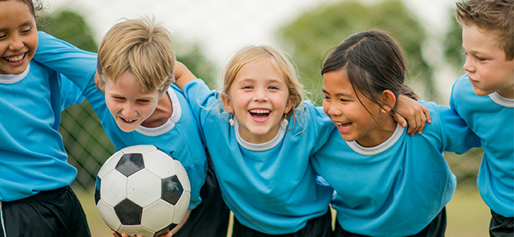
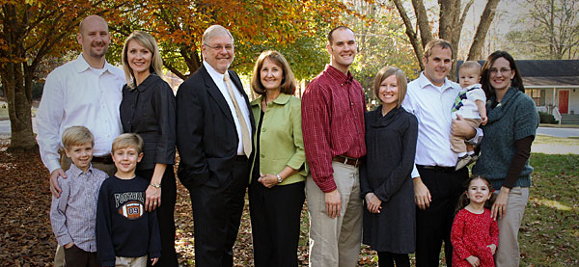

More question cards (speaking/writing)
Choose one of these pictures to talk/write about.
Why did you choose this picture?
What are three words that describe this picture?
What are these people doing?
When and where do they live? How do you know?
What are these people thinking about? How do you know?
What advice do you want to give them? Why?

Slide 25
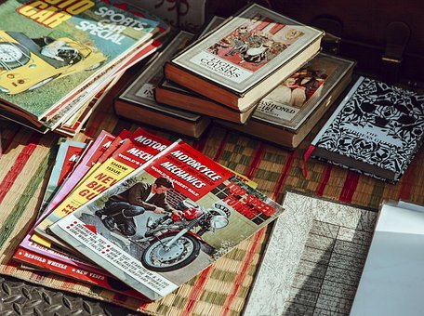
Collecting pictures and other images
Calendars
Magazines
Sales ads
Postcards
Tourism brochures

Slide 26

Today’s Activities
Colors and feelings
  any age/any proficiency level
  speaking; describing (adjectives)
Observation activity
  any age/beginner and higher
  speaking; describing (adjectives, nouns)
Compare/Contrast
  any age/beginner and higher
  speaking; describing; comparing
Who is it?

Slide 27
Review: Why use visuals?
Capture student’s attention
Reduce
  anxiety
  teacher talk time
Provide
  a model
  scaffolding
  a reference point
Support comprehension
  Motivating
  Improves retention
Easy to find
  Calendars
  Magazines
  Online
Flexible to use
  Different foci
  Speaking prompt
  Writing prompt

Slide 28
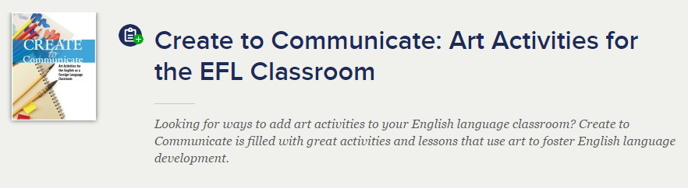
http://americanenglish.state.gov http://americanenglish.state.gov/resources/create-communicate-art-activities-efl-classroom

Slide 29
Sources for finding CC-licensed content and/or copyright-free images
Creative Commons search tool
https://wordpress.org/openverse/?referrer=creativecommons.org
Google Advanced Search
https://www.google.com/advanced_search?hl=en
Flickr Search
http://www.flickr.com/commons/
Flickr Advanced Search
http://www.flickr.com/creativecommons/
PowerPoint
Free images in Insert/Icons/Images
Canva
https://www.canva.com/photos
Freeimages.com
Depositphotos
LibreStock
Freepik
Picjumbo.com
StockSnap.io
Pexels
Gratisography
Burst.shopify.com
Wikimedia Commons

