Slide 1
Teacher Well-Being
Impacts of Teaching Students Living with Trauma

Slide 2
Territorial Acknowledgement
We acknowledge this land out of respect for the Indigenous nations who have cared for Turtle Island, also called North America, from before the arrival of settler peoples until this day. Most importantly, we remember the history of these lands has been tainted by poor treatment and a lack of friendship with the First Nations who call them home. This history is something we are all affected by as we are all treaty people in Canada. We all have a shared history to reflect on, and each of us is affected by this history in different ways. Our past defines our present, but if we move forward as friends and allies, then it does not have to define our future.
Notes:
Amea: Impact of trauma via colonization. Think about the territory you are on.

Slide 3
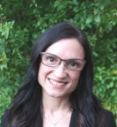
Introductions
Dr. Allyson Eamer Jennifer Allore Dr. Katie Crossman Dr. Amea Wilbur Dr Jia Li

Slide 4
Agenda
Introductions
Mindfulness exercise
Migration and trauma
Trauma and language learning - past study
Teaching Refugees
Bow Valley College Study on Vicarious Trauma
Our Study
What we hope to accomplish

Slide 5
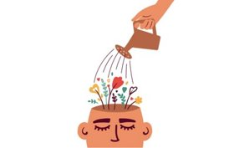
How do you support your own well-being?
Answer in the chat

Slide 6
Mindfulness practice (breathing exercise)

Slide 7
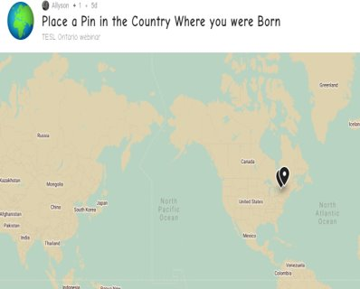
Go to the Padlet and put a pin in the country where you were born.
https://padlet.com/allyson_eamer/1nas63uvz8u07nvv
You may need to click on the zoom in/out button to find the part of the world where you were born. Click on the Plus button. Choose option one. Enter the name of your city in the search bar. Then hit publish.

Slide 8
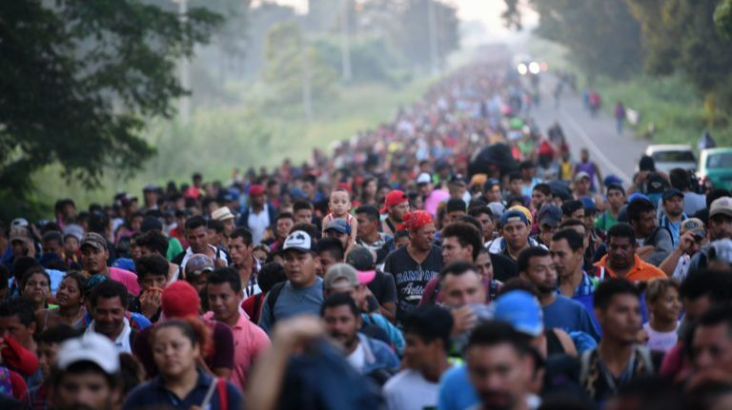
Take the poll….
Approximately how many of the earth’s current inhabitants fall within UNHCR categories of refugees, asylum seekers, internally displaced or stateless people?

Slide 9
First point: Migration
More than 3% of the earth’s population is living in a country other than the one they were born in.
67 million of the earth’s inhabitants fall within UNHCR categories of refugees, asylum seekers, internally displaced or stateless people
As many as 56 million people have had to learn—or are still learning—English when settling into their new lives in Canada or the U.S.
Eamer, A. (2018).

Slide 10
Migration and Mental Health Challenges: Push and Pull Factors
Push
Unemployment
Limited educational opportunities
Persecution
Crowded conditions
Pull
Family links
Job opportunities
Political/Religious freedom
Better quality of life
Eamer, A., Fernando, S. & King, A. (2017)

Slide 11
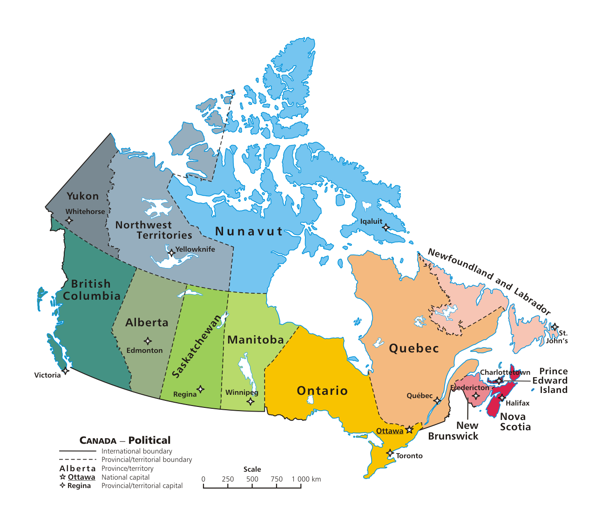
Canada
Accepts over 300,000 immigrants annually
Our "First Tier" cities (Toronto, Vancouver, Montreal) attract 72.6% of the newly arrived immigrants
Immigrants from East Asia, Southeast Asia, and Central Asia generally prefer to reside in first-tier cities
Williams, A. et al (2015)

Slide 12
Even under the best circumstances, there are stresses
Eamer, A., Fernando, S. & King, A. (2017)

Slide 13
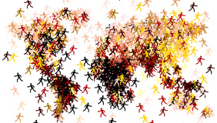
The complexity of the acculturation and integration process: “When you’re alone, it’s not a life”
Jennifer Allore
Dr. Allyson Eamer
Dr. Jia Li
Notes:
Jennifer

Slide 14
Burundi Myanmar Tunisia Palestine Syria

Slide 15
Trauma and Language Acquisition
Allore, J., Eamer, A., Li, J. (2019)

Slide 16
Emerging Themes:
Resilience
Agency
Resourcefulness
New identities

Slide 17
The Language Learning Experience
Predictability
Agency
Learner experience and perception
Teacher experience and perception

Slide 18
Trauma | Troma (Greek) = wound or pierce
Traumatic events overwhelm the ordinary systems of care that give people a sense of control, connection and meaning. Traumatic events are extraordinary, not because they occur rarely, but because they overwhelm the ordinary human adaptations to life. They confront human beings with the extremities of helplessness and terror and evoke the responses of catastrophe (Herman, 1992, p.33).
An overwhelming experience that has potential negative impacts on an individual in the moment and in the future. Trauma often refers to an experience that is beyond the capacity for an individual to adapt effectively… (Siegel, 2012, p. 82).

Slide 19
Trauma continued...
Historical Trauma
The traumatic event(s) generate high levels of collective distress
The trauma is shared by a group of people
The trauma spans multiple generations
Group members who may be far removed from the traumatic events in time and space may experience trauma-related symptoms
Intergenerational Trauma
An intergenerational transmission of historical trauma.
Individuals, families, groups and communities subjected to long-term and mass trauma (e.g., historical occurrences such as colonization, slavery, war, and genocide) may experience unresolved trauma, and this can reverberate throughout several generations, after the occurrence of the original events.
Collective Trauma
Collective trauma refers to the psychological reactions to a traumatic event that affect an entire society.

Slide 20
A little more on trauma
Trauma results in a fundamental reorganization of the way the mind and brain manage perceptions. It changes not only how we think and what we think about, but also our very capacity to think.
(Bessel Van Der Kolk)

Slide 21
Window of Tolerance

Slide 22
Trauma Informed Pedagogy and Practice
Trauma Informed Pedagogy and Practice (https://cmascanada.ca/wp-content/uploads/2016/09/1467063427_01_beyond_trauma_complete_1.pdf)

Slide 23
Research Project: Vicarious Trauma in the Classroom
Many English Language Learners (ELLs) have experienced trauma, which can impact not only their own learning, but also their instructors’ wellbeing.
Our research team interviewed over 50 instructors, program coordinators, and trauma experts across Canada to better understand how trauma affects teaching and learning in language classrooms.

Slide 24
Goals of the Research Project

Slide 25
Professional Quality of Life

Slide 26
Proposed study- A large scale survey (in-service ESL teachers)

Slide 27
Objectives
This survey is created in response to the experiences of the many learners in our classrooms who are living with trauma and its effects.
Trauma has far-reaching impacts, with implications for learning and teaching.
We are exploring the implications for language educators, both professionally and personally.

Slide 28
Survey
15-20 minutes online

Slide 29
Demographics
5 questions about teaching experience

Slide 30
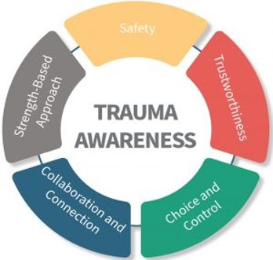
Trauma Awareness
4 questions about taken any courses, workshops, or professional development about how trauma impacts on student learning

Slide 31
Vicarious Trauma
13 questions about experience in working with students suffering trauma and support you need to address such situation

Slide 32
Professional Quality of Life
30 5-point Likert scale questions to assess your current levels of burnout, secondary traumatic stress and compassion satisfaction

Slide 33
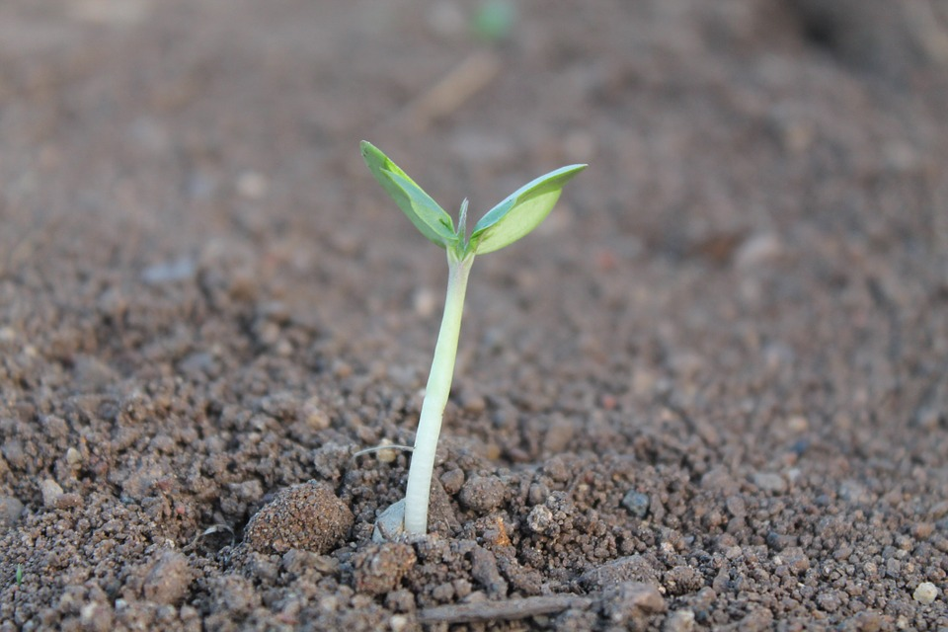
What we hope to accomplish…..
Identify any gaps in pre-service training nationwide (Who is doing this well? How can we learn from their approach?)
Make recommendations for in-service professional development (current issues in migration; compilation of resources; training the trainer)
Identify gaps in policy and procedures within regulatory bodies and program administrators (Do teachers know where/how to direct students who disclose trauma? How are teachers are supported? How is teacher well-being promoted?)
Contribute to enhanced professional quality of life for English language teachers.

Slide 34
Resources
https://the-harvard-edcast.simplecast.com/episodes/how-we-can-better-support- refugees-in-education (Supporting refugees in Education)
https://bit.ly/3sXbW9W (The Conversation article on Afghan and Ukrainian refugees)
https://files.institutesi.org/together_we_can_report_2021.pdf (The Impact of Covid on Stateless People)
https://cmascanada.ca/wp-content/uploads/2016/09/1467063427_01_beyond_trauma_complete_1.pdf Beyond Trauma
https://proqol.org/self-care-tools-1 (Professional Quality of Life Self Care Tools)
https://selfcare.ca/ (Self Care Canada Resources)
https://www.edcan.ca/articles/teacher-self-care/ (Why we Need to Care about Teacher Self-Care)

Slide 35
References
Allore, J., Eamer, A., Li, J. (2019). The Complexity of the Acculturation and Integration process: “When you’re alone, it’s not a life. ACLA/CAAL Conference, June, 2019, University of British Columbia.
Crossman, K., Kostouros, P., Wall, L. & MacDonald, D. (2020). Project News: Vicarious Trauma in the Classroom. Bow Valley College. https://globalaccess.bowvalleycollege.ca/sites/ default/files / 8.5x11-Newsletter-Nov2020-VOL1.pdf
Eamer, A., Fernando, S. & King, A. (2017). Still on the margins: Migration, English language learning and mental health in immigrant psychiatric patients. Diaspora, Indigenous and Minority Education 11:4, 190-202, DOI:10.1080/15595692.2017.1289918
Eamer, A. (2018). Migration, trauma and mental illness: implications for language learning. Contact. Fall, 2018.
http://contact.teslontario.org/migration-trauma/
Jeffries, D. & Wilbur, A. (2016) Beyond Trauma: Language Learning Strategies for New Canadians Living with Trauma. Language Instruction Support and Training Network https://cmascanada.ca
/2016/09/07/beyond-trauma-strategies-for-working-with-new-canadians-living-with-trauma/
School of Global Access. (2022). Vicarious Trauma in the Classroom. Bow Valley College. https://globalaccess.bowvalleycollege.ca/our-research/applied-research-projects/vicarious-trauma-classroom
The Centre for the Victims of Trauma. (2021). Compassion Satisfaction Professional Quality of Life. https://proqol.org/compassion-satisfaction
Williams, A. et al (2015). Immigrants’ perceptions of quality of life in three second- or third-tier Canadian cities. The Canadian Geographer / Le Geographe canadien, 59(4): 489–50

Slide 36
Questions?
Contact information:
If you have additional questions, do not hesitate to reach out to us:
Jennifer Allore: jennifer.allore@ontariotechu.net
Dr. Allyson Eamer: allyson.eamer@ontariotechu.ca
Dr. Amea Wilbur: Amea.Wilbur@ufv.ca
Dr. Katie Crossman: kcrossman@bowvalleycollege.ca
Dr. Jia Li: Jia.Li@ontariotechu.ca

