Slide 1

The effectiveness of using automated writing evaluation (AWE) in ESL/EFL contexts
By Ameni Benali

Slide 2
Agenda
Rationale
Key term
The importance of using WCF
Effective feedback types
Automated writing evaluation
Benefits of using AWE in the classroom
Issues and concerns with the use of AWE
Implications, limitations and recommendations
References
Questions

Slide 3


Rationale
Feedback is a core feature of the second language writing classroom
COVID-19 outbreak in Canada and the world
teachers may not always be able to provide their learners with immediate and frequent corrective feedback (Woodworth & Barkaoui, 2020)

Slide 4
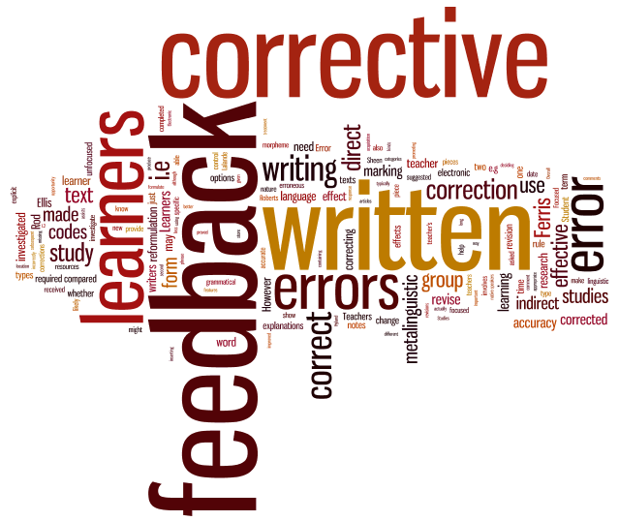
Key terms
written corrective feedback (WCF)
post response information “which informs the learners on their actual states of learning and/or performance” (Narciss, 2008, p. 292)
involves identifying students’ errors (Liu et al., 2017)
can be provided by teachers, peers or machines (Mehrabi-Yazdi, 2018).
Notes:
1-Do you think that WCF can improve the quality of learning?

Slide 5

The importance of WCF in L2 writing development
practice and feedback play a central role in second language (L2) writing development (Barkaoui, 2007)
feedback can raise students’ awareness, improve their texts, and help them learn to use the language effectively (Hyland & Hyland, 2019)
can facilitate learners’ uptake and retention of correct forms for writing development (Ellis, 2009)
leads to successful revisions of drafts (Ferris & Roberts, 2001),
Notes:
2-Do you think that the same type of feedback can be uses regardless of the students’ background and context?

Slide 6
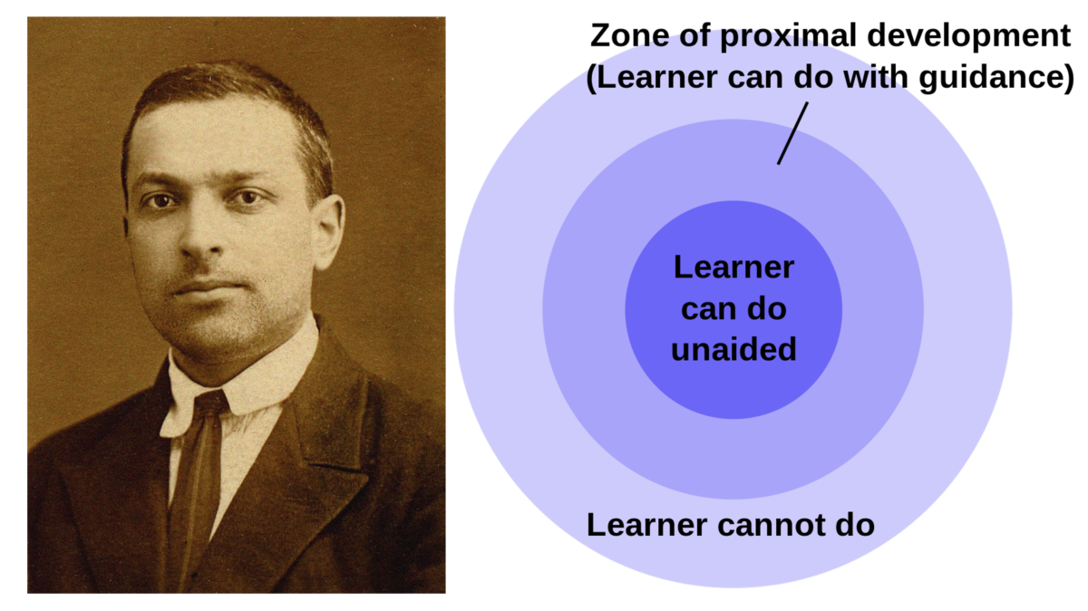

Theoretical framework
Sociocultural theory
WCF is an important tool for scaffolding L2 writing development (Bitchener & Storch, 2016; Lavolette et al., 2015)
WCF needs to be adopted to the learner’s ZPD: The distance between what a learner can accomplish alone and what that learner can achieve with the support of more capable experts, peers, and/or cultural artefacts (Vygotsky, 1987)
Cognitive theory
WCF can facilitate the conversion of declarative/explicit knowledge into implicit knowledge (Bitchener & Ferris, 2012)

Slide 7
Effective feedback types: insights from theory & research
Feedback typology
formative
Revising and editing can improve the quality of writing (Mellati & Khademi, 2018)
indirect
leads to improvement in accuracy and learning ability (Ferris & Roberts, 2001)
Direct:
metalinguistic
draws the learners’ attention to the error and explains it (Jeon & Kaya, 2006)
immediate
Constructive & can Increase writing production (Gibbs & Simpson, 2015)
focused
targets single error types chosen for learning goals,) (Ranalli, 2018)
Dialogic
help learners get further explanations negotiate meaning with teachers and peers (Merhabi-Yazdi, 2018; Woodworth & Barkaoui, 2020)
Notes:
3- Do you think that providing immediate and frequent feedback can be daunting for teachers?

Slide 8
Introducing automated writing evaluation (AWE)
Feedback is essential for second language writing development
second language learners prefer and request frequent and immediate corrective feedback on multiple drafts (Lee, 2017)
some teachers struggle to provide immediate frequent feedback inside and outside the classroom due to lack of time and resources(Crusan et al., 2016; Woodworth & Barkaoui, 2020)
AWE can give the students more opportunities to receive immediate & frequent feedback even outside the classroom (Woodworth & Barkaoui, 2020).
Notes:
4- After COVID 19, have you shifted to online learning/teaching?
Video
5- Have you ever used AWE?

Slide 9

Benefits of using AWE tools
Benefits of AWE
improve the quality of writing (Chen & Cheng, 2008)
promote learner autonomy & motivation
(Cheng, 2017; Chen & Cheng, 2008)
ease the burden on teachers (Stevenson & Phakiti, 2014)
Notes:
6- Do you think that AWE can be as effective as human feedback?

Slide 10

Issues and concerns with the use of AWE systems
Issues of AWE
lacks human inferencing skills (Stevenson & Phakiti, 2014)
generates unfocused feedback (Ferris, 2012)
explicitness of feedback (Ranalli, 2018)
inaccuracy of error flagging (Ranalli, 2018)
lack of dialogic feedback Merhabi-Yazdi, 2018)
washback effects
(Stevenson & Phakiti, 2014)
Notes:
7-What might affect the effectiveness of AWE?
8-Do you think that automated feedback can replace teachers’ feedback?

Slide 11


Conclusion
the effectiveness of AWE tools depends on two main factors:
a hybrid approach that combines human and AWE feedback (Chen & Cheng, 2008; Woodworth & Barkaoui, 2020)
an efficient and judicious use of AWE systems (teacher training)

Slide 12

Implications
provides insights for teachers and AWE program designers to devise or improve feedback techniques
teachers’ guidance and pedagogical instructions play an important role in increasing students’ benefits from using these machines
AWE systems need to be used to support writing instruction and not to replace writing teachers (Chen & Cheng, 2008).

Slide 13

Limitations
investigating the effectiveness of AWE was based on two assumptions:
1- corrective feedback is effective in improving essay quality
2- students’ needs and goals are aligned with teachers’ pedagogical and instructional goals

Slide 14

Recommendations
future studies should aim at improving AWE program design to improve current systems and overcome the shortcomings of current systems:
activating the dialogue box to overcome the lack of dialogic features of automated feedback
Integrating insights from applied linguistics and computer technology
Integrating current AWE systems with other kinds of support (games and tutorials, classroom instructional practices)

Slide 15
References
Bitchener, J., & Storch, N. (2016). Written Corrective Feedback for L2 Development. Multilingual Matters Limited.
Crusan, D., Plakans, L., & Gebril, A. (2016). Writing assessment literacy: Surveying second language teachers’ knowledge, beliefs, and practices. Assessing Writing, 28, 43-56.
Cheng, G. (2017). The impact of online automated feedback on students’ reflective journal writing in an EFL course. The Internet and Higher Education, 34, 18-27.
Chen, C.-F. E., & Cheng, W.-Y. E. C. (2008). Beyond the design of automated writing evaluation: Pedagogical practices and perceived learning effectiveness in EFL writing classes. Language Learning & Technology, 12(2)
Ellis, R. (2008). A typology of written corrective feedback types. ELT Journal, 63(2), 97-107.
Ferris, D., & Roberts, B. (2001). Error feedback in L2 writing classes: How explicit does it need to be. Journal of second language writing, 10(3), 161–184.
Ferris, D. R. (2012). Written corrective feedback in second language acquisition and writing studies. Written Corrective Feedback in Second Language Acquisition and Writing, 45, 1–220
Hyland, K., & Hyland, F. (2019). Feedback in second language writing: Contexts and issues. Cambridge University Press.
Jeon, E. H., & Kaya, T. (2006). Effects of L2 instruction on interlanguage pragmatic development. Synthesizing research on language learning and teaching, 165–211.
Kellogg, R. T., Whiteford, A. P., & Quinlan, T. (2010). Does automated feedback help students learn to write? Journal of Educational Computing Research, 42(2), 173–196.
Kourbani, V. (2017). Writing center asynchronous/synchronous online feedback: The relationship between e-feedback and its impact on student satisfaction, learning, and textual revision. In R. Aaron & R. K. S. Amant (Eds.), Thinking globally, composing locally: Rethinking online writing in the age of the global Internet (pp. 233–256). Utah State
University Press.

Slide 16
References
Li, J., Link, S., & Hegelheimer, V. (2015). Rethinking the role of automated writing evaluation (AWE) feedback in ESL writing instruction. Journal of Second Language Writing, 27, 1-18.
Liu, M., Li, Y., Xu, W., & Liu, L. (2017). Automated Essay Feedback Generation and Its Impact on Revision. IEEE Transactions on Learning Technologies, 10(4), 502-513.
Mehrabi-Yazdi, O. (2018). Short communication on the missing dialogic aspect of an automated writing evaluation system in written feedback research. Journal of Second Language Writing, 41, 92-97.
Mellati, M., & Khademi, M. (2018). Exploring Teachers’ Assessment Literacy: Impact on Learners’ Writing Achievements and Implications for Teacher Development. Australian Journal of Teacher Education, 43(6), 1-18.
Narciss, S. (2008). Feedback strategies for interactive learning tasks. In J. M. Spector, M. D. Merrill, J. V. Merrieünboer, & M. P. Driscoll (Eds.), Handbook of research on educational communications and technology (3rd ed., pp. 125–143). Erlbaum.
Ranalli, J. (2018). Automated written corrective feedback: how well can students make use of it? Computer Assisted Language Learning, 31(7),
Stevenson, M., & Phakiti, A. (2014). The effects of computer-generated feedback on the quality of writing. Assessing Writing, 19, 51-65.
Wang, E. L., Matsumura, L. C., Correnti, R., Litman, D., Zhang, H., Howe, E., Magooda, A., & Quintana, R. (2020). eRevis(ing): Students’ revision of text evidence use in an automated writing evaluation system. Assessing Writing, 44.
Woodworth, J., & Barkaoui, K. (2020). Perspectives on Using Automated Writing Evaluation Systems to Provide Written Corrective Feedback in the ESL Classroom. TESL Canada Journal, 37(2), 234-247.

Slide 17



Slide 18


