Slide 1
Using and Licensing (OERs): Part II
Shahla Noor AL-Deen

Slide 2
Poll
The Future of OERs
Do we have the obligation(as educators) to make OERs open, free, and universal education for everyone?
Yes
No
Is it ethical to use OERs and technical tools to convert distance education materials into Open Educational Resources (OERs)?
Yes
No
This Photo by Unknown Author is licensed under CC BY-SA

Slide 3
Objectives
In this webinar, attendees will:
Learn about various types of OERs and permissions and restrictions associated with the creative commons licenses
Consider the question “Open for Whom? The impact of OERs on equity, accessibility, diversity, and inclusion
Discover best practices in creating, evaluating, modifying, and publishing OERs
This Photo by Unknown Author is licensed under CC BY-SA

Slide 4
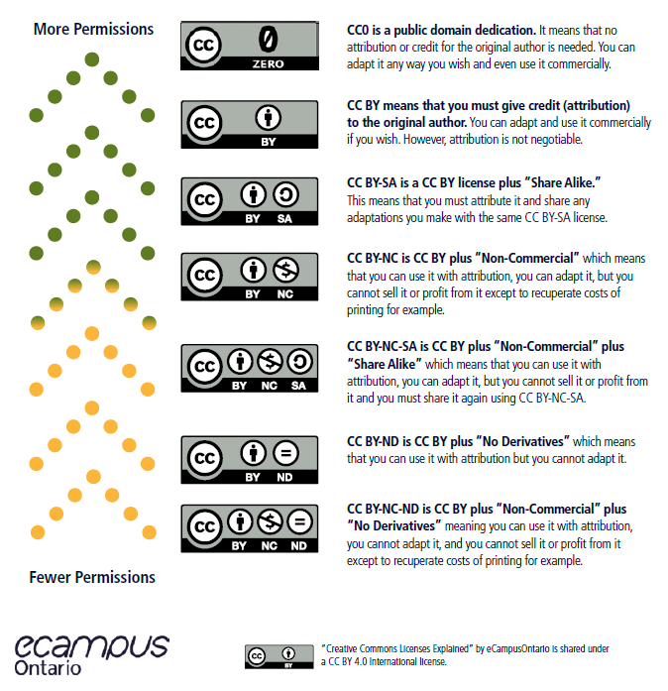
Creative Commons Licensing
Creative Commons(CC)
Public Domain (CC 0)
Attribution (BY)
Share Alike (SA)
Non-commercial (NC)
No Derivatives (ND)

Slide 5
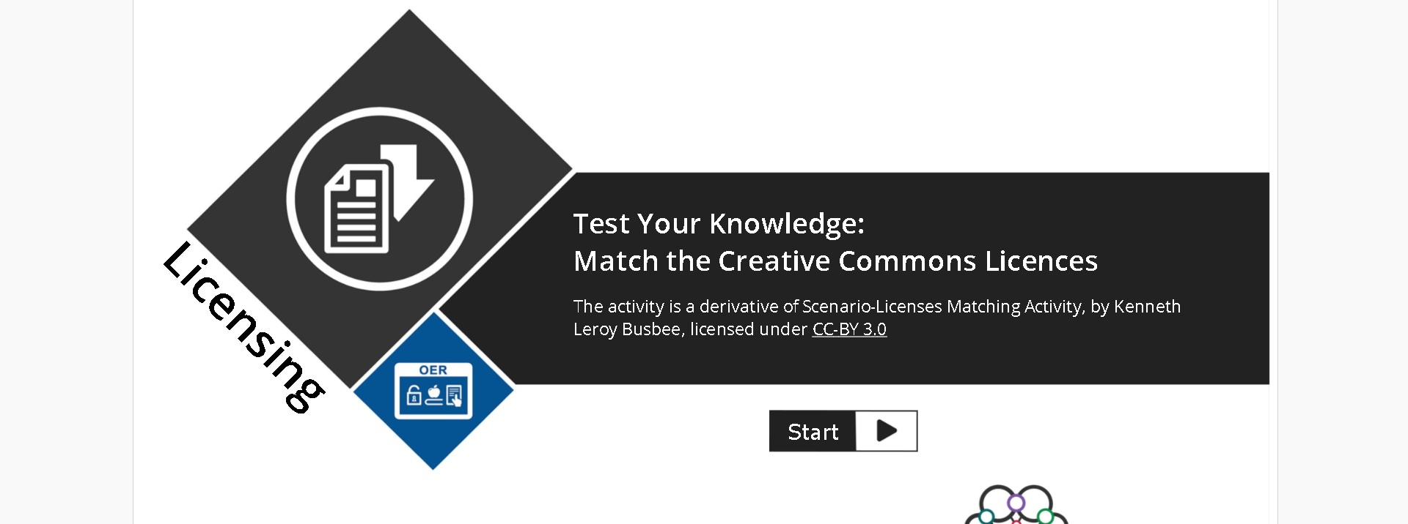
Open Licensing Matching Activity
https://plato.algonquincollege.com/ac-Library/OER/license-matching-activity/story_html5.html

Slide 6
HOW DO I FORMALLY LICENSE MY WORK?
Licensing can be :
Simple as a bit of text stating the license in a copyright notice, or
Complex as embedding the license information on your website using the HTML code associated with the particular license.
Including a link to the applicable license.
"License chooser" by Creative Commons is licensed under CC BY 4.0

Slide 7
“Sometimes when folks are in the midst of a monumental, feel-good shift, they fail to realize who has been excluded from that space”( Jessie Loyer, 2019)
Quote

Slide 8
Equity in Open Knowledge. Open for Whom?
It can exclude a significant portion of the world’s population in both western and developing nations (Willems and Bossu, 2012)
A wide array of voices seem to currently be missing from the OER world, including those of indigenous peoples, other non-Eurocentric cultural groups, and non-Anglophone languages (Flor, 2013)
Marginalized stakeholders with no access such as refugees, underrepresented student groups, low-income populations, etc.

Slide 9
Everyone has the right to education. Education shall be free, at least in the elementary and fundamental stages. Elementary education shall be compulsory. Technical and professional education shall be made generally available and higher education shall be equally accessible to all on the basis of merit.
Education shall be directed to the full development of the human personality and to the strengthening of respect for human rights and fundamental freedoms. It shall promote understanding, tolerance and friendship among all nations, racial or religious groups, and shall further the activities of the United Nations for the maintenance of peace.
Parents have a prior right to choose the kind of education that shall be given to their children.
According to Article 26 of the Universal Declaration of Human Rights in Higher Education
Universal Declaration of Human Rights | United Nations

Slide 10
The Impact of OERs on Teaching and Learning (Best practices)
Flexibility in OERs and not sticking to one static content or textbook is important for our diverse learners in the 21st century.
The impacts of accessibility and lowering the cost of textbooks on educational outcomes for marginalized and underrepresented students to attain social justice?

Slide 11
What does open access mean?
The aim of many open education endeavors is to provide free access to education.
Open education resources reduce costs for students and allow for greater flexibility for instructors.
If the materials are not accessible and in downloadable format for each and every student,
then they do not achieve the obligation to deliver fully open education?

Slide 12
Communities of Practice and Possibilities
Sharing, collaboration, and mindfulness
"learner-driven" and students as contributors, designers and transformers of knowledge in Higher Education not just as consumers and audience.
It is important for educators to be flexible and open to students’ new concepts and ideas .
Encouraging students to have agency and a social and public impact
Creating models of recognizing students' contributions and academic labor.
DeRosa, R. and Robison, S. (2017) From OER to Open Pedagogy: Harnessing the Power of Open in Jhangiani, R S. and Biswas-Diener, R. (2017 Open: The Philosophy and Practices that are Revolutionizing Education and Science London: Ubiquity Press.

Slide 13
Student Reflection
Some key components identified by a Keene State College undergraduate student who was reflecting on her experiences with Open Education.
“Open education is the philosophy and belief that people, even the world should produce, share, and build on knowledge that everyone has access to.”
"This Photo" by Laurenz Kleinheider on Unsplash
What Open Education Taught Me by Jaime Marsh is licensed under CC BY 4.0

Slide 14
Why should I use OER?
Cost savings is not the only benefit of using OER – they are an essential part of an open pedagogy and can be used to create a powerful learning experience for your students.
Studies have revealed a “positive relationship between the use of OER and student academic achievement” [PDF] and suggest that OER may help to decrease withdrawal rates while increasing overall student grades.
Former BCcampus Director of Curriculum Services, Paul Stacey, shared a comprehensive article on the Economics of Open, which provides an abundance of reasons to choose and use OER.
"What are OER? " by BCcampus OpenEd is licensed under CC BY 4.0

Slide 15
Assessing OERs: Criteria C.R.A.A.P Test
Currency = the timeliness of the information
Relevance = the importance of the information for your needs
Authority = the source of the information
Accuracy = the reliability and truthfulness of the information
Purpose = the reason the information exists
Let's watch a video!
http://ontarioextend.ca/curator-assessing-oer/
"Assessing OER: Spotlight on C.R.A.A.P" is licensed under CC BY-NC-SA 4.0

Slide 16
C.R.A.A.P Test
http://ontarioextend.ca/curator-assessing-oer/

Slide 17
Assessing Open Educational Resources
Guide for assessing OERs--BCcampus

Slide 18
Searching for and Finding and OERs:
OERs Repositories:
https://search.ecampusontario.ca
OASIS (geneseo.edu)
BC Reads: Adult Literacy Fundamental English Course Pack 5 - Open Textbook Library (umn.edu)
Search Results (geneseo.edu)
https://www.oercommons.org/
https://open.bccampus.ca/browse-our-collection/find-open-textbooks/

Slide 19
References
United Nations Educational, Scientific and Cultural Organization (2019). Open Educational Resources.
Retrieved from https://en.unesco.org/themes/building-knowledge-societies/oer
BCCampus (2017). Open Education. Retrieved from
https://open.bccampus.ca/
Caswell, T., Henson, S., Jensen, M., & Wiley, D. (2008). Open Content and Open Educational Resources: Enabling universal education. The International Review of Research in Open and Distributed Learning, 9(1). https://doi.org/10.19173/irrodl.v
DeRosa, R. and Robison, S. (2017) From OER to Open Pedagogy: Harnessing the Power of Open in Jhangiani, R S. and Biswas-Diener, R. (2017 Open: The Philosophy and Practices that are Revolutionizing Education and Science London: Ubiquity Press.
Flor, A. (2013). Exploring the downside of open knowledge resources: The case of indigenous knowledge systems and practices in the Philippines. Open Praxis, 5(1), 75-80.
Willems, J., & Bossu, C. (2012). Equity considerations for open educational resources in the globalization of education. Distance Education, 33(2), 185-199.9i1.469

