Slide 1
MS TEAMS TUTORIAL FOR TEACHERS
Presented by: Marlaina Riggio

Slide 2
AGENDA
Quick Polls
MS Teams Platform
Basic Features
Collaborative Classroom
Useful Apps
Updates

Slide 3
I teach…
a. LINC b. Post-secondary c. Adult ESL d. EAP e. Other

Slide 4
I am familiar with MS Teams.
YES
NO
Image retrieved May 2020 from: https://tracyvanderschyff.com/2017/10/05/microsoft-teams-youre-so-hot-right-now/

Slide 5
CONVERSATION FEATURES

Slide 6
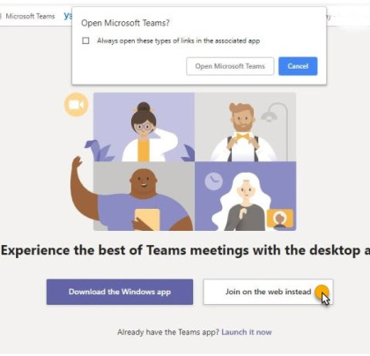
Simple Videoconferencing
Send students your MS Teams link
Clicking the link, will lead them to the page on the left.
Click join on the web instead

Slide 7
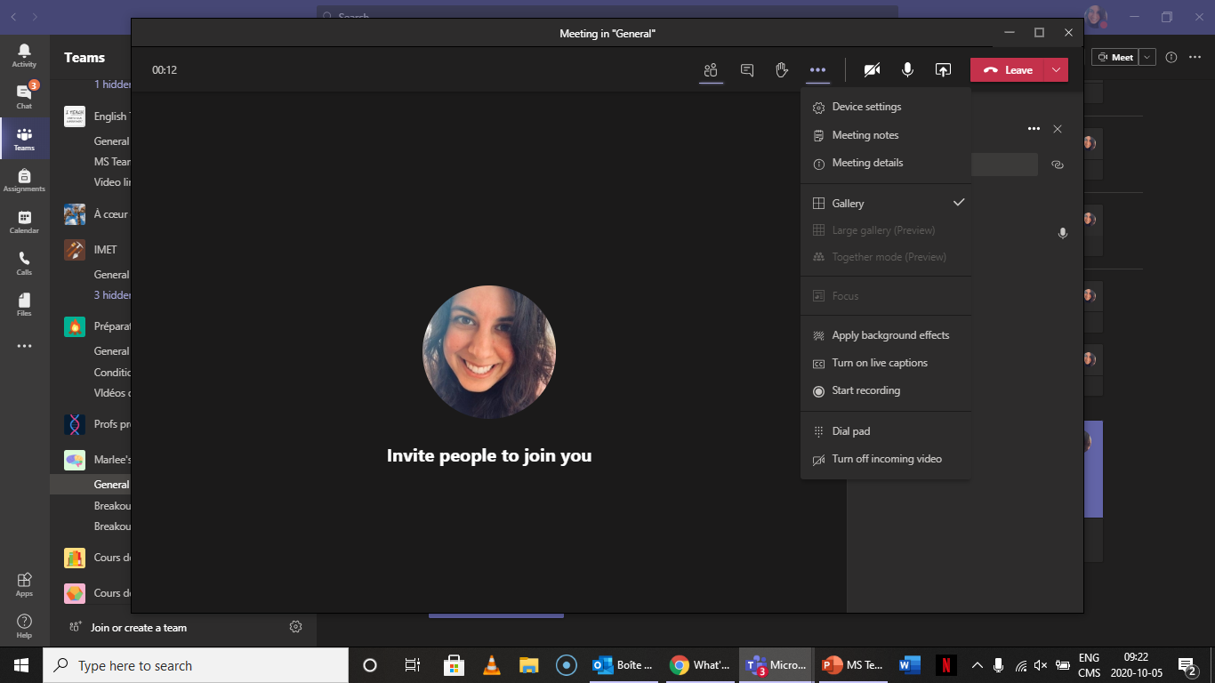
Videoconference Screen

Slide 8
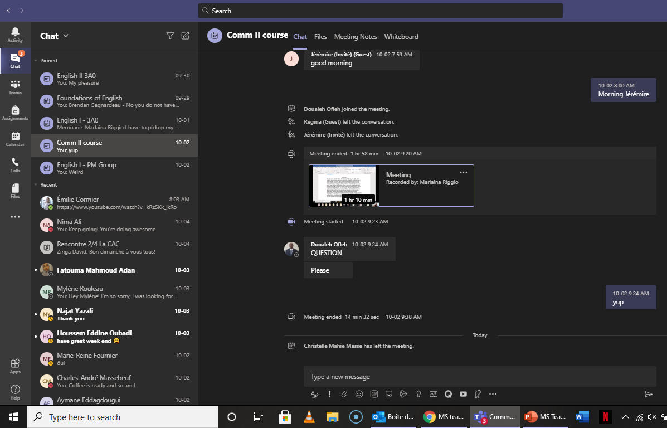
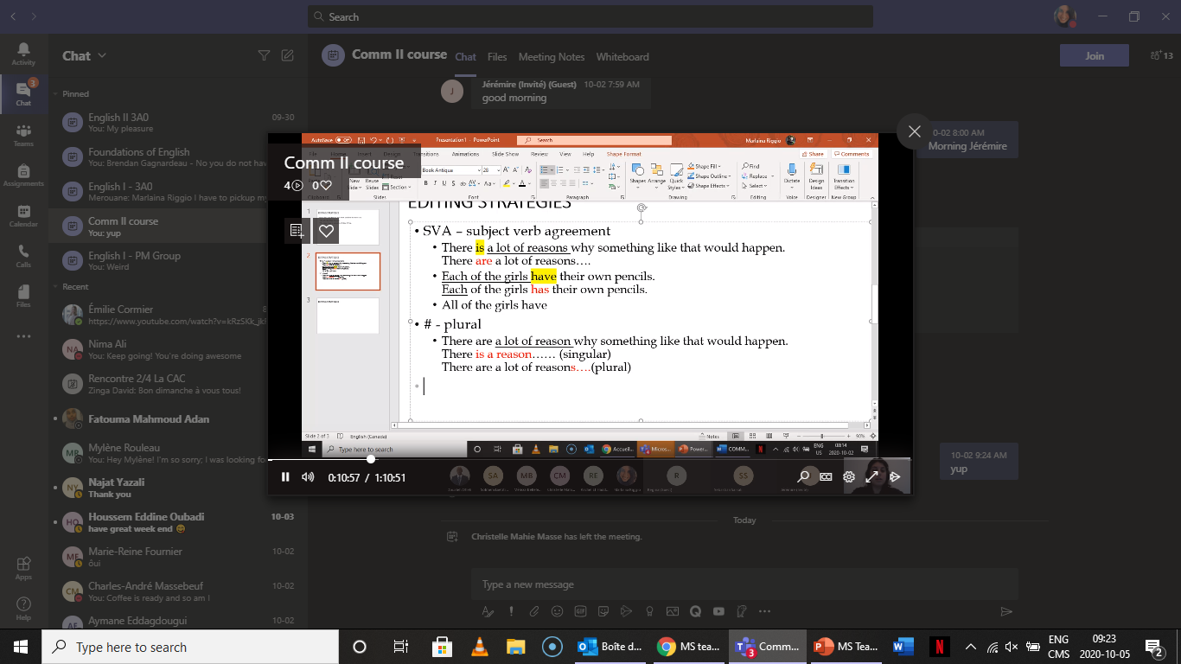
Recording Your Sessions

Slide 9
Channel Screen

Slide 10
Assignments: Student View

Slide 11
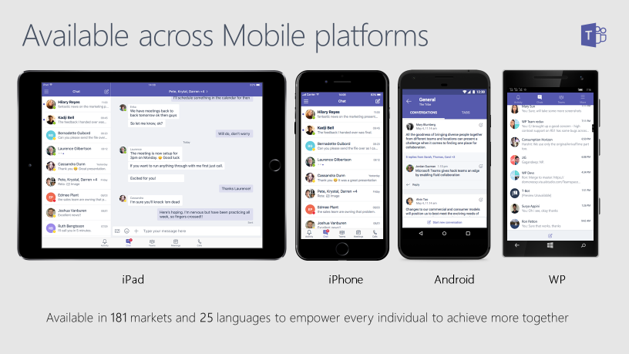
Image retrieved May 2020: https://techcommunity.microsoft.com/t5/microsoft-teams-events-blog/mvp-live-blog-collaborate-on-the-go-with-microsoft-teams-mobile/ba-p/111108

Slide 12
UPDATES
Gallery view (49 participants)
Breakout Rooms (in Beta testing)
Website: https://support.microsoft.com/en-us/office/what-s-new-in-microsoft-teams-d7092a6d-c896-424c-b362-a472d5f105de

Slide 13
Which emoji best describes your feeling after this webinar?
C
D
E
B
A

Slide 14
THANK YOU!

