Slide 1
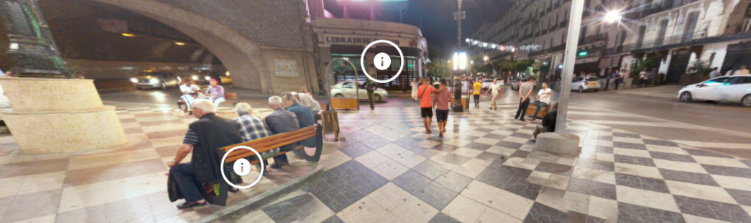
Energize Online Classes With Virtual Experiences
John Allan @mrpottz

Slide 2


Virtual tours everywhere
https://www.doorsopenontario.on.ca

Slide 3
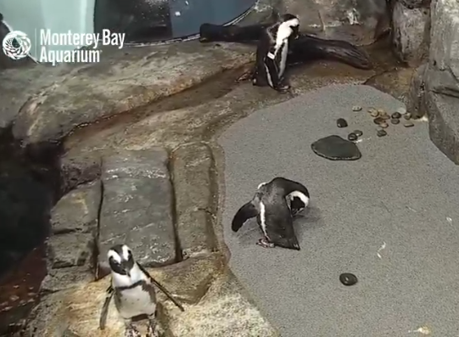
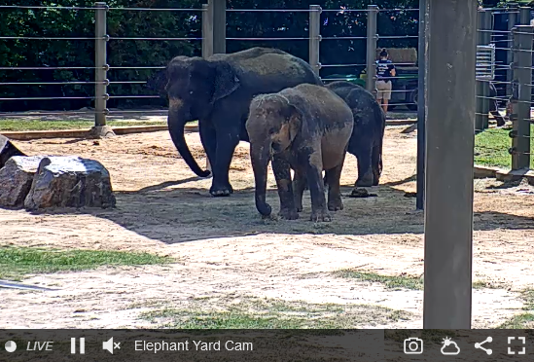
Virtual experiences

Slide 4
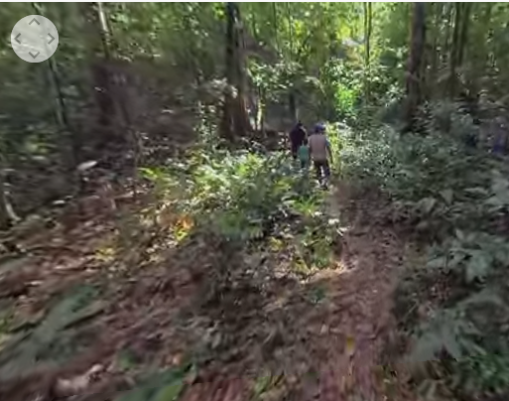
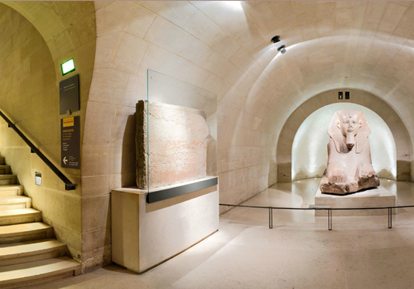
Virtual experiences

Slide 5

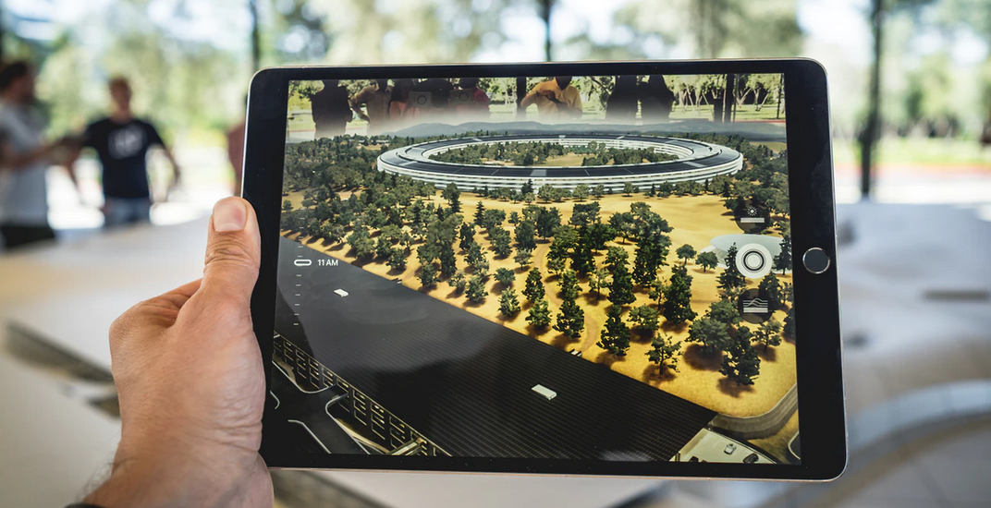
Our Tour
Virtual vs Augmented Reality?
Expeditions VR Tours
Create a VR Tour
Expeditions AR Models
Google Earth Voyager
GeoGuessr
Resources
Questions
Photo by Patrick Schneider on Unsplash

Slide 6
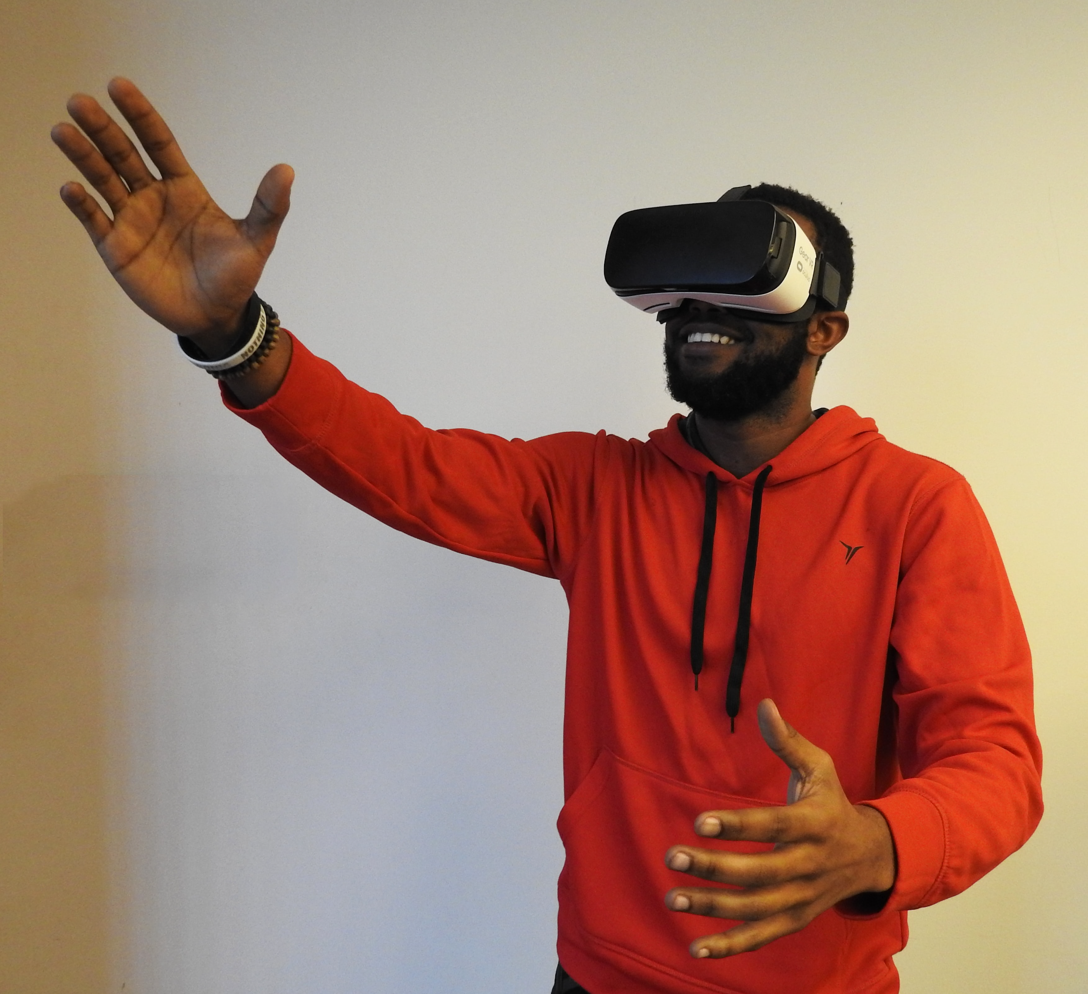

Virtual Reality vs Augmented Reality
Virtual reality (VR) implies a complete immersion experience that shuts out the physical world through a viewing device.
However, VR can be experienced without a headset.
Photo by Jeswin Thomas on Unsplash
Photo by Hammer & Tusk on Unsplash

Slide 7
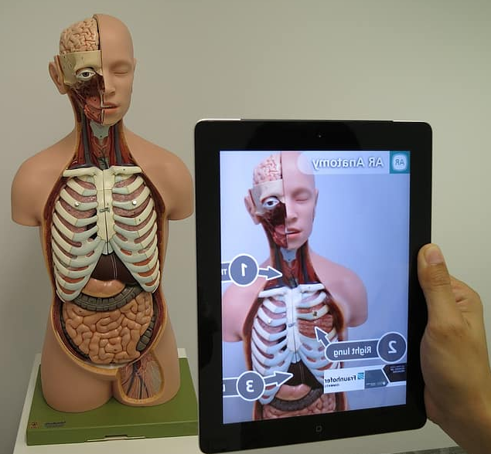
Virtual Reality vs Augmented Reality
Augmented reality (AR) adds digital elements to a digital view often by using the camera on a portable device.
https://www.pikist.com/free-photo-vjikl

Slide 8

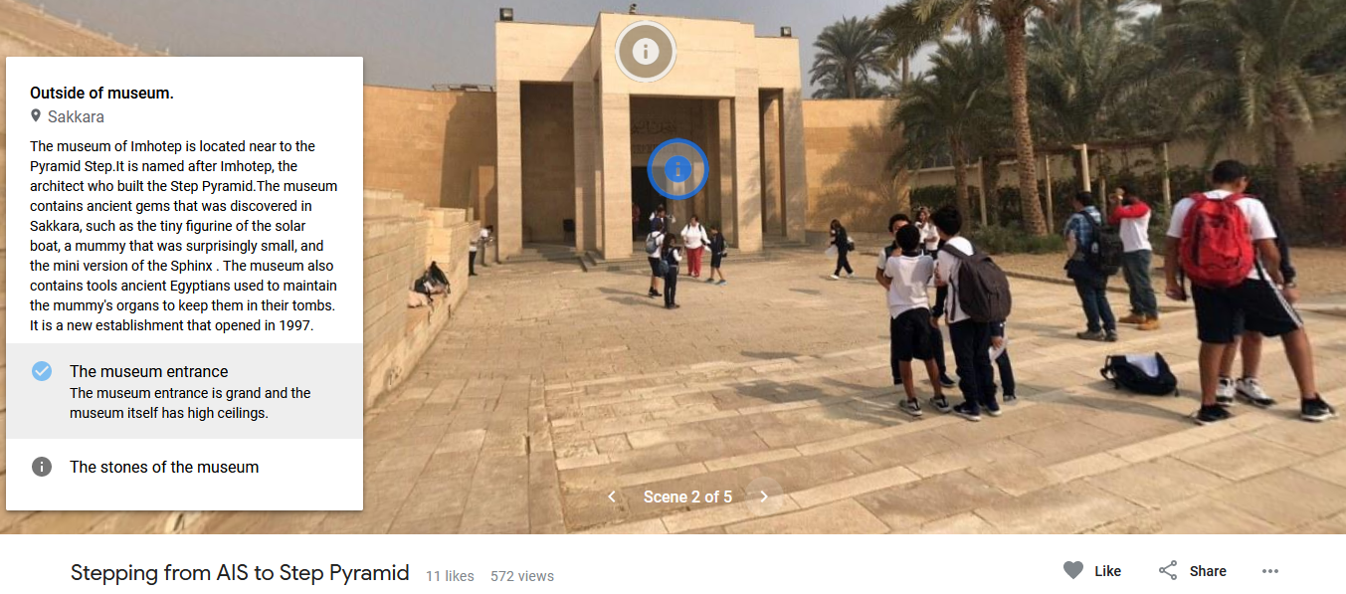
Have you used AR or VR in the classroom?

Slide 9
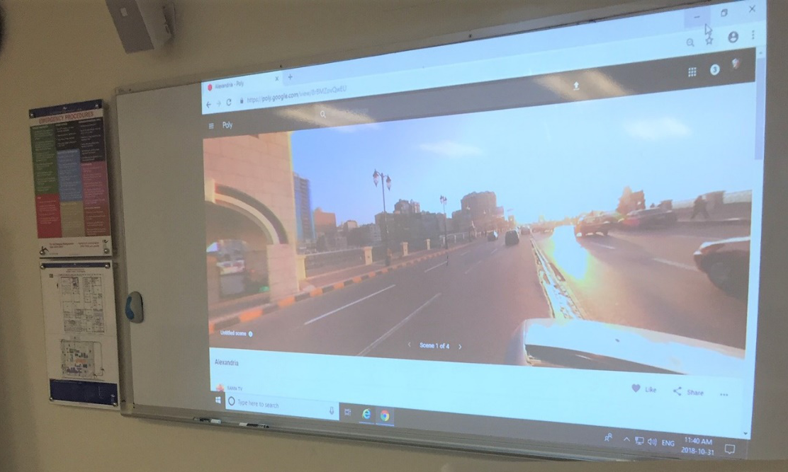
Have your students generated any AR models or VR tours in your language classes?

Slide 10
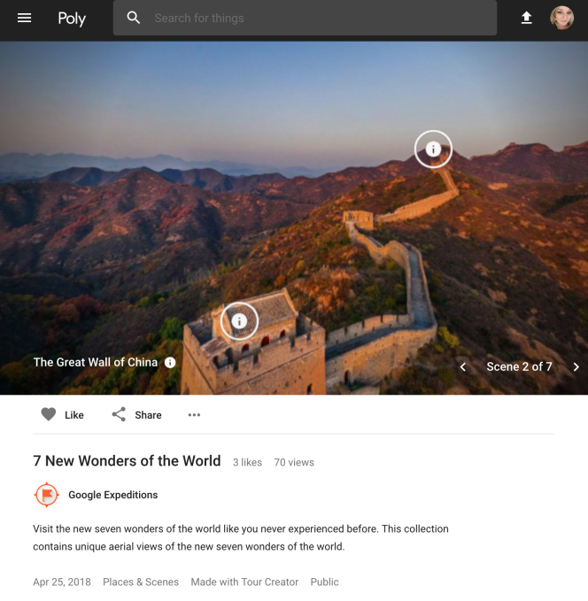

1 Google Expeditions
VR Tours

Slide 11
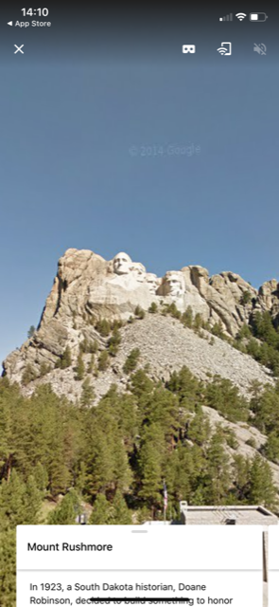
Why?
COVID travel limitations
Explore inaccessible places
Limited class disruption
Inexpensive
Potentially limitless experiences
Provided paths
Provided activities

Slide 12
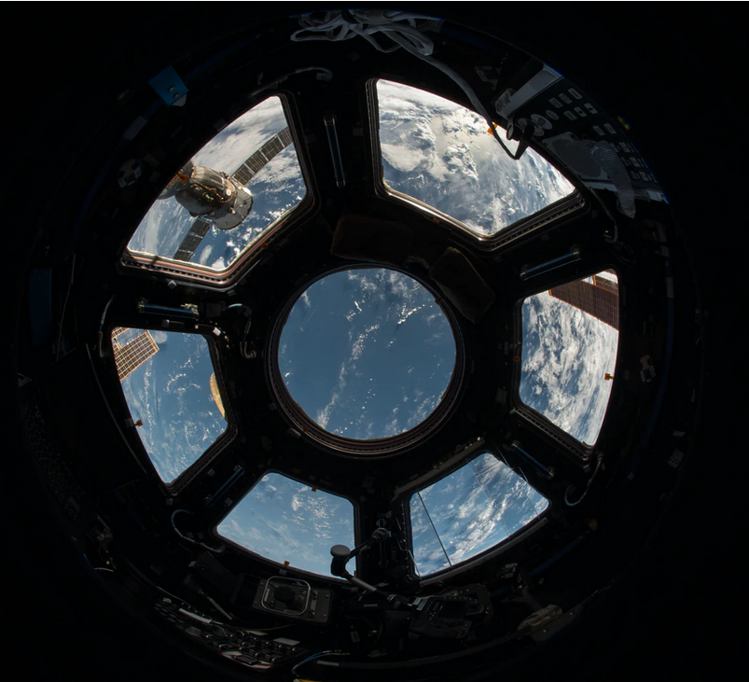
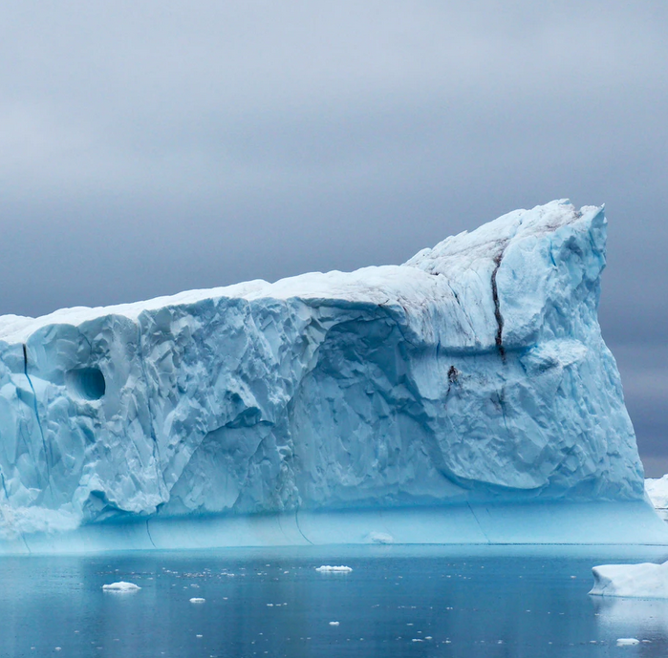
Explore Exotic Places
International Space Station to Antarctica
Photo by NASA on Unsplash
Photo by Xavier Balderas Cejudo on Unsplash

Slide 13



Exploring potential careers
Aquarist
Chef
Civil engineer
Coder
Metal artisan
Microbiome scientist
Museum photographer
Paleontologist
Park ranger
Pharmacist
...

Slide 14
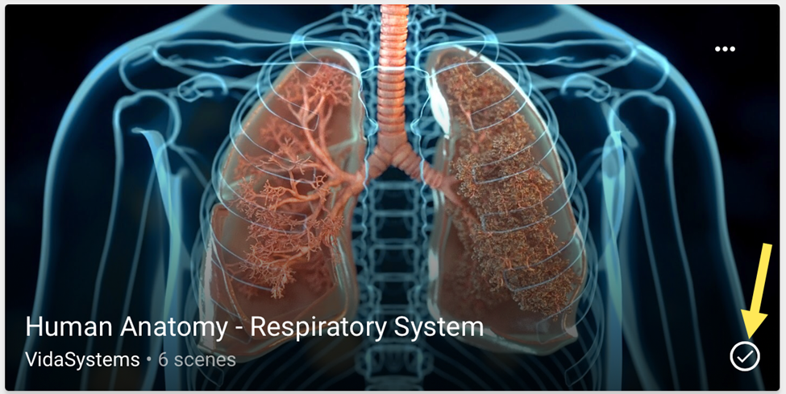
Inaccessible spaces
Inside the respiratory system
Gears
Nervous system
Human heart
Muscular system
Migrane Anatomy
Airplanes
Fusion reactor

Slide 15
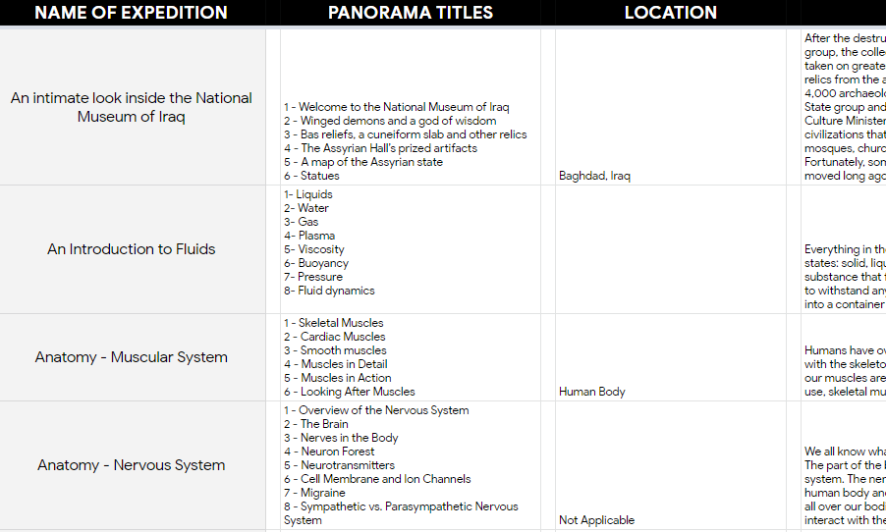
Comprehensive List of Tours
https://bit.ly/2RRfwRy

Slide 16

Technology Required
Internet connection
Mobile devices / Workstation
Viewer (optional)
Photo by Jesus Kiteque on Unsplash

Slide 17

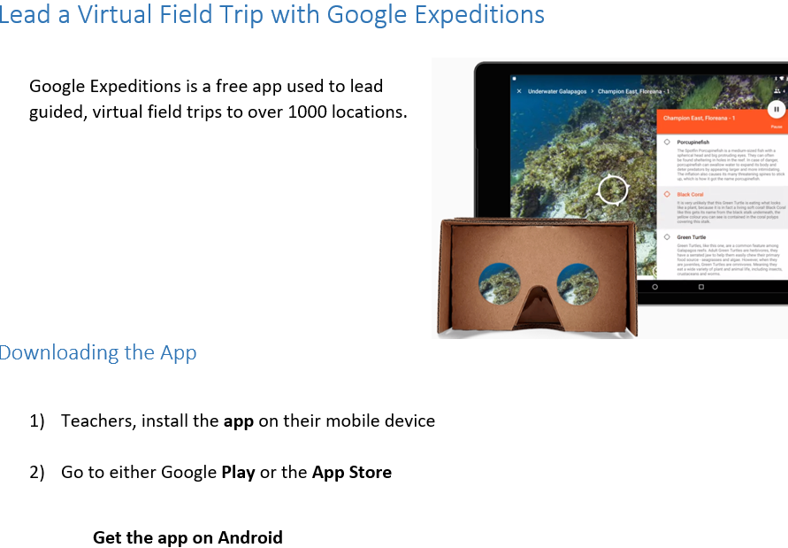
Instructor Leads a Tour (blended learning)
Instructor introduces concept
Instructor shares activity/worksheet with learners
Instructor starts tour on their device
Students connect to the instructor’s tour
Instructor guides learners through tour
Students complete the activity
Filename: Google_Expeditions_teacher_lead
(blended learning version)

Slide 18
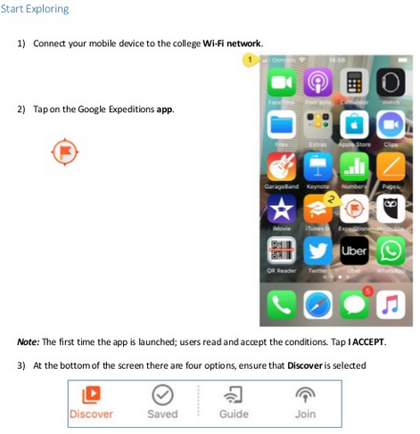
Student Self-discovery tour
Instructor
  introduces concept
  instructor shares worksheet with learners
Students
  locate tour
  start tour on their laptop/workstation/device
  learners through tour
  students complete activity
Filename: Google_Expeditions_first_exploration

Slide 19
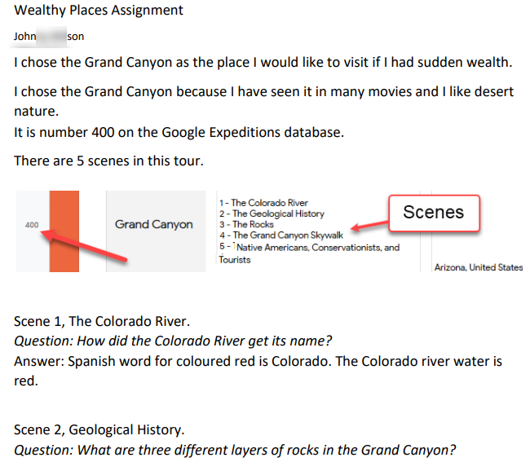
Activity
Instant Wealth
Unit
Choose a Tour!
Filename:
Myfave_VR_Tour

Slide 20
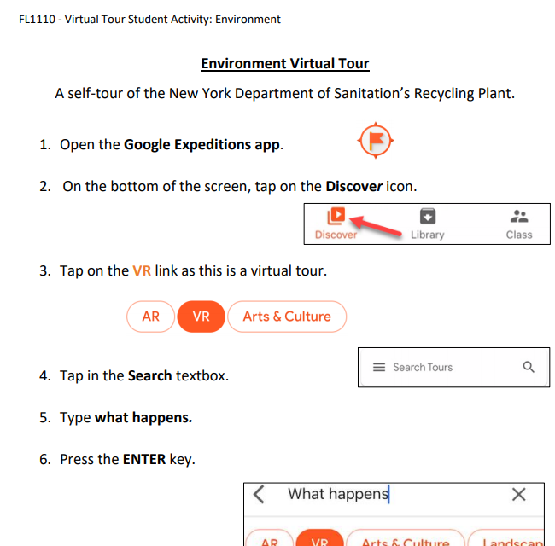
Adaptation – Environment
Filename:
Google_Expedition_Environment_student

Slide 21

After a few tours…
students create their own tours…

Slide 22

2 Google Tour Creator

Slide 23
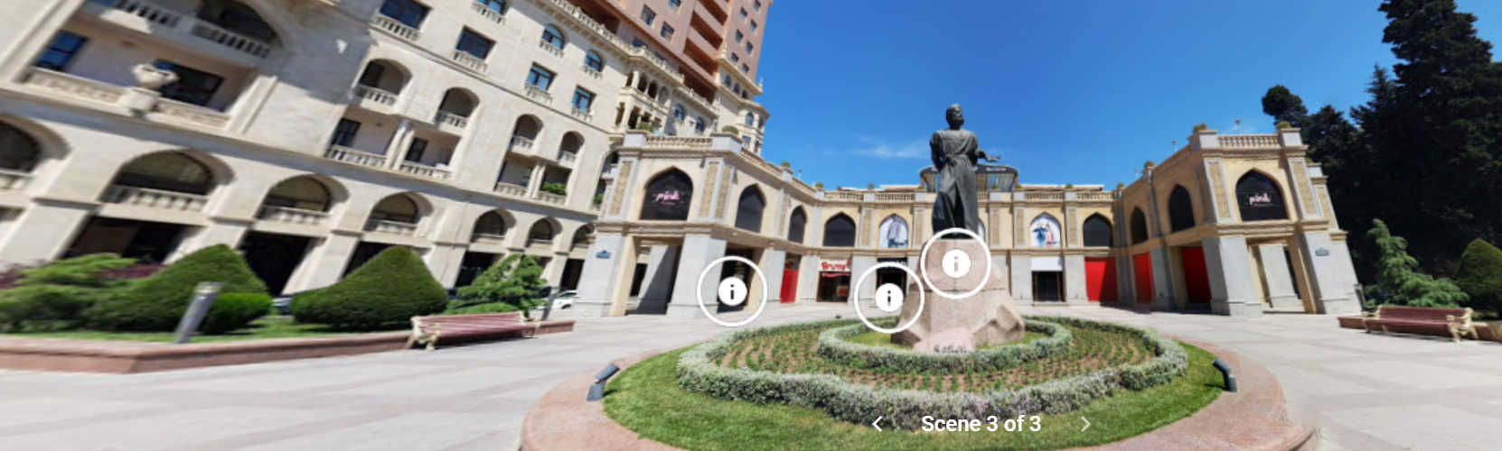
Learner Generated Student presentations
https://poly.google.com/view/89QwLqFFviW

Slide 24
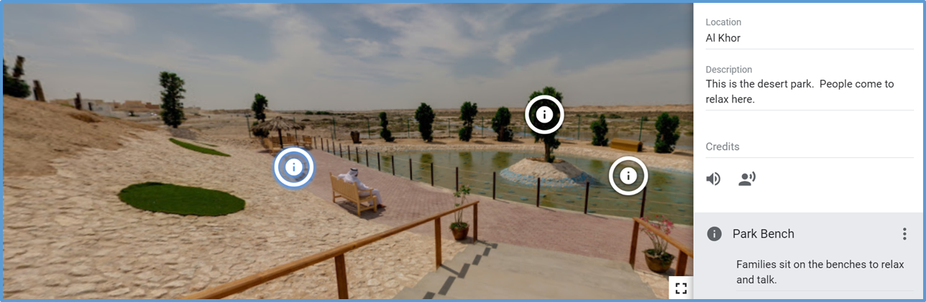
Student Generated Tours
Information found on Google Street View panoramas

Slide 25

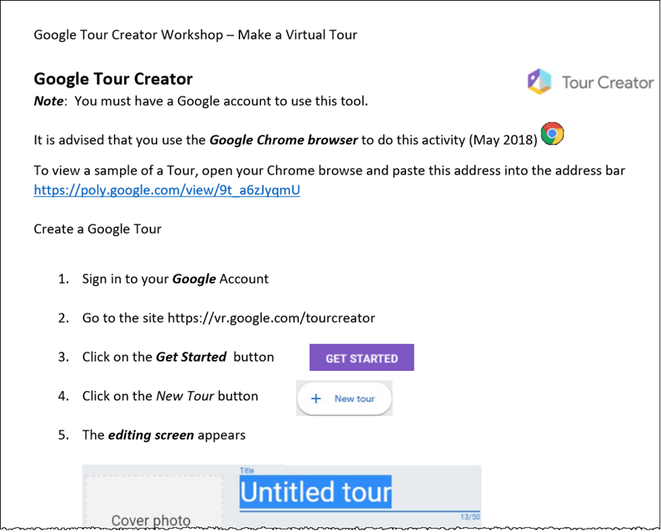
How to guide
Filename:
Making_a_Google_Tour

Slide 26
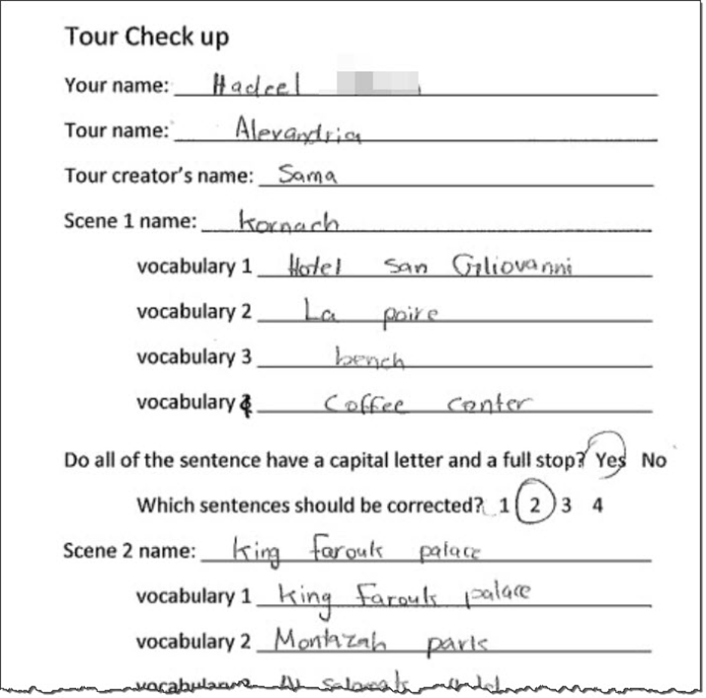
Peer review
&
Corrections

Slide 27
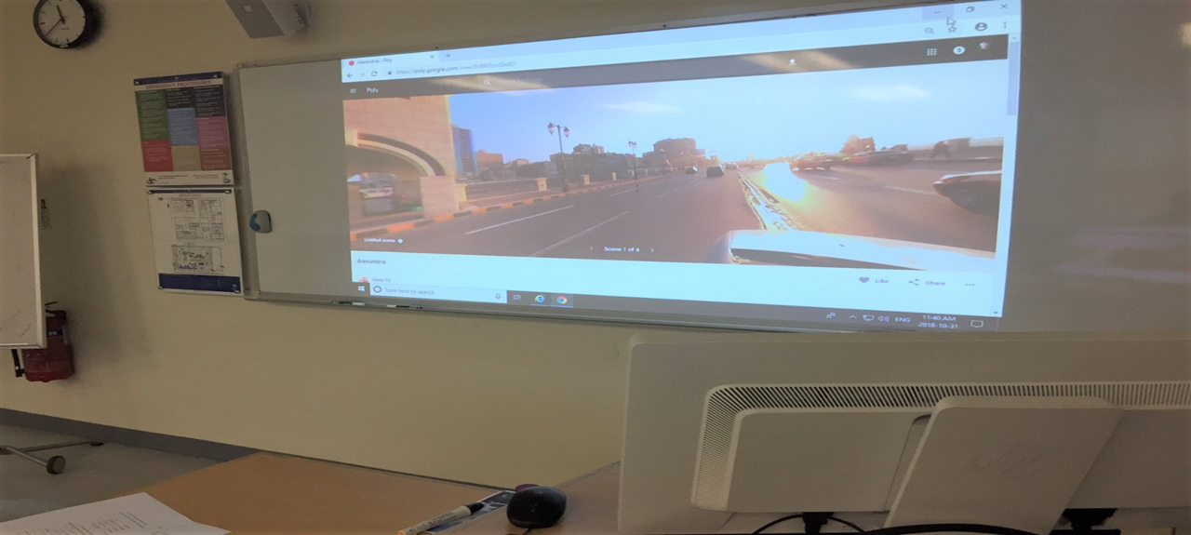
Presentations

Slide 28
Student Projects
Alexandria, https://poly.google.com/view/8rBMZovQwEU
Baku, https://poly.google.com/view/89QwLqFFviW
Algiers, https://poly.google.com/view/eZJ4a6qvRB6
Al Khor, https://poly.google.com/view/3tEEm9ZHdCr

Slide 29
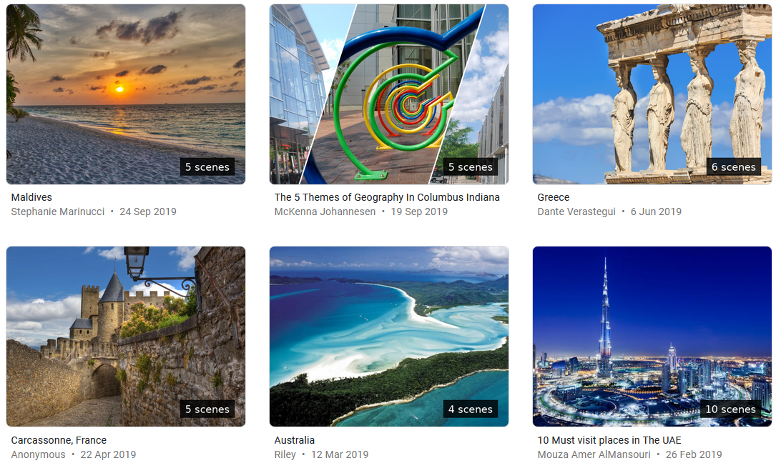
Explore other community made tours

Slide 30
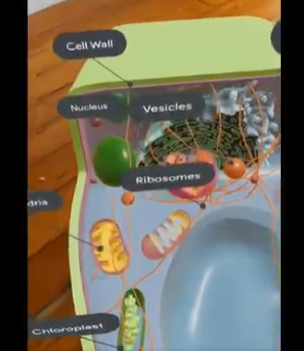
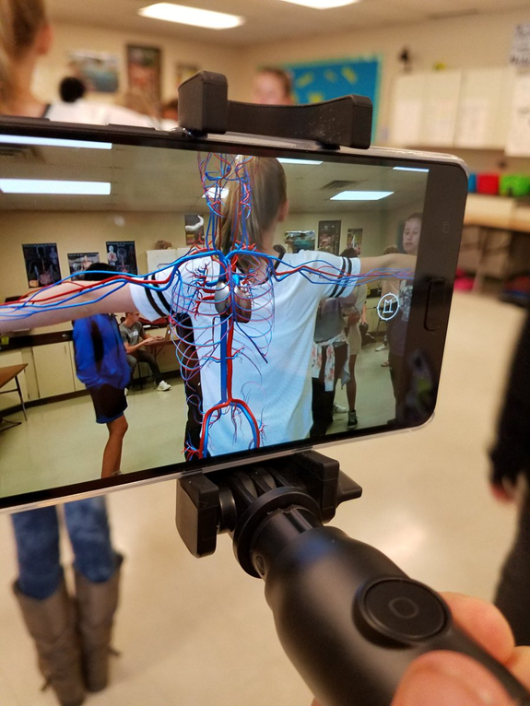
3 Google Expeditions - AR
•ESP courses: engineering technology
health sciences

Slide 31
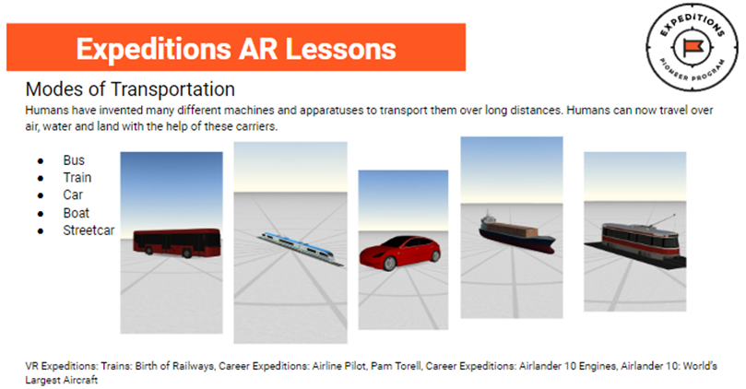
Google Tour AR Models
Modes of Transportation
Human Nervous system
Human Skeletal System
Forms of Energy
Camouflage
Coral Reef
Teeth
Simple Machines
Gears

Slide 32

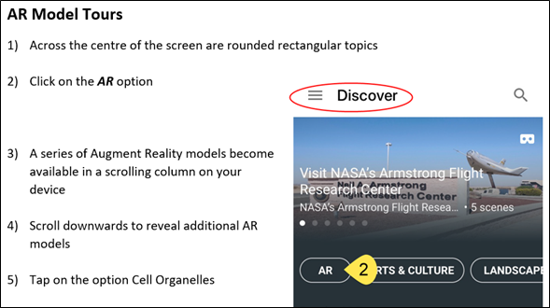
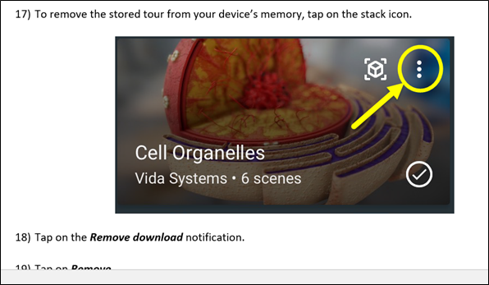
AR Tour Worksheet
Filename:
Google_Expeditions_AR _Tours

Slide 33
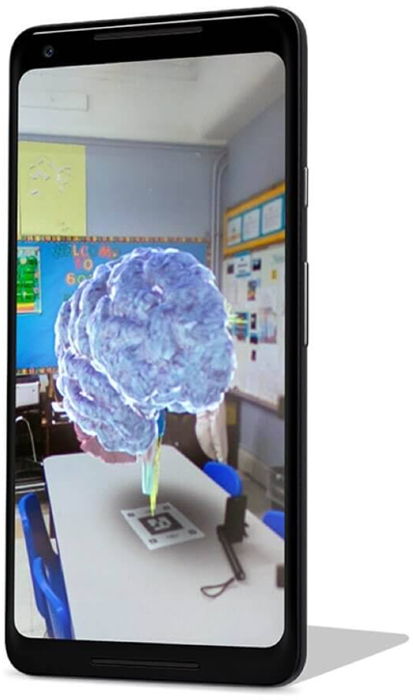

AR Markers
Blended Learning

Slide 34
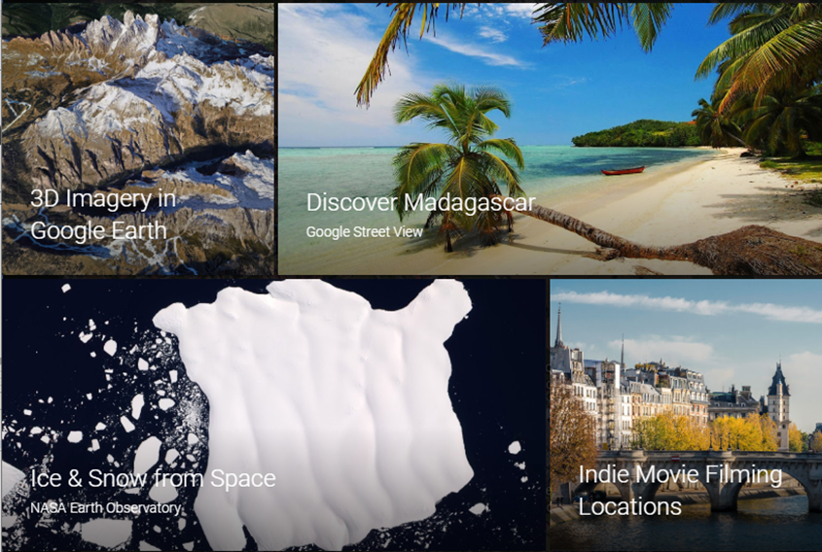
4 Google Earth - Voyager
•Deeper dives into
•Geography
•Culture

Slide 35
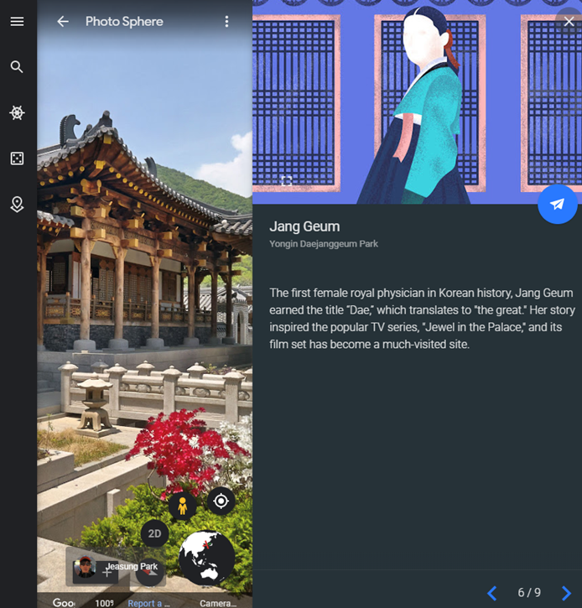

Voyager example

Slide 36
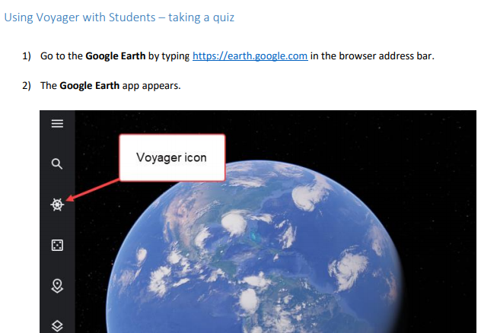
Google Earth How To
Quiz
Explore
Filename:
Google_Earth_Voyager

Slide 37
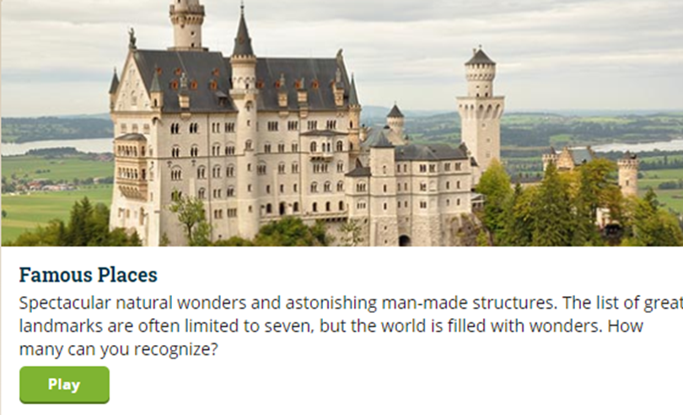
5 Geoguessr
Geography guessing game based on genre
•Geography
•Culture
•Gamification -> Fun!

Slide 38
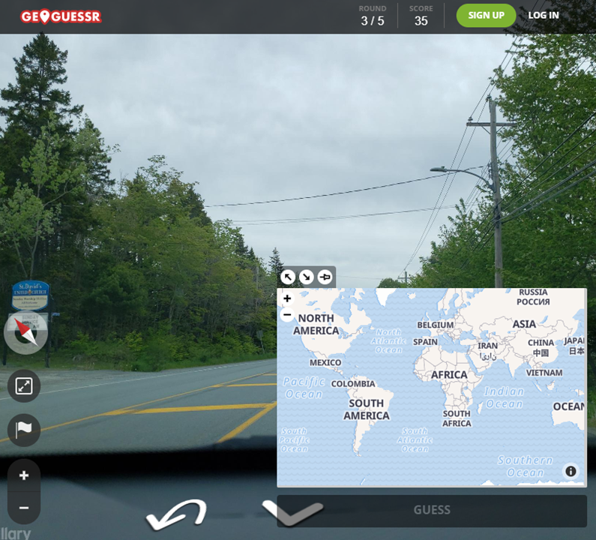
Guess where?

Slide 39
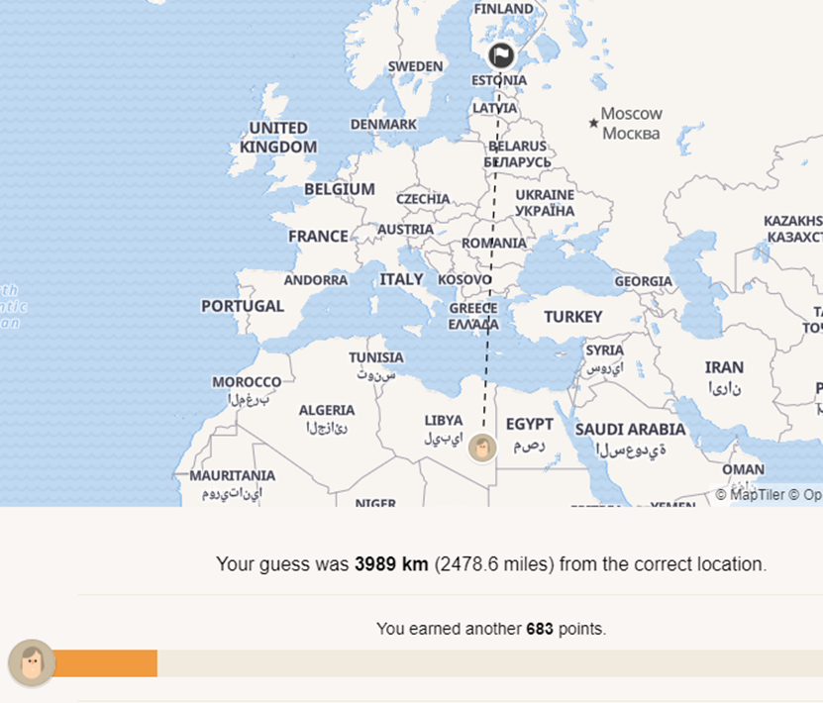
Feedback
Points
Distance

Slide 40
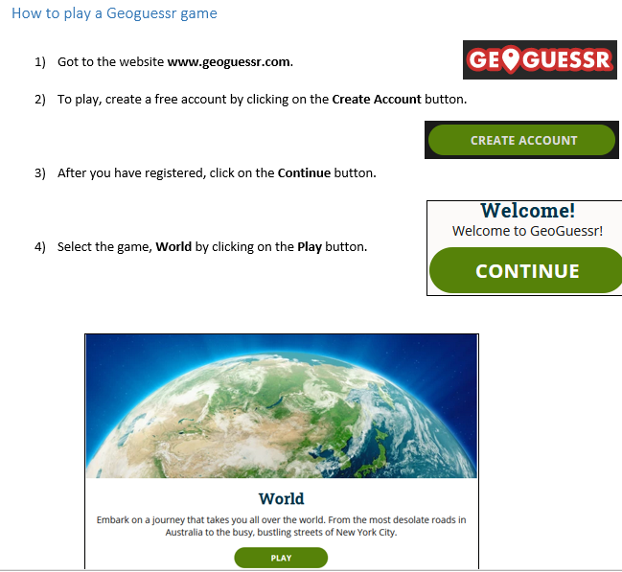
How to Guide
Filename:
Geoguessr

Slide 41
Questions

