Slide 1

Online Tools with ELLs
By Emily Castle-Dunn

Slide 2
Key Questions:
How do I explain to someone who doesn’t speak English how to access and do assignments on Google Classroom?
How do I help students access more detailed platforms like Canvas/Moodle?

Slide 3
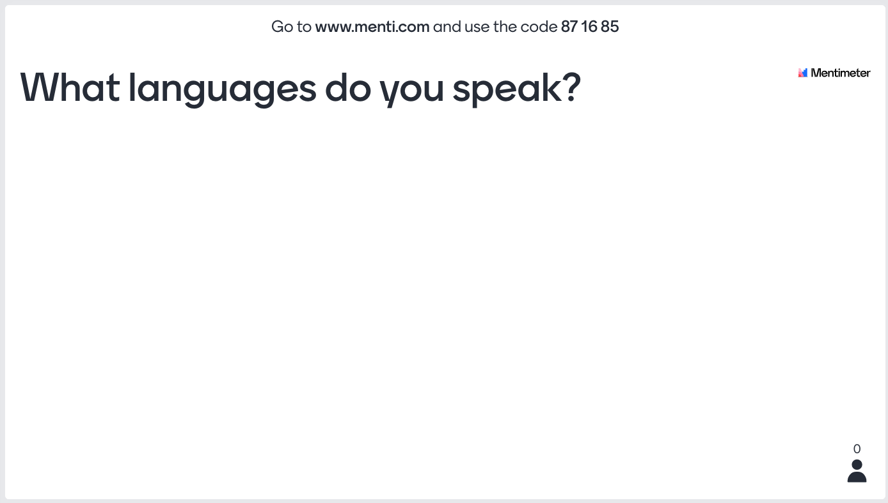

Slide 4
General Tips
Keep verbiage simple and avoid synonyms when giving directions
Use templates/graphic organizers for online assignments
Speak slowly when giving directions

Slide 5

Using

Slide 6
Posting in Google Classroom
Post with concise verbiage.
Use consistent labels for assignments.
Use consistent formatting.

Slide 7
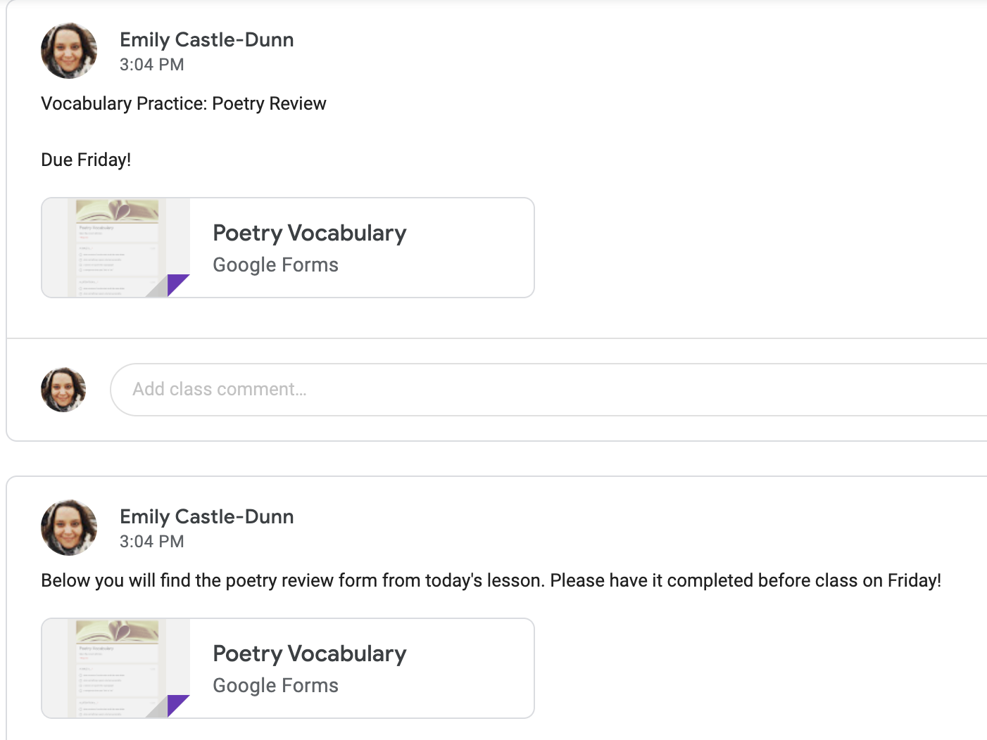


Which do you think is easier to understand?

Slide 8
Finding Tools in Google Classroom
Limit places to search for assignments in your directions.
Be consistent in how you explain finding assignments.

Slide 9
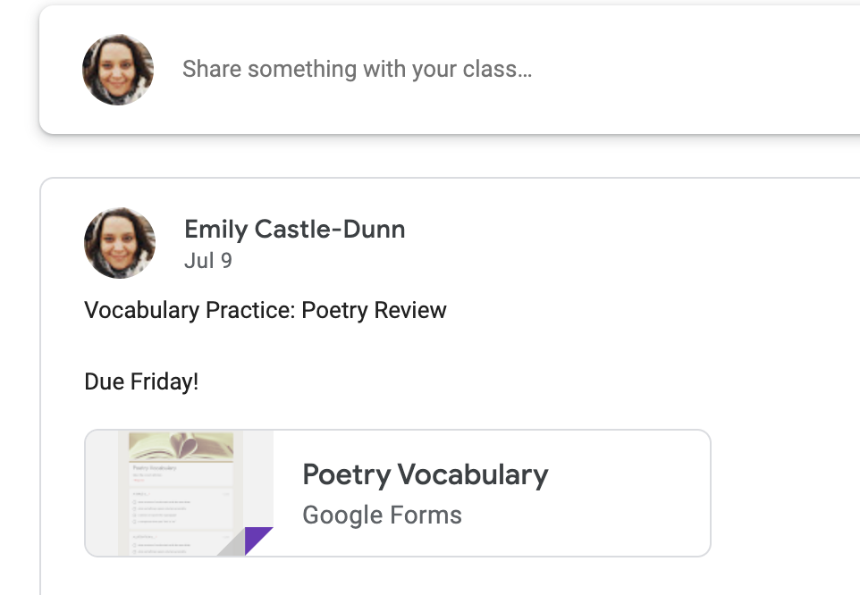
Finding Tools in Google Classroom
Direct students to the “Stream” for non-graded assignments ONLY!
Why? Posts may have visuals. Assignments only show words.

Slide 10
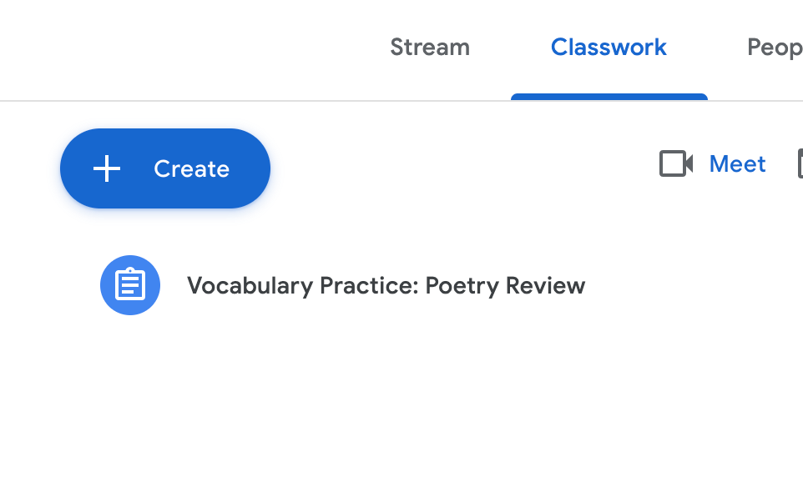
Finding Tools in Google Classroom
Direct students to “Classwork” for graded assignments.

Slide 11
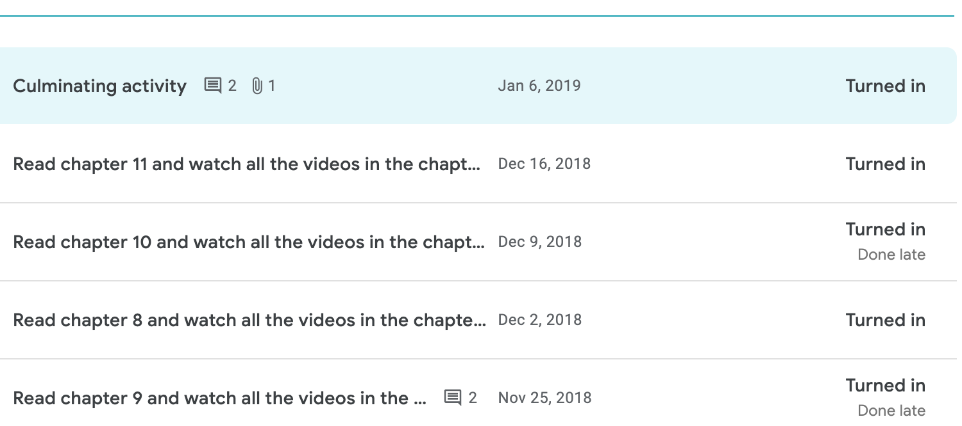
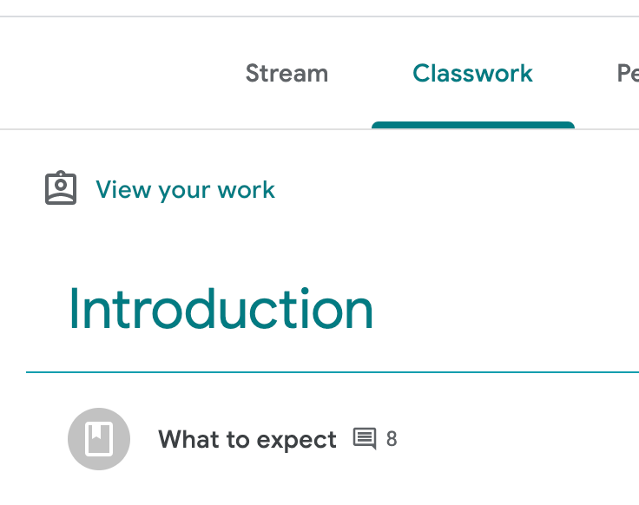
Finding Tools in Google Classroom
Direct students here and look for “Missing”

Slide 12
Which do you think is easier to understand?
You’ll see all the assignments posted in Classroom.
When you go to Google Classroom, the first thing you see is “Poetry Review.”
A
C
You need to turn in your missing assignments. They are all posted in Google Classroom.
In Google Classroom, click on “Classwork” for the assignment.
D
B

Slide 13
General Tips
Don’t explain ALL the tools on the first day! Explain as you need them. For example, just after you give an assignment.

Slide 14

Using

Slide 15
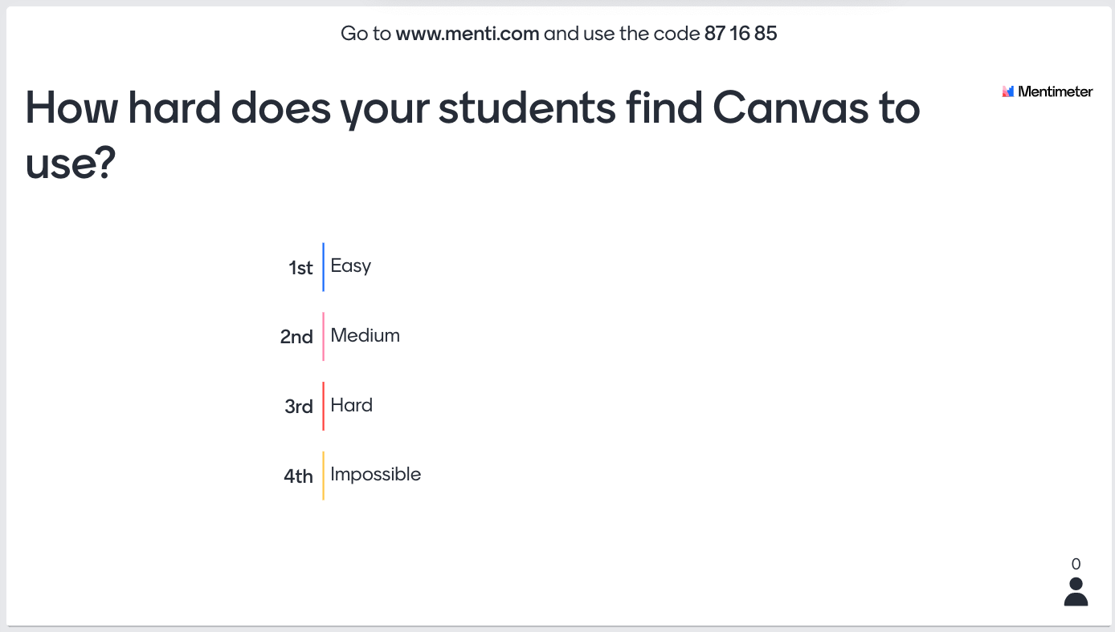

Slide 16
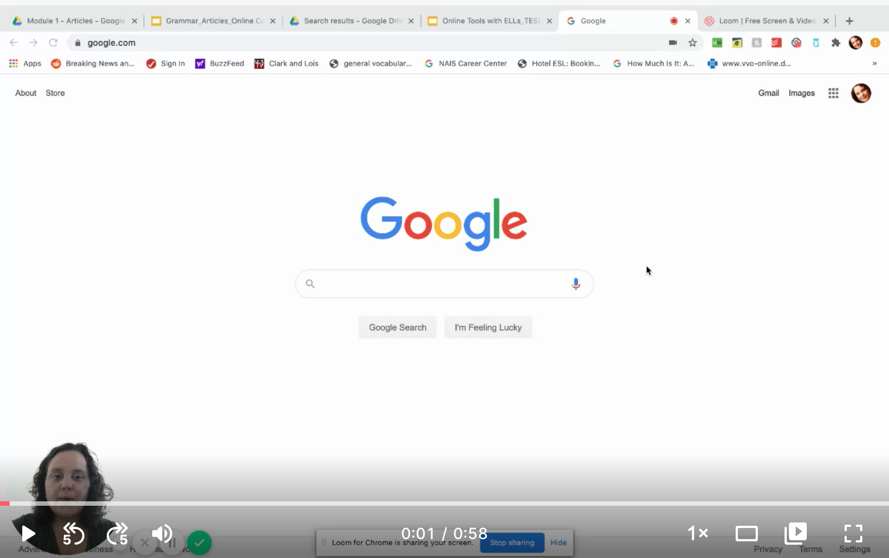
Video Example of directing students to a non-graded assignment:
Video Example of directing students to a graded assignment:

Slide 17
Assignment Formats and Templates
Written directions are harder to understand. Use visuals whenever you can, even on assignments students need to create themselves.
Embedding directions and template example
Create graphic organizers for written assignments:
Essay example
Vocabulary
  Easy
  More advanced

Slide 18
Finding Assignments in Canvas
Limit places to search for assignments in your directions.
Be consistent in how you explain finding assignments.
Take your time and repeat steps as necessary.
Don’t post in multiple places. Limit to 2-3.

Slide 19
Using Tools in Canvas
Recommended sections:
Announcements
Modules OR Assignments
Quizzes
Studio (if this is your in-person platform)

Slide 20
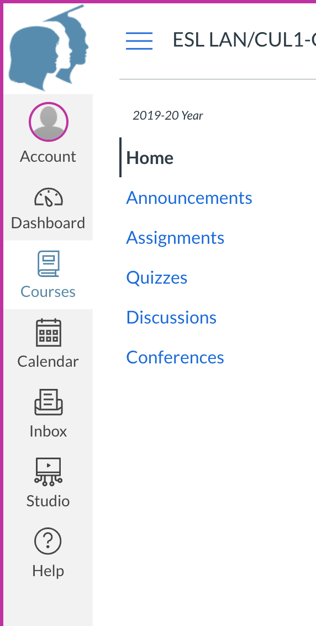
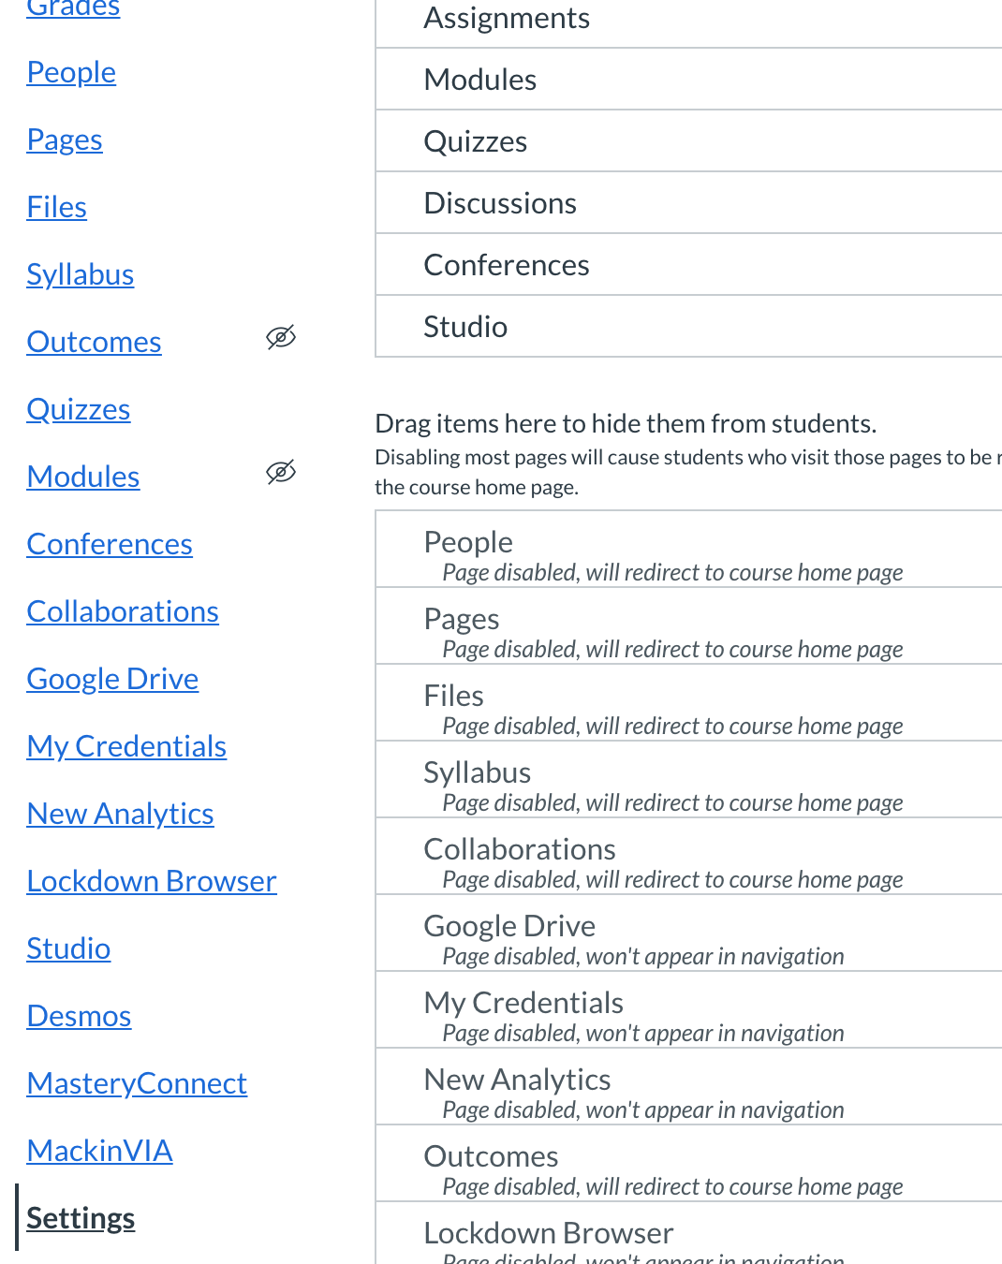
Using Tools in Canvas
Turn off all other sections!
Student’s View

Slide 21
Using Tools in Canvas
Embed visuals whenever possible.
Use precise language for directions.
Use matching or multiple choice whenever possible.

Slide 22
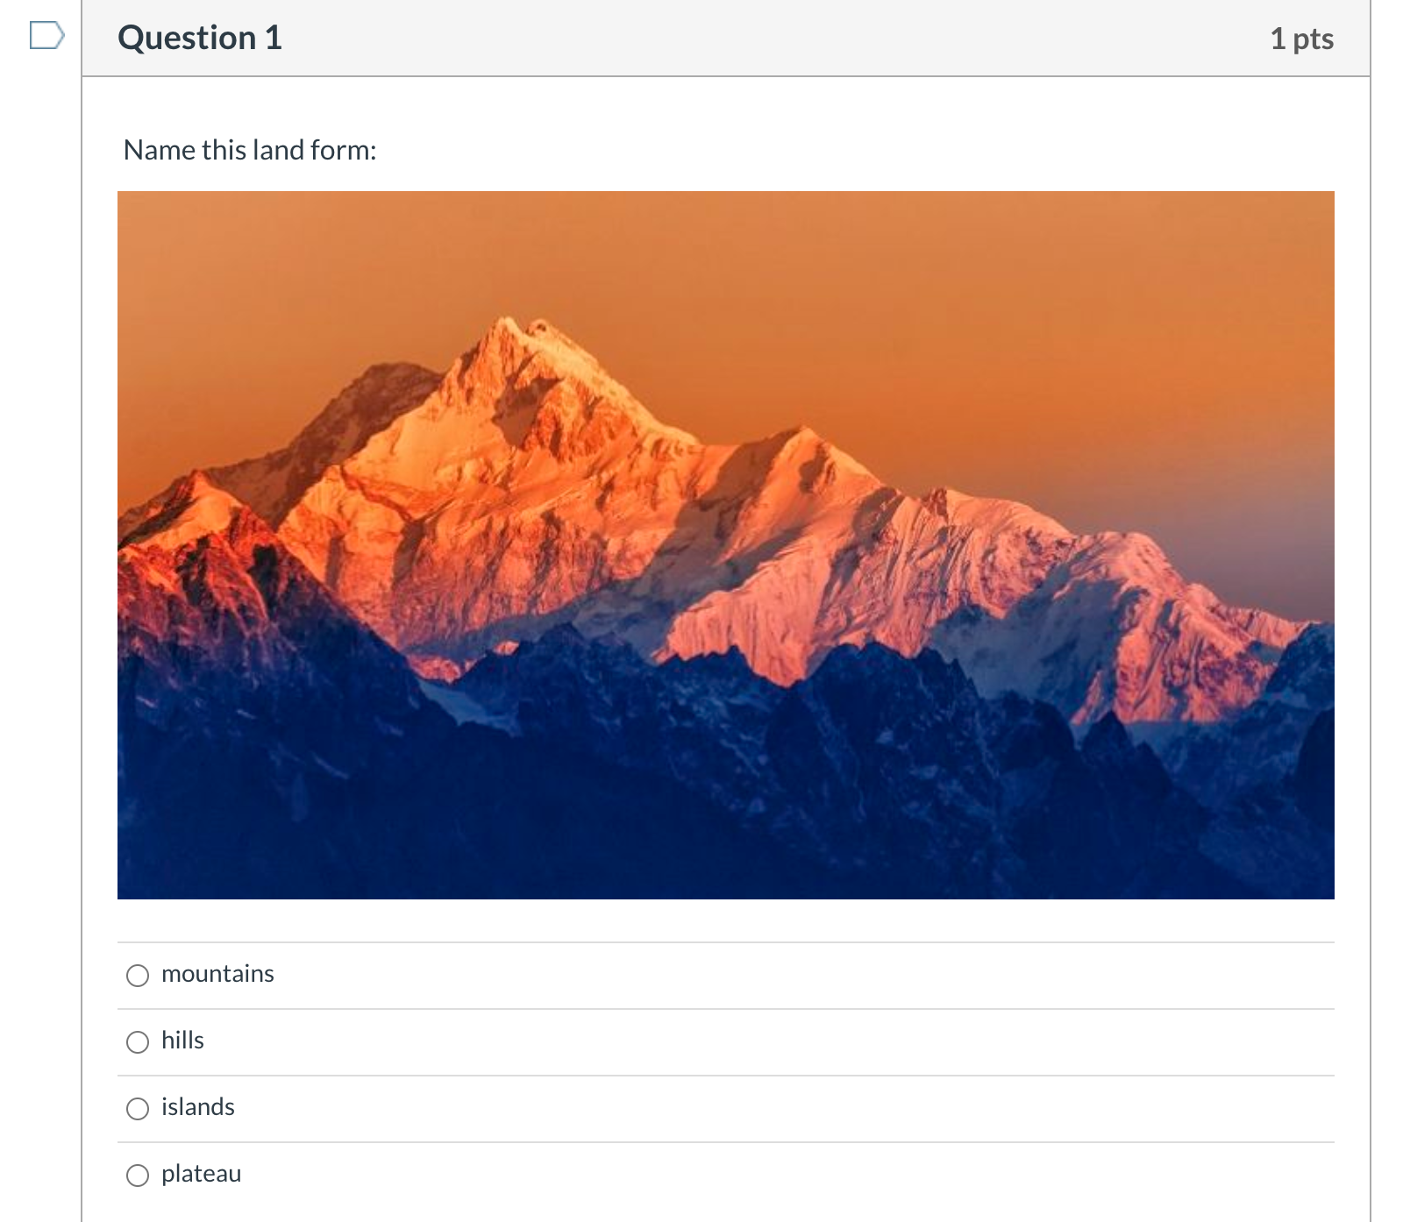
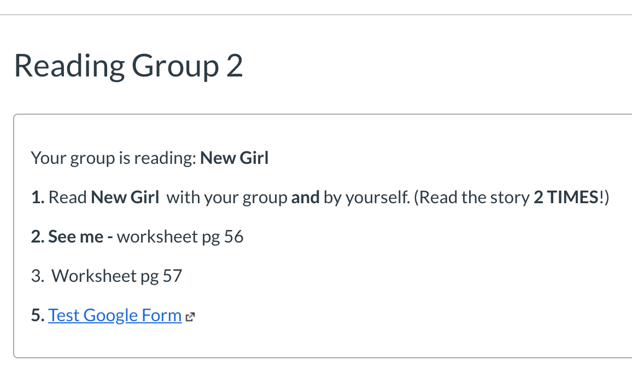
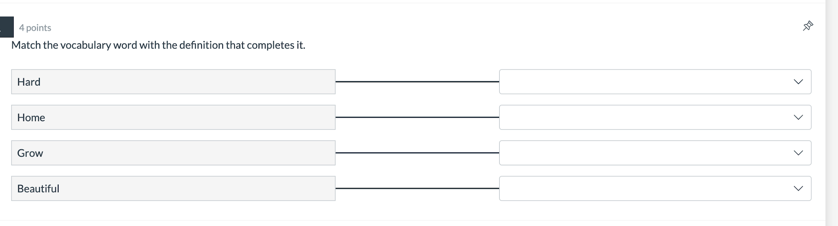
Using Tools in Canvas - Examples
Classic Quizzes
New Quizzes

Slide 23
Which do you think is easier to understand?
Everything you missed yesterday is in “Assignments.”
Look for “Assignments” on the left. Click on it and look for “Vocabulary Review”
A
C
Take the quiz I just posted.
Click the blue “submit” button in Canvas when you finish in Google Docs.
B
D

Slide 24
General Tips
Limit how many options you use in Canvas.
Explain each task step-by-step until students are comfortable.

Slide 25
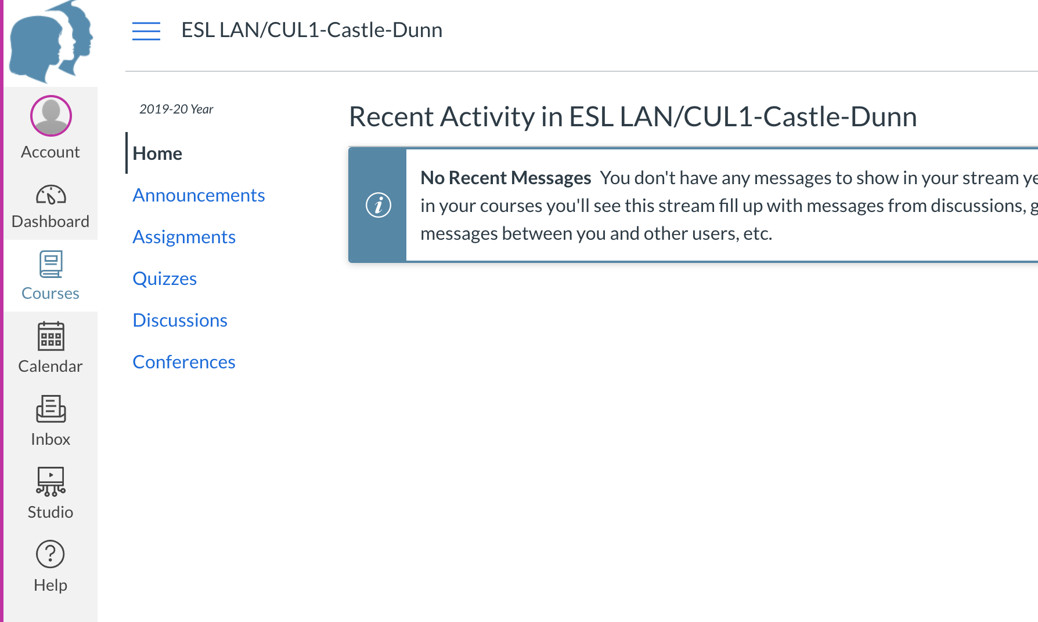
Video Example of taking a quiz in Canvas.

Slide 26
Emily Castle-Dunn
ESL teacher with 11 years experience
Curriculum writer for Peak Support, since 2017
  Teaches ESL for customer service
High school ESL teacher, since 2018
International Schools, 2 years
Business English teacher in Germany, 5 years
Language Assistant in France, 2 years
Certified in TEFL, ESL, ELA and Elementary Education
More on LinkedIn

