Slide 1

CanAvenue
Independent learning resource for Canadian language learners

Slide 2
CanAvenue – designed for
Prospective immigrants before their 'arrival’
Newcomers on waiting lists for formal language training
Learners in formal LT (LINC or other) and needing or wanting supplementary curriculum
Newcomers preferring to learn autonomously or facing formal LT barriers
Newcomers who have exhausted their formal LT eligibility and still want to develop their skills
Refugee claimants
Temporary foreign workers

Slide 3
Welcome to CanAvenue
Free
Open-access
Independent learning resource

Slide 4


Canadian-themed content

Slide 5
Learner Opportunities with CanAvenue
Orient themselves to Canadian formal language training
Engage in remedial learning
Extensive reading library
Extensive listening library
Perform extracurricular activities independently

Slide 6
Courses – adapted from Avenue courses
Repurposed for independent learners
  Canadian Citizenship
  Formal Language Training in Canada
  English Practice (edulinc courseware)
  Pronunciation

Slide 7
Courses – original
  Extensive Reading Library
  Extensive Listening Library

Slide 8

Resource Libraries – Literacy, Stage 1, 2
Extensive Reading
Wide variety of Canadian-themed content

Slide 9
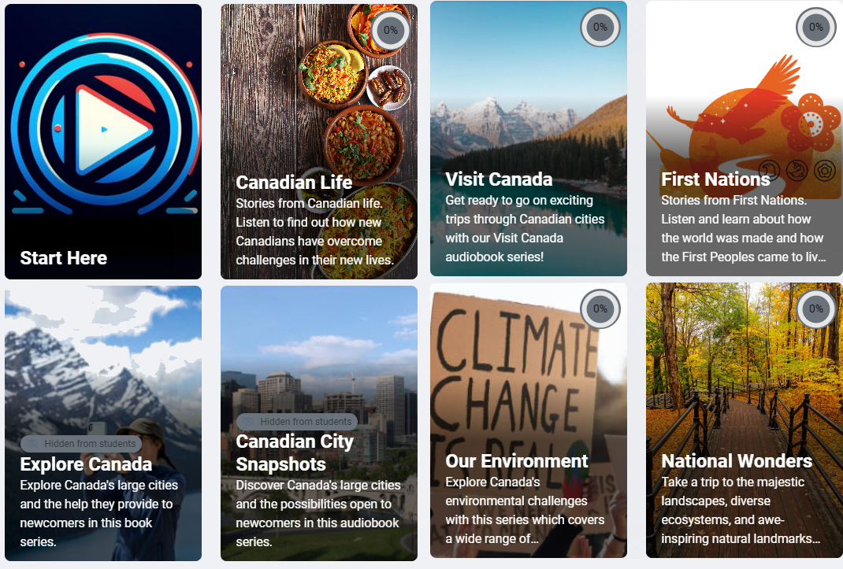
Resource Libraries
Extensive Listening Libraries
Wide variety of Canadian-themed content

Slide 10
Assessment and Tracking
  Formative/summative assessments do not transfer to LINC courses
  Participants view progress in CanAvenue’s gradebook
  Gradebook not transferable

Slide 11
Access and User Registration
Free and open for all, no registration limitations
All users registered as students
No instructor accounts or editing privileges

Slide 12
Teacher/Administrator Roles
Refer students to CanAvenue for independent learning
No teacher access to student data or tracking options

Slide 13
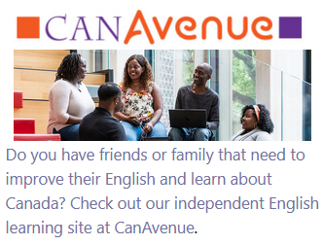
Avenue block access

Slide 14
Content Usage and Permissions
Learning objects not transferable to Avenue
Content aligned with Creative Commons license
(CC BY-NC-ND 4.0)

Slide 15
Platform Limitations
No formal activity or progress reports generated
No instructors, facilitators, or ePortfolio options
No PBLA units or group-based learning

Slide 16
Independent Practice for Learners
CanAvenue supports practice in areas like:
  Extensive reading & listening
  Citizenship or Canadian studies
  Pronunciation course
  Supplementary language activities Levels courses
  Speaking, writing, pronunciation, reading

Slide 17
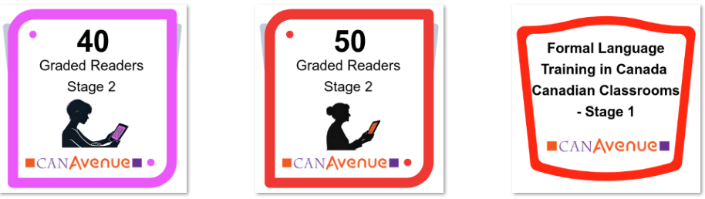
Completion and Recognition
Activity Completion: Achieved through different mechanisms (viewing, self-checking)
No formal ePortfolio submissions
Course badges

Slide 18

Reporting issues
report errors through Contact Email in the CanAvenue footer

Slide 19
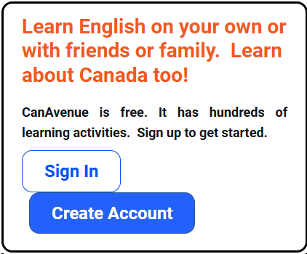
Getting an Account
canavenue.ca

Slide 20
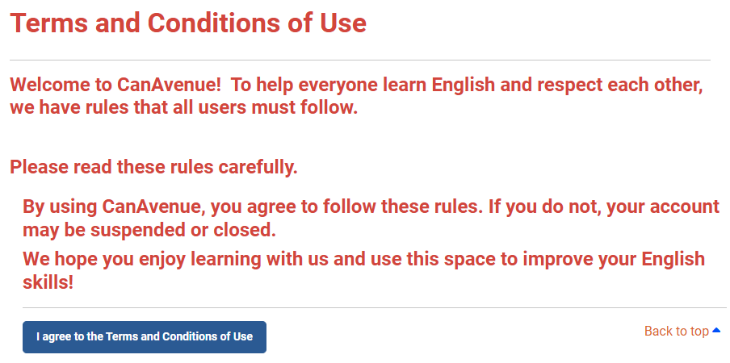

Slide 21
CanAvenue Tour

Slide 22
Questions

