Slide 1
Speaking Activities With Poodll Plugins
John allan
TESL Ontario 2024

Slide 2
Session Description
How can I create online learning speaking activities that students can use independently? Can I use contemporary tools that use AI to provide my students with automatic and detailed feedback on their speaking? Can I integrate independent speaking activities into more complete learning events?

Slide 3
Session
This session will introduce and demonstrate independent digital speaking activities for online and blended language courses.
The technologies are a set of Poodll plug-ins which are integrated into the Moodle learning management system.
These tools will allow instructors to witness possibilities of providing learners with independent speaking practice.

Slide 4
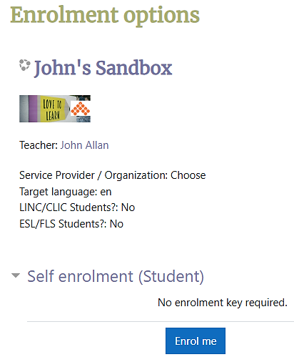
Model Course
https://avenue.ca/classroom/course/view.php?id=6

Slide 5
I moderated Avenue webinars on Poodll technologies by Justin Hunt. Since then, I have been developing learning experiences for the CanAvenue.ca project using Poodll technologies and would like to share some of the basics with the TESL Ontario community.

Slide 6
What is Poodll?
students to…
Technology that allows audio/video recording in
Quizzes
Assignments
Moodle HTML areas (Pages,…)

Slide 7
What is Poodll?
teachers to…
Technology that allows audio/video feedback in
Quizzes
Assignments

Slide 8
What is Poodll?
Not free
Moodle compatible
Automatic transcriptions of student utterances
AI assisted feedback

Slide 9
Poodll tools
Moodle-Poodll Integrated Editing toolbar tools
Widgets
Wordcards
ReadAloud
Solo
Notes:
innovative ways for students to practice and improve their target language reading, speaking, and vocabulary. By integrating these tools into Moodle courses, more engaging and personalized learning experiences can be available for your students.

Slide 10
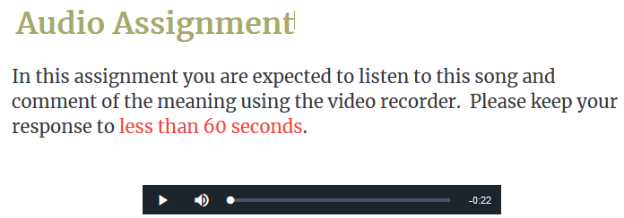
Moodle-Poodll Integrated Assignment
Record audio Record video Record Screen Widgets
Notes:
innovative ways for students to practice and improve their target language reading, speaking, and vocabulary. By integrating these tools into Moodle courses, more engaging and personalized learning experiences can be available for your students.

Slide 11
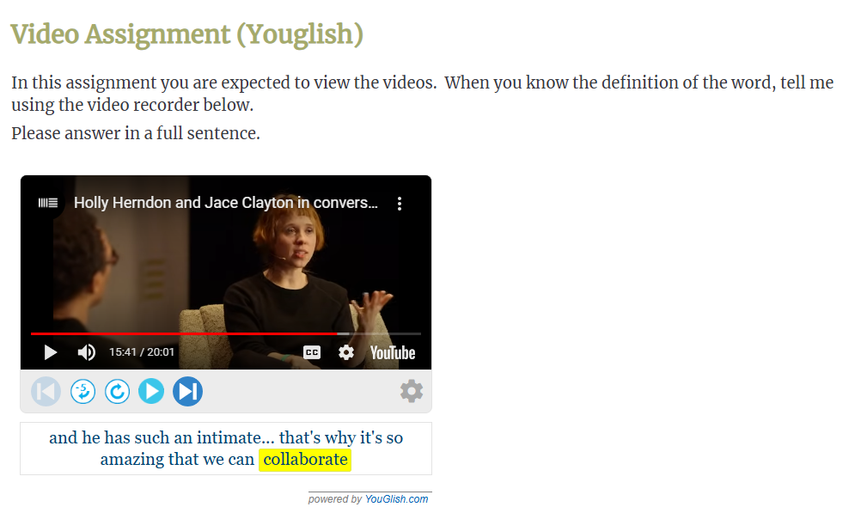
Moodle-Poodll Integrated Assignments
Notes:
innovative ways for students to practice and improve their target language reading, speaking, and vocabulary. By integrating these tools into Moodle courses, more engaging and personalized learning experiences can be available for your students.

Slide 12
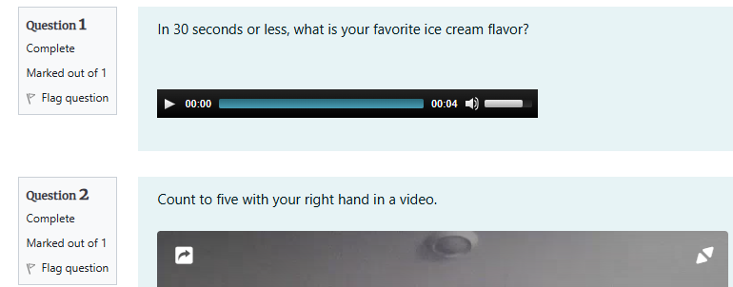
Moodle-Poodll Integrated Quiz
Notes:
innovative ways for students to practice and improve their target language reading, speaking, and vocabulary. By integrating these tools into Moodle courses, more engaging and personalized learning experiences can be available for your students.

Slide 13
Moodle-Poodll Integrated Editing toolbar tools
Record audio Record video Record Screen Widgets
Notes:
innovative ways for students to practice and improve their target language reading, speaking, and vocabulary. By integrating these tools into Moodle courses, more engaging and personalized learning experiences can be available for your students.

Slide 14
Moodle Poodll Integrated widgets
Notes:
innovative ways for students to practice and improve their target language reading, speaking, and vocabulary. By integrating these tools into Moodle courses, more engaging and personalized learning experiences can be available for your students.

Slide 15
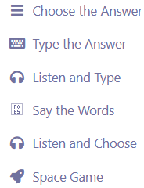
WordCards
vocabulary flashcard & activity sets
students are introduced to and review concepts
practice in various modes

Slide 16
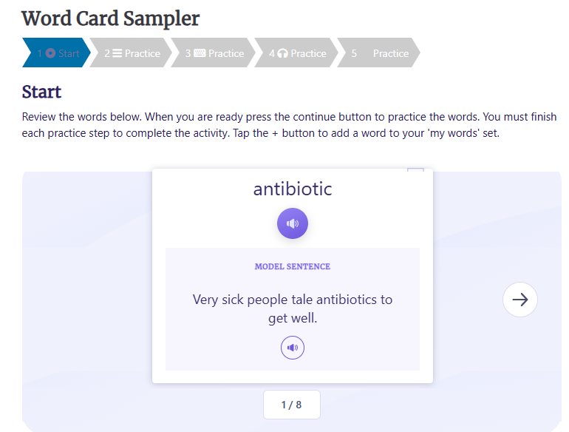
WordCards

Slide 17
ReadAloud
listening activities
AI assessed pronunciation & reading practice
independent learning tool

Slide 18
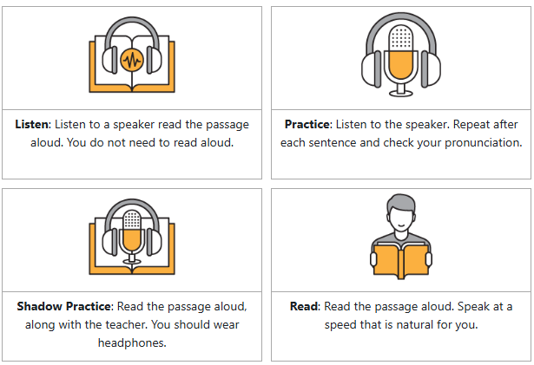
ReadAloud Activities

Slide 19
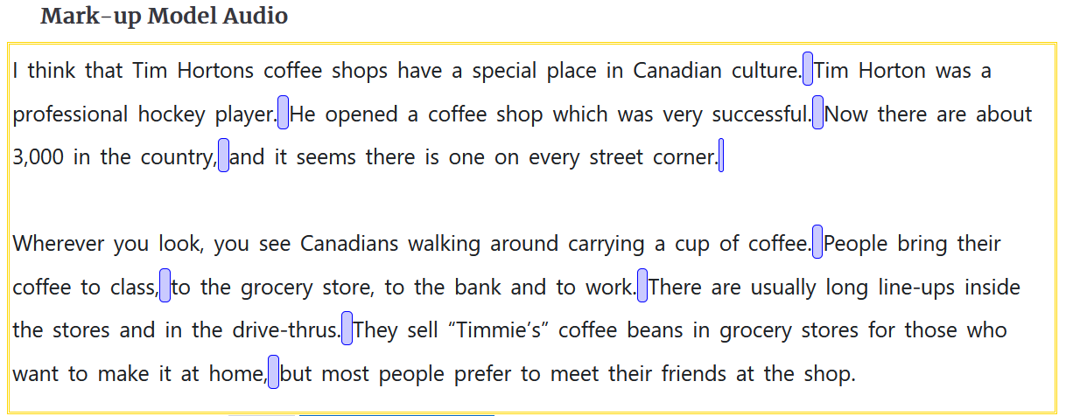
ReadAloud - Model Audio

Slide 20
Solo – AI assessed speaking activity
Prepare
Record
Transcribe
Evaluation/Feedback - Review

Slide 21
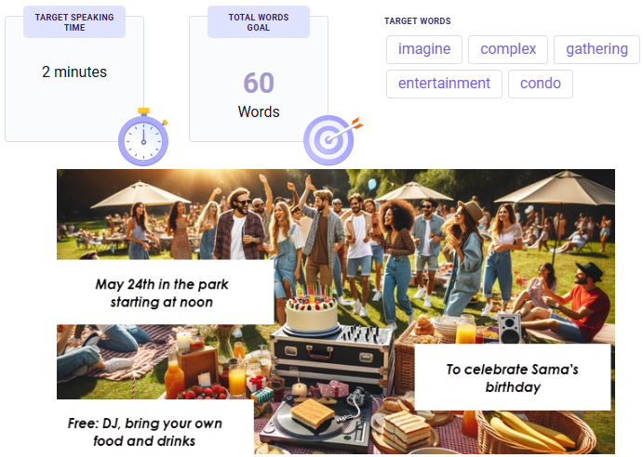
Solo Activity

Slide 22
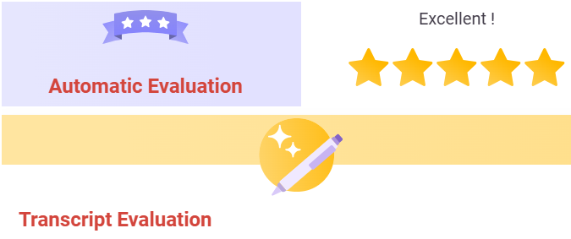
Solo Feedback Evaluation

Slide 23
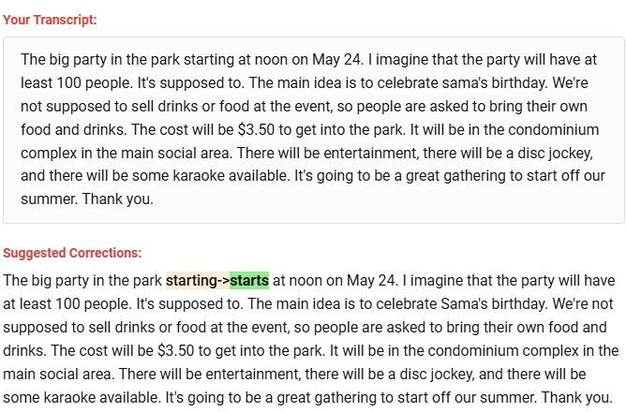
Solo Feedback Evaluation

Slide 24
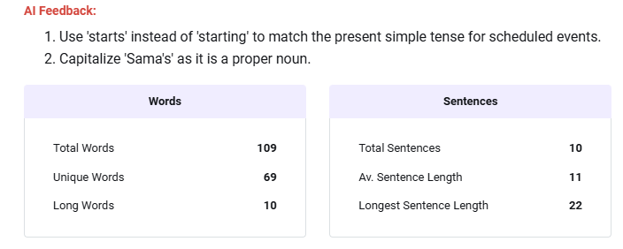
Solo Feedback Evaluation

Slide 25
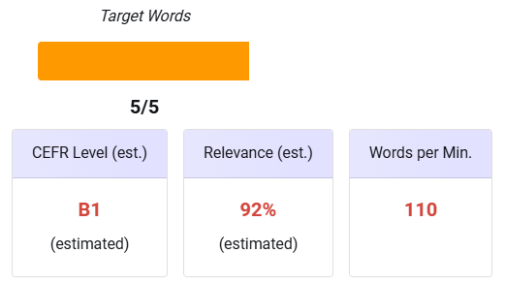
Solo Feedback Evaluation

Slide 26
See and Try – Poodll Media
https://poodll.com/see-and-try

Slide 27
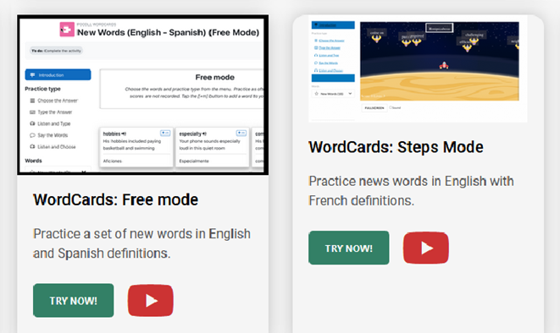
See and Try – Poodll Media
https://poodll.com/see-and-try

Slide 28
See and Try – Poodll Media
https://poodll.com/see-and-try

Slide 29
See and Try – Poodll Media
https://poodll.com/see-and-try

Slide 30
Questions

Slide 31
CanAvenue Examples
https://canavenue.ca

Slide 32
Resources
Poodll, https://poodll.com
Poodll See and Try Poodll for Yourself, https://poodll.com/see-and-try
Youglish, https://youglish.com
Poodll on Moodle Blog Post, https://blog.teslontario.org/poodll-on-moodle

