Slide 1
Cultivating Trauma-Informed Spaces in Education TESL Ontario Webinar May 17, 2023 7- 8p.m.
Nicole Johnson, M.Ed. Professor, Social Service Worker Program, Sheridan College

Slide 2
Land Acknowledgment
I would like to begin by acknowledging the land on which we gather has been and still is the traditional territory of several Indigenous nations, including the Anishinaabe, the Haudenosaunee Confederacy, the Wendat, the Mississaugas of the Credit First Nation, and the Métis. Since time immemorial, numerous Indigenous nations and Indigenous peoples have lived and passed through this territory.
As a settler, I am grateful to be living and working on this land. I recognize it is my collective responsibility to honour and respect those who have gone before us, those who are here, and those who have yet to come. I recognize and pledge to advocate for change by helping to lift the voices of Indigenous people as they fight for the well-being of their communities and in our commitment to Truth and Reconciliation.

Slide 3
Webinar Agenda
Welcome, Introductions & Hopes
What is Trauma & Trauma-Informed Education? Why We Should Care About it as Educators and Learning Professionals
Micro Level Strategies:
Fostering Authentic, Courageous & Safer Spaces
Supporting Choice & Autonomy
Creative & Supportive Curriculum Design
Commitment to Reflective Practice & Growth
Cultivating Individual & Collective Wellness
4. Highlight of Some Macro Strategies
5. Final Thoughts & Questions

Slide 4
I recognize the sensitive nature of trauma and that discussions today may raise a range of emotions.
I encourage you to use grounding/centering tools and wellness strategies if you feel uncomfortable or activated by the content today.
Your well-being is important to me.

Slide 5
Introductions
a) What is your professional role?
b) What are your hopes for this webinar?

Slide 6
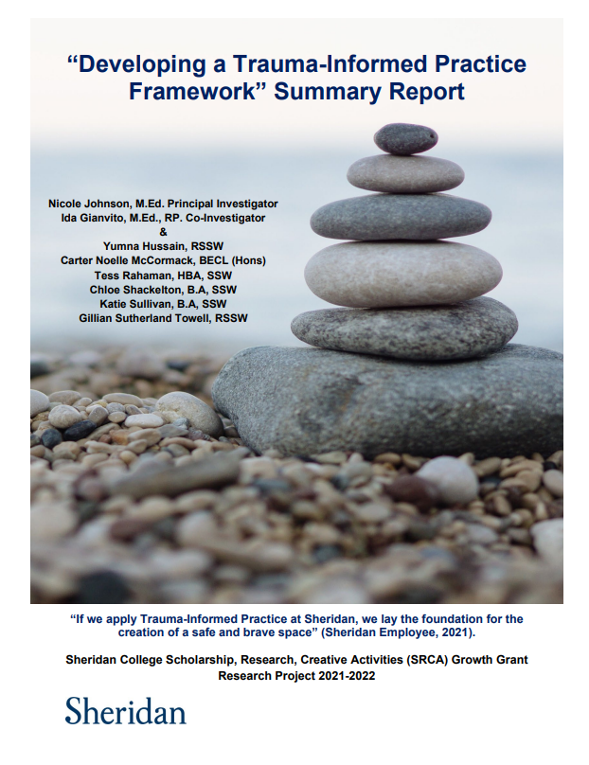
Nicole Johnson (School of Community Studies) & Ida Gianvito (Student Affairs) collaborated on a research project entitled “Developing a Trauma-Informed Practice Framework”. Funded by Sheridan College Scholarship, Research, and Creative Activities (SRCA) 2021-2022 Growth Grant. Goal: To develop proactive measures to enhance student support, and safer learning experiences, and reduce trauma, re-traumatization, and vicarious trauma. Expanded to include employees working in education. Community-driven approach: 18 focus groups; 11 interviews & a Community of Practice Forum with 9 community agencies. Supported by a comprehensive literature review.

Slide 7
Prevalence of Trauma
76% of Canadian adults report some form of trauma exposure in their lifetime (Government of Nova Scotia, 2015).
50% of college students identified being exposed to a potentially traumatizing event in their first year of college (Galatzer-Levy et al., 2012).
47% of students at Canadian post-secondary institutions witnessed or experienced discrimination on the basis of, gender, gender identity, or sexual orientation in the past year (Burczycka, 2020).
71% of students at post-secondary schools across Canada witnessed or experienced unwanted sexualized behaviours in a post-secondary setting (Burczycka, 2020).

Slide 8
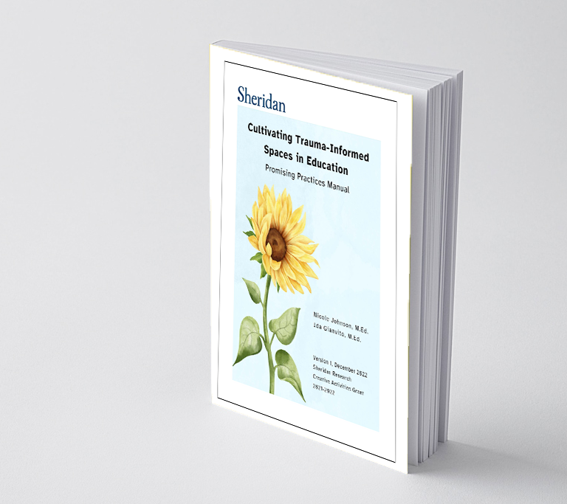
Cultivating Trauma-Informed Spaces in Education Promising Practices Manual
Section 1: Foundation (glossary, information on trauma, Trauma-Informed Practice and Education)
Section 2: Framework and Promising Practices (macro, mezzo and micro level- strategies to implement)
Section 3: Practice Activities (case scenarios, reflective practice, and further reading)
Available on SOURCE at https://source.sheridancollege.ca/centres_sgg_2023_trauma_education/1/

Slide 9
How do you define trauma?
In a few words, or first thoughts.

Slide 10
Our Expanded Definition of Trauma
Trauma is a subjective response to an expected or unexpected event, collection of events, repetitive experiences, or the cumulation of multiple experiences; that compromises an individual’s sense of safety and control (adapted from Klinic Community Health Centre, 2013).
Trauma can take different forms: single incidents, complex or repetitive, developmental, historical, and intergenerational (Klinic Community Health Centre, 2013), and intersects with racism and various forms of oppression.
It is best defined by the person that experiences it.

Slide 11
Our Expanded Definition of Trauma
Trauma responses can impact a person - behaviorally, economically, emotionally, physically, psychologically, relationally, and spiritually.
Trauma can be both an individual and collective experience, often the result of systemic oppression, patriarchy, colonization, and social determinants of health.
Trauma can result from: navigating the very systems intended to support people, including the health care, social service, education, and criminal justice system;from demonstrating empathy and compassion for others.

Slide 12
Trauma-Informed Education Grounded in a Systemic Analysis
Is a multi-faceted pedagogical approach and practice which integrates principles of Equity, Diversity, Inclusion, Anti-Racism and Anti-Oppression, Harm Reduction, and Universal Design of Learning.
It builds upon Harris & Fallot’s (2001) term “Trauma-Informed Practice” and the five core values of trust, safety, choice, collaboration, and empowerment.
Recognizes the prevalent and systemic nature of trauma.
Is a system-wide approach and practice that is best implemented across macro, mezzo, and micro, systems to effect real change.

Slide 13
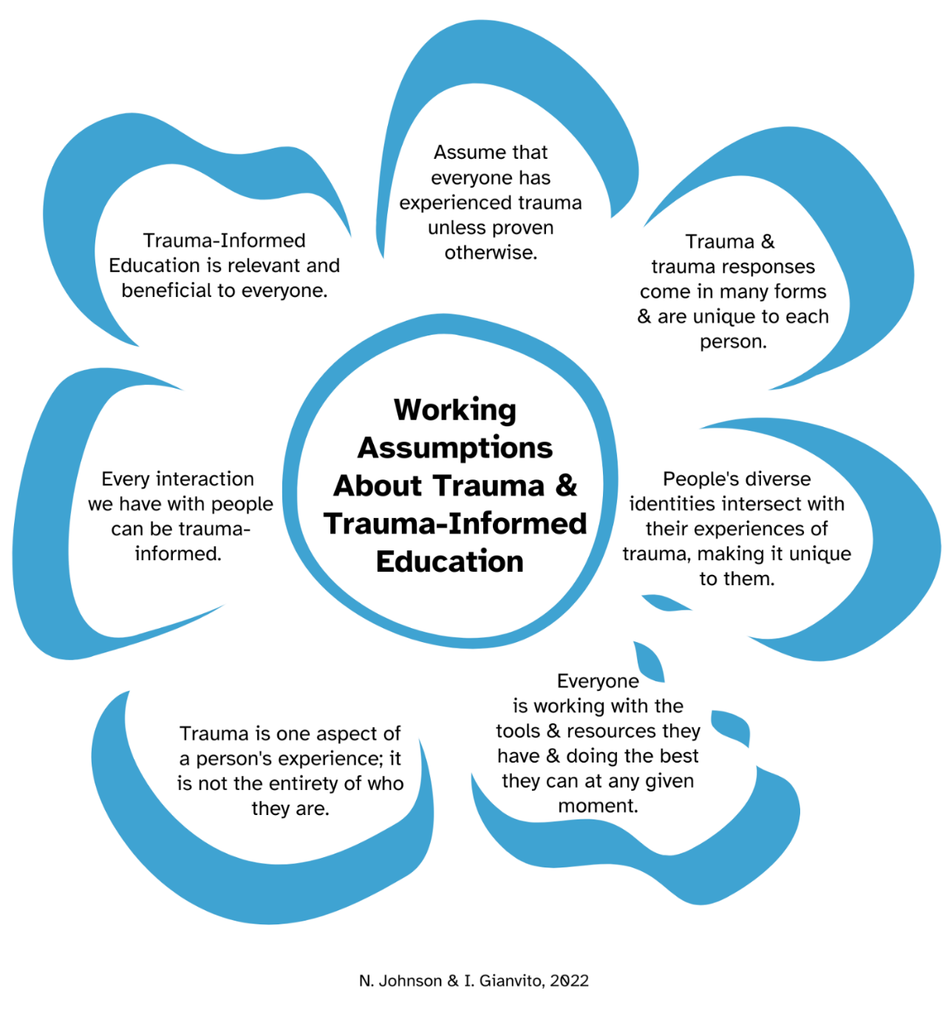
“If we apply Trauma-Informed Practice at Sheridan, we lay the foundation for the creation of a safe and brave space”
(Sheridan Employee, 2021).

Slide 14
Why We Should Care About Trauma-Informed Education
Ministry of Education and various professions are requiring programs to add Trauma-Informed Practice as learning outcomes.
Decreases new trauma experiences, re-traumatization and vicarious trauma. Destigmatizes trauma; values lived experiences.
Supports positive organizational and learning outcomes for students and employees (increased engagement, retention, enhances safety and wellness, healthier communities).
Supports principles and practices of Equity, Diversity, and Inclusion, Anti-Racism, Anti-Oppression, Intersectionality, and Universal Design of Learning. Supports systemic change.

Slide 15
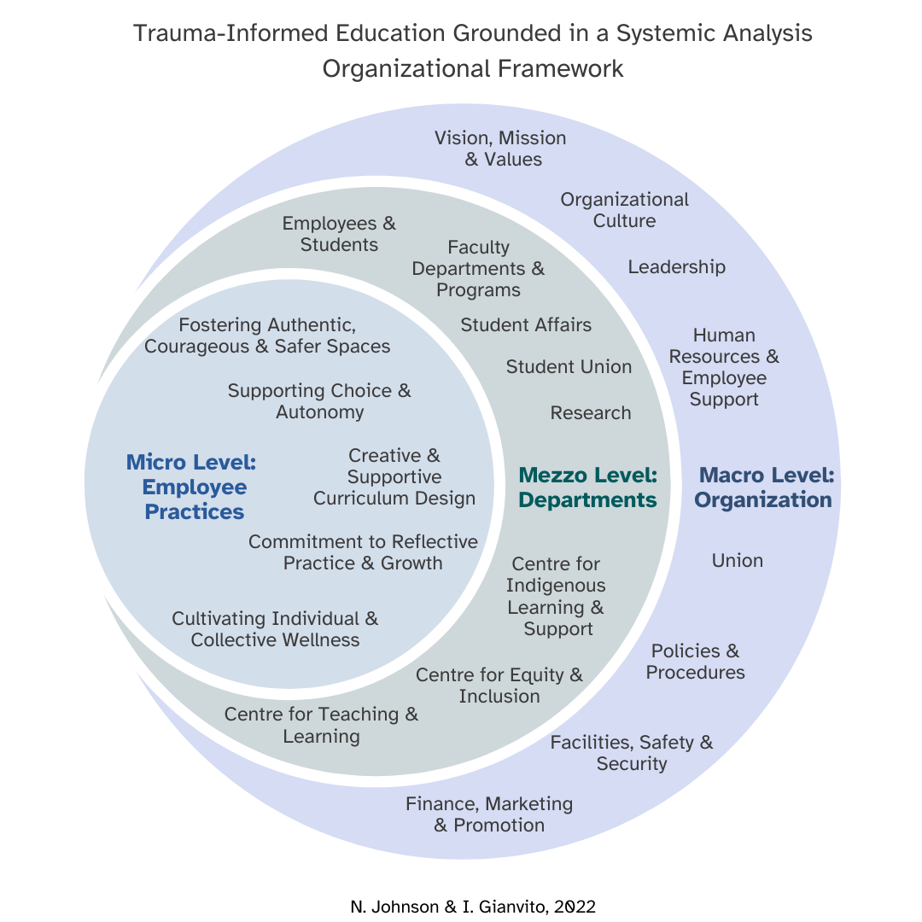
It is important to acknowledge that Trauma Informed Education is not a one size fits all model. Every organization must find what works for them based on their organizational structure, diverse departmental identities, as well as their unique strengths and areas of enhancement.

Slide 16
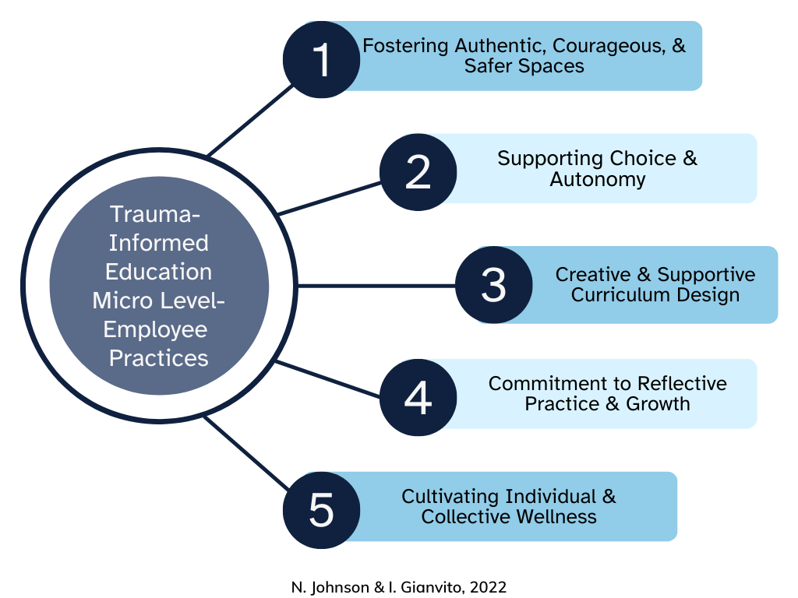
“Trauma-Informed Practice is a way of reaching people with what they need, as opposed to what it is that we think that they need”
(Community Agency, 2021).

Slide 17
As educators, we are often trained to ‘manage student behaviors’ and ‘manage the classroom’. In this context, behaviors are often viewed in labelling, stigmatizing, and deficit-based ways. It also implies the onus is on educators to control and manage people’s diverse ways of being and responding in learning environments.
Often the behaviors we are seeing are trauma responses.
These negative views serve to disempower learners and impact our ability to connect with them.

Slide 18
In your experience, how does trauma manifest itself in the classroom?

Slide 19
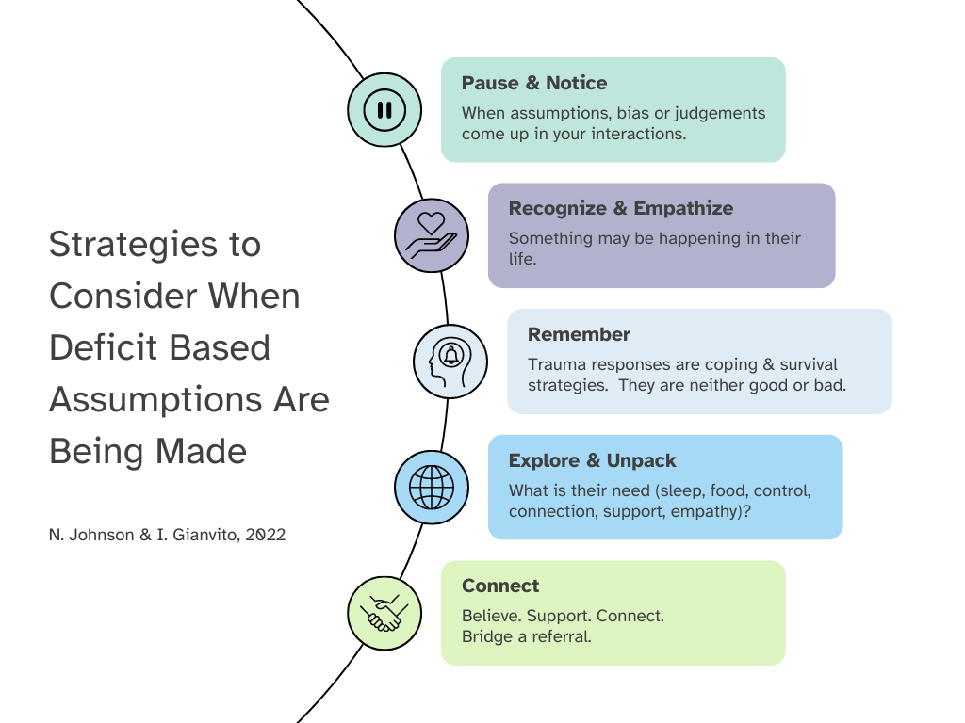
Bring empathy, non-judgment, and understanding to learners’ and employees’ behaviors.
Disrupt deficit-based and pathologizing beliefs about learners and employees.
Reframe behaviors- seeing strengths and survival (coping) strategies.
Assume people’s behavior has a purpose – it might be a pattern or serving them well.

Slide 20
Learner’s may be activated (triggered) by content.
They may miss class or not participate or not submit an assignment.
They may not be in ‘learner mode’ if they feel unsafe.
Recognize the survival responses to trauma (7 f’s - stress responses/survival responses): flock (take cues from environment); flight; fight; freeze (dissociation); flood (overwhelmed with emotion); fawn (people pleasing); flop (unresponsive/faint).
They may not be in their ‘window of tolerance’. Hyper-aroused- outburst of emotions; easily startled; Hypo-aroused-numb, refuse to work with others.

Slide 21
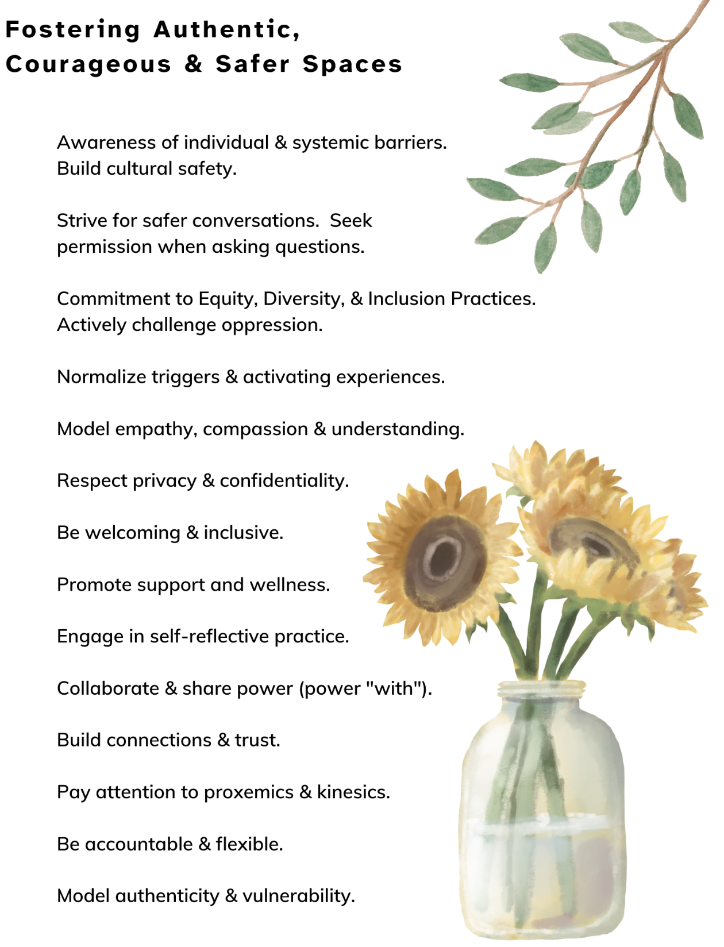
Co-create a power “with” model.
Model inclusive practices (such as gender pronouns; people-first language).
Explore ways for the physical space to be safer (circles).
Be mindful of communication that is minimizing, dismissive, threatening, ridiculing, impatient, disappointing, or power differences (Carello & Butler, 2015).
Address conflict, harm, microaggressions, and oppression. Safety is built upon a space that is committed to social justice and change.

Slide 22
How do you address trauma in your curriculum?

Slide 23
How Do You Address Trauma in your Curriculum?
Re-evaluate your current practices and how your practices may inadvertently cause harm, trauma, re-traumatization, and vicarious trauma (i.e. curriculum violence, shock value stories, rigid policies, documentation, being trauma ‘indifferent’).
Reflect on how you ‘hold’ space, cultivate and contribute to space (social location, practice cultural humility, commit to Anti-Racism and Anti-Oppression, power ‘with’ models).
Provide sensitive content warnings (not trigger warnings) and give notice.

Slide 24
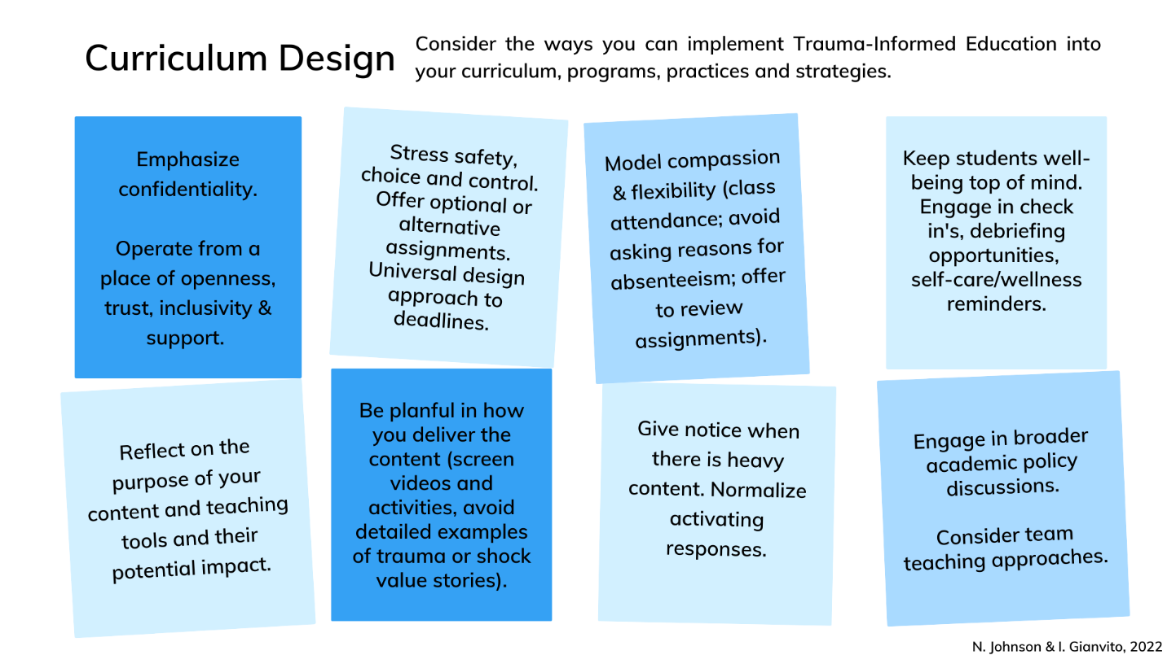
“Students need to feel like they have choices, they have control over some of the things that they get to learn about and choose. Those things support academic outcomes” (Faculty, 2021).

Slide 25
Sample Statements to add to your Course Syllabus
Sensitive Content Note: This course covers various sensitive topics, including trauma and oppression. There may be times when you or your colleagues feel uncomfortable and may experience a range of emotions, thoughts, and reactions. For some, the content may impact you more personally.
Support and Wellness: Your well-being is important to me. I encourage you to explore ways to support your well-being while learning, including wellness strategies and support systems. I can also support you with referrals to Student Services.

Slide 26
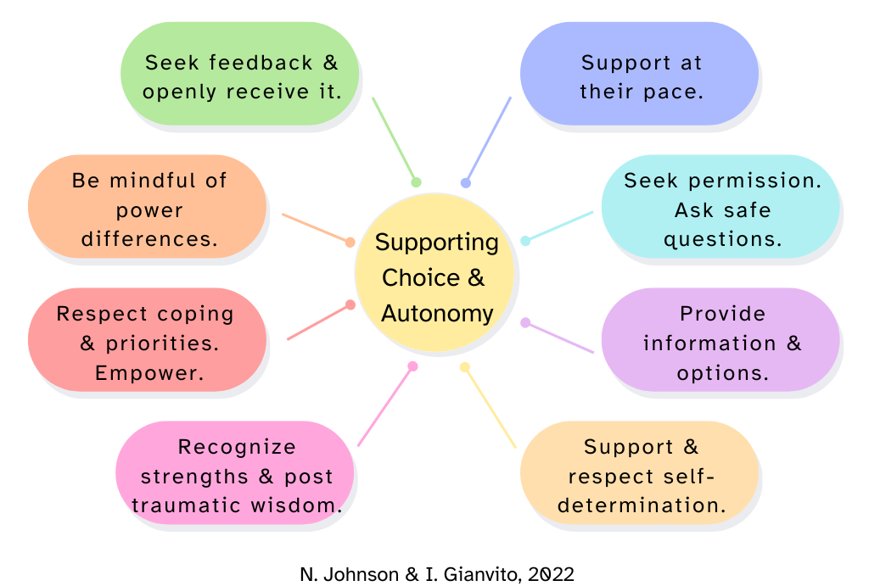
Remind students that they have the power to make their own decisions to support their physical, mental, emotional, and spiritual well-being.
Support body sovereignty.
Ensure students are not retelling their stories if they don’t want to.
Witness and honor someone’s experience without interpreting it or judging it.
Check in with all students as some may not ask for help.
Follow-up to show care and interest in their well-being and success.

Slide 27
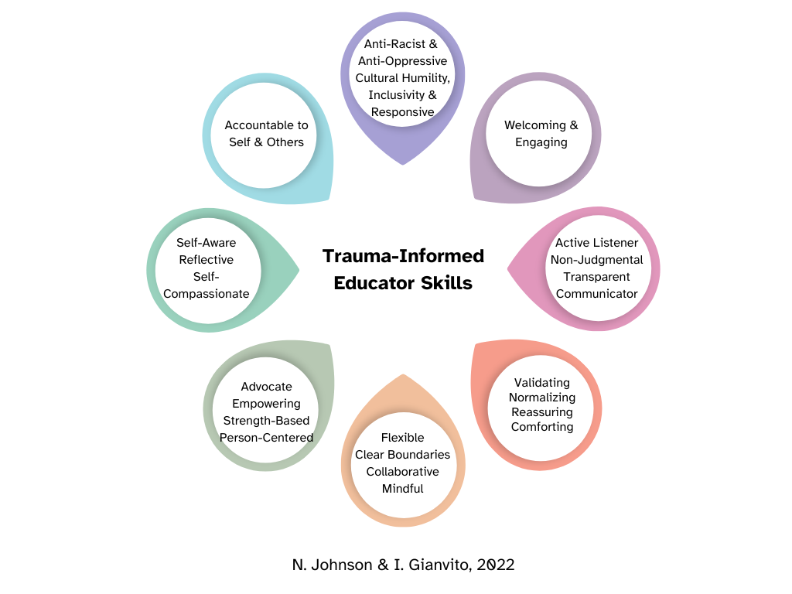
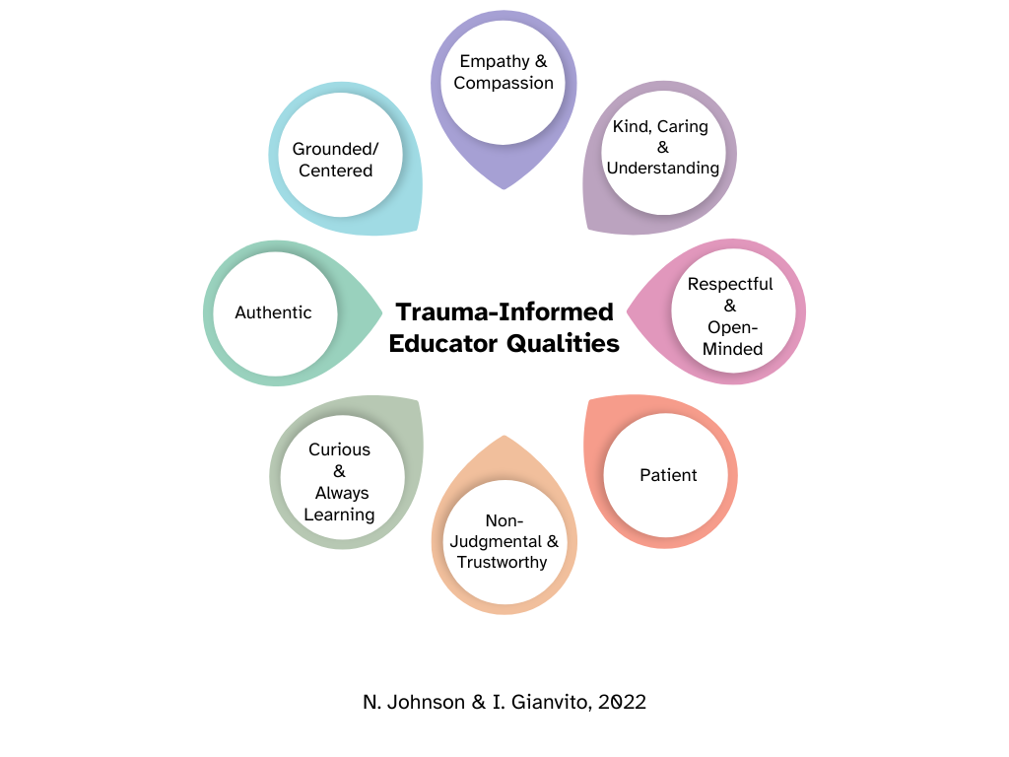
What Trauma-Informed Qualities & Skills
Do You Bring to Your Work?

Slide 28
How do you engage in self-reflective practice as an educator/professional?

Slide 29
Commitment to Self-Reflective Practice & Growth
Consider how you are perpetuating oppression and trauma.
Practice cultural humility (social location, worldview, learning, unlearning, ongoing reflection). Commit to Anti-Racist Education.
Explore courageous vulnerability and stay in tune with the emotions of others and yourself at your own pace.
Reflect on your own lived experiences of trauma and vicarious trauma.
Practice grounding & wellness strategies for yourself. Debrief & connect.

Slide 30
Cultivating Individual & Collective Wellness
“Professors need to be prepared and deal with their own trauma to be prepared to deal with students’ trauma” (Alumni, 2021).
“When I first had a suicide disclosure, it was profoundly traumatic. It affected me for quite some time” (Employee, 2021).
“I've always been a firm believer that student engagement and student experience start with employee engagement and employee experience. If employees feel like they have a safe place to work, then we can provide a safe place for students to learn”
(Faculty, 2021).

Slide 31
How could a Trauma-Informed Education lens be applied to these scenarios?

Slide 32
Scenarios- Consider Ways to Bring a TIE Approach
In this reading and writing course, the students are required to write a descriptive paragraph on their parents along with pictures. A student does not hand it in which seems atypical for this student. The teacher gives them a 0.
For a class activity, the teacher discusses current news to form their class activity. She begins to discuss the wars in Syria, Iran and the Ukraine. A student packs her belongings, stands up and says I don’t know what this has to do with what we are learning, and walks out.
A student walks out of class during a video discussing Racism.
A student tells you they self-injure.
A student tells their teacher the assignment is too personal and they don’t think they can do it.

Slide 33
Some Macro Strategies

Slide 34
Our hope is that educators and educational institutions, through this preventative and harm-reducing approach, can enhance their learning spaces and workplaces to become more compassionate, supportive, equitable and flexible; further supporting the collective care and well-being of the diverse community, while addressing the systemic causes of trauma within and outside of the educational system.

Slide 35
Closing Reflection
What are you taking away from today’s dialogue?
What practices will you continue to do and/or do differently?
How will you commit to self-reflective practice and take care of your wellness in your work?

Slide 36
Acknowledgments
Our research project and Promising Practices Manual were the results of the recommendations and strategies from the research study participants, the literature review, and the researchers.
We are grateful to the many
co-creators of this Manual.

Slide 37
Let’s Connect!
Nicole Johnson
nicole.johnson4@sheridancollege.ca
Ida Gianvito
ida.gianvito@sheridancollege.ca
(On maternity leave until June 2023)
Connect with us on Linked In.

Slide 38
References
Burczycka, M. (2020). Students’ experiences of unwanted sexualized behaviours and sexual assault at postsecondary schools in the Canadian provinces, 2019. Canadian Centre for Justice and Community Safety Statistics. https://www150.statcan.gc.ca/n1/en/pub/85-002-x/2020001/article/00005-eng.pdf?st=2pX9QRnP
Carello, J., & Butler, L. D. (2015). Practicing what we teach: Trauma-informed educational practice. Journal of Teaching in Social Work, 35(3), 262–278. https://doi.org/10.1080/08841233.2015.1030059
Galatzer-Levy, I. R., Burton, C. L., & Bonanno, G. A. (2012). Coping flexibility, potentially traumatic life events, and resilience: A prospective study of college student adjustment. Journal of Social and Clinical Psychology, 31(6), 542–567. https://doi.org/10.1521/jscp.2012.31.6.542
Government of Nova Scotia. (2015, May). Trauma-Informed approaches: An introduction and discussion guide for health and social service providers. https://novascotia.ca/dhw/addictions/documents/TIP_Discussion_Guide_1.pdf
Harris M. & Fallot R. D. (eds). (2001). Using Trauma Theory to Design Service Systems.Jossey-Bass.
Klinic Community Health Centre. (2013). Trauma-Informed: The trauma toolkit, second edition, 2013. Manitoba Trauma Information and Education Centre. Retrieved on November 11, 2022, from https://Trauma-Informed.ca/wp-content/uploads/2013/10/Trauma-Informed_Toolkit.pdf
Photography by Nicole Johnson.

