Slide 1


ChatGPT: Challenges & Opportunities
John Allan, March 28, 2023

Slide 2
Our path
Polls
ChatGPT phenomenon
ChatGPT challenges
ChatGPT opportunities
Questions
What’s next?

Slide 3

Have you informally researched AI or ChatGPT technologies?
YES NO

Slide 4
Are you considering using AI chat technologies to prepare your lessons?
YES NO

Slide 5

Are you considering using AI chat technologies in-class/on-line with your students?
YES NO

Slide 6
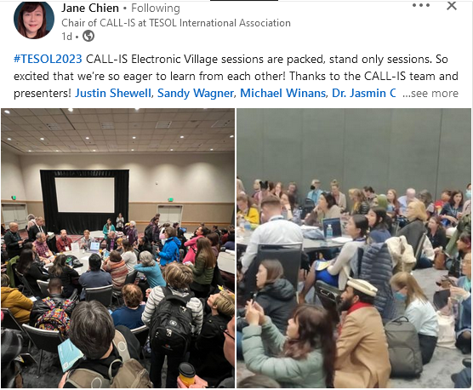
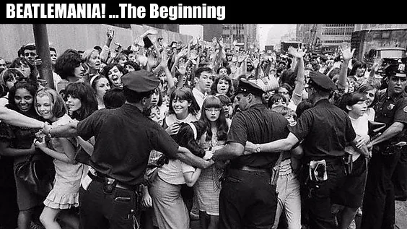
Craze?

Slide 7
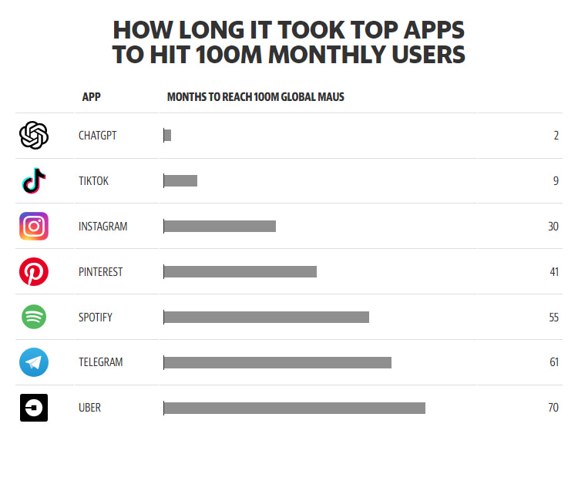
Phenomenon?

Slide 8
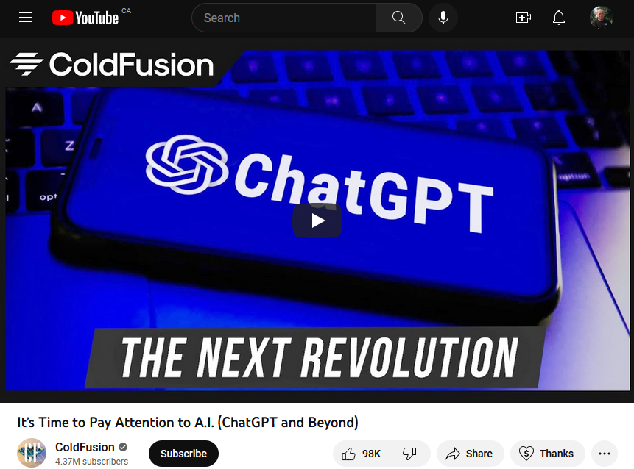
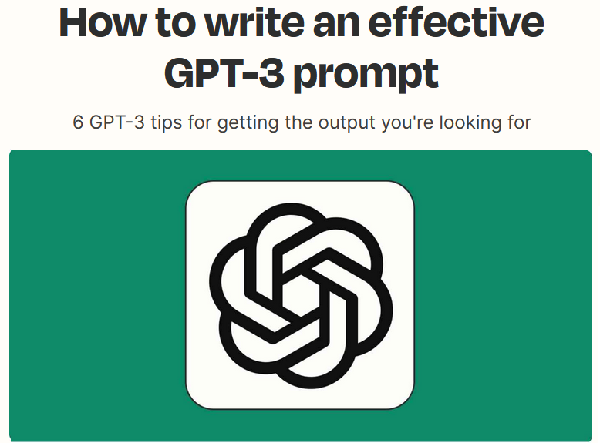

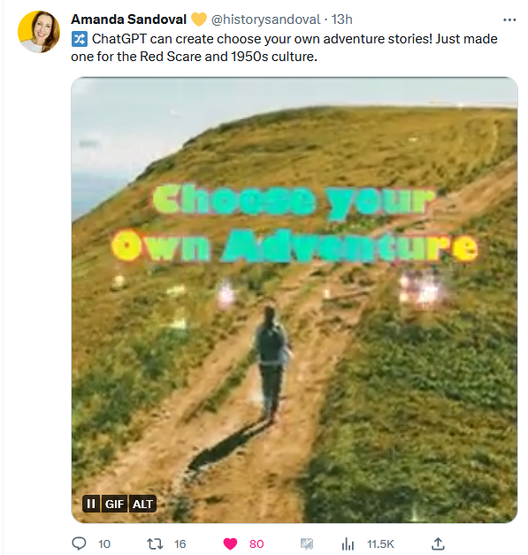
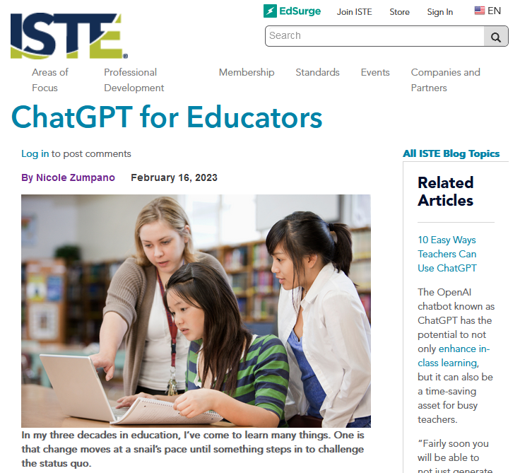
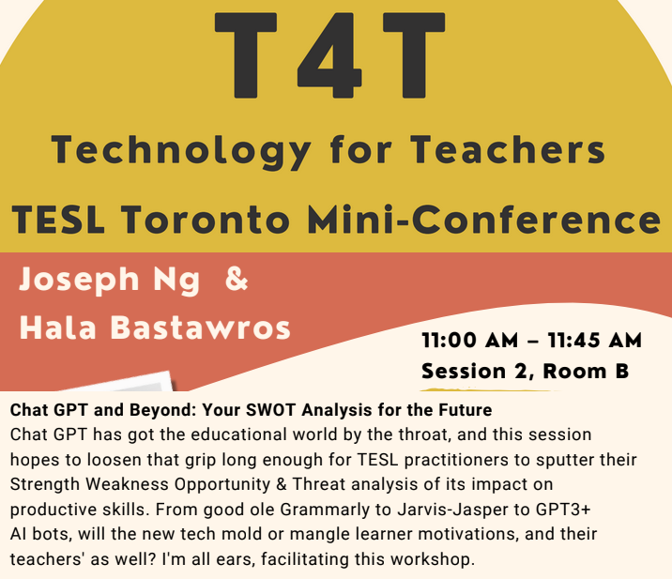
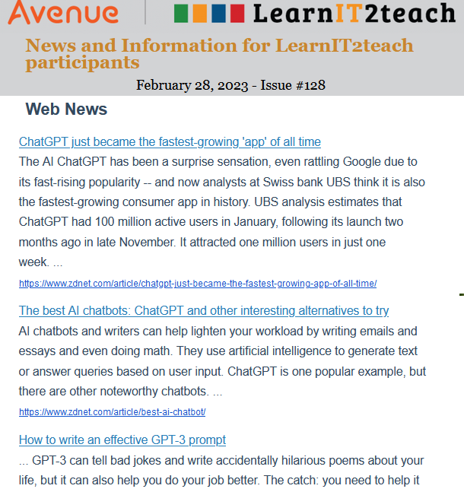
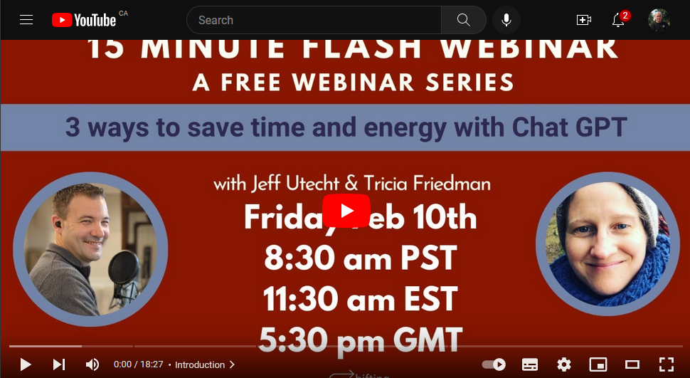
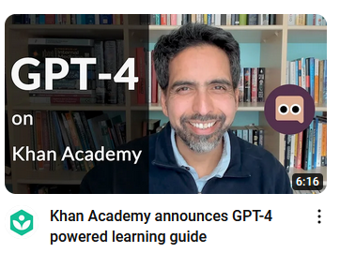
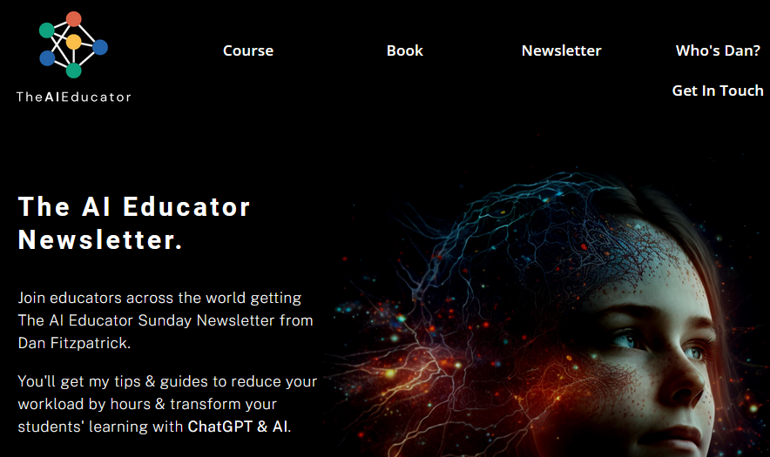
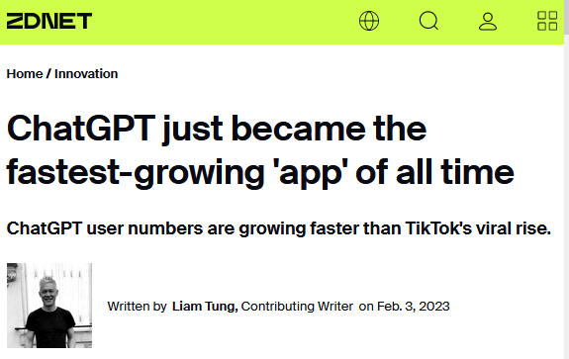
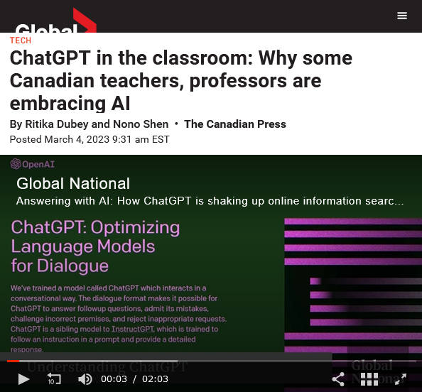
ChatGPT Tsunami?

Slide 9
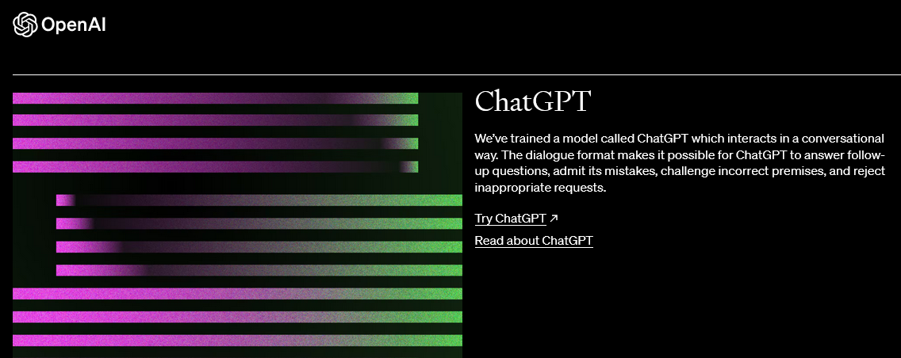
OpenAI’s ChatGPT
Notes:
ChatGPT is an artificial intelligence chatbot developed by OpenAI and launched in November 2022. It is built on top of OpenAI's GPT-3 family of large language models and has been fine-tuned (an approach to transfer learning) using both supervised and reinforcement learning techniques.

Slide 10
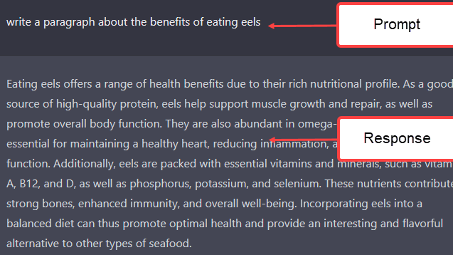

Slide 11

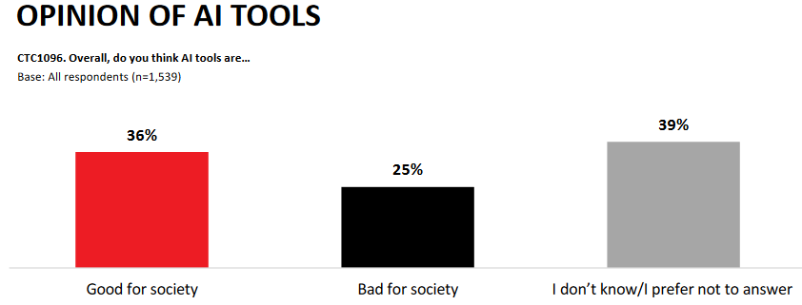
Leger, Feb. 23
1539 Canadians

Slide 12
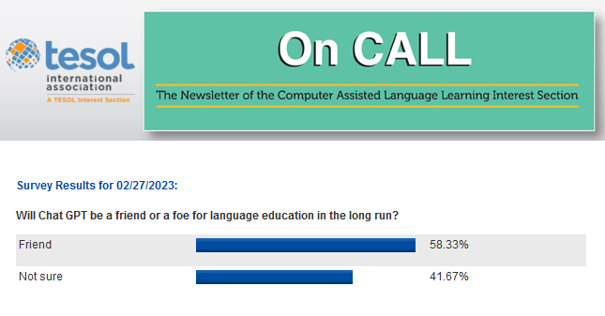

Slide 13
ChatGPT & Language Educators
Challenges vs Opportunities

Slide 14
Challenges
Overreliance
Plagiarism apprehension
Proficiency barriers
ChatGPT limitations & hallucinations

Slide 15
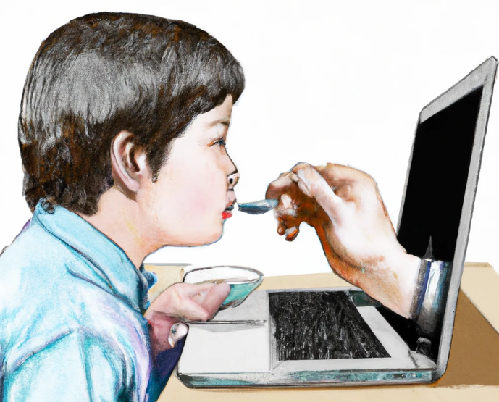
AI overreliance
DALL-E, Prompt = a computer holding a spoon feeds a student as a watercolor

Slide 16
Overreliance
  reduces critical thinking
  lessens problem-solving skills
  stifles creativity & originality
  weakens social skills
  reduces genuine interpersonal language practice
  contributes to a decline in academic integrity

Slide 17
Plagiarism apprehension
complicates the evaluation of submissions
evaluating proficiency (Is it the student’s work?)
  content original or machine generated?
authenticity, will students verify information?
AI (ChatGPT) detectors?

Slide 18
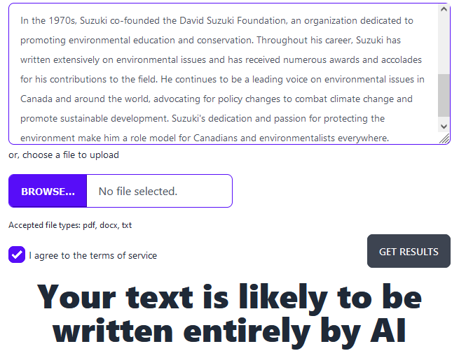
GPTZero

Slide 19
Proficiency may be a barrier
some learners may be at a disadvantage
  language
  prompt formation (engineering)

Slide 20
ChatGPT Limitations
capacity limitations
no emotional intelligence
no knowledge after September 2021
ambiguous language confusion, “I saw her duck.”

Slide 21
ChatGPT Limitations
potentially bias based on its training
limited knowledge based on its training
cannot identify a struggling student

Slide 22
Hallucinations
factually incorrect
nonsensical
unrelated to the prompt
invented events

Slide 23
Factually incorrect
"What is the capital of Italy?"
ChatGPT responds,
"The capital of Italy is Venice."

Slide 24
Nonsensical
"How do I care for my pet rock?“
ChatGPT responds, "To care for your pet rock, be sure to feed it twice a day and provide it with fresh water."

Slide 25
Unrelated answers
A user asks, "How can I improve my running speed?“
ChatGPT responds, "To cook a perfect steak, make sure you let it rest before cutting into it."

Slide 26
Invented events or people
A user asks, "Who won the 2022 World Chess Championship?”
ChatGPT responds, "The 2022 World Chess Championship was won by John Smith."

Slide 27
Possible remedies to AI challenges
Update institutional/organizational policies
Teacher training (patterns, deficits, tools, advantages)
Actively teach ethics of using AI tools (Digital Citizenship)
Integrate AI tools into lessons
Use AI chat detectors
Banning AI in schools

Slide 28
Opportunities (Potential > Risks?)
API integration
Assistant

Slide 29
Opportunities
API integration – additional functionality to existing tools
  Eventually all digital tools

Slide 30
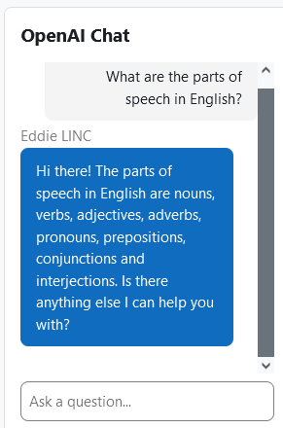
Moodle – (Avenue)

Slide 31
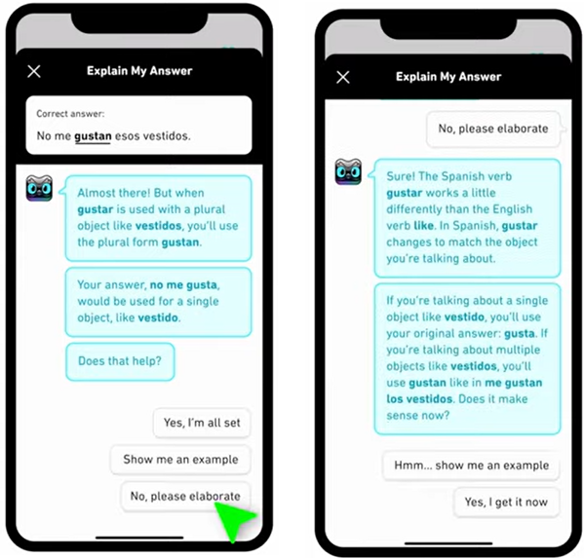
Duolingo
AI tutor

Slide 32
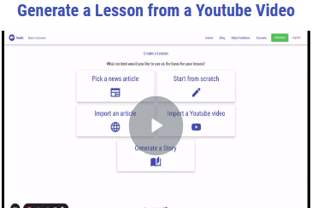
Customized apps – Roshi.ai
Combines ChatGPT with YouTube videos and web content
Produces: Summaries, vocabulary lists, question activities and even H5P course presentations.
CLB - CEFR aligned

Slide 33
Plug ins (extensions)
Allows use of ChatGPT on internet sites
  ChatGPT Writer (respond to Tweets, write tweets, respond to emails,…)
  ChatGPT for Search Engines (enhances web searches, prompt templates)
  Promptheus (Say your ChatGPT prompts)
  YouTube Summary with ChatGPT (Summarizes YouTube videos)
  WebChatGPT Extension (extends ChatGPT to current knowledge)

Slide 34
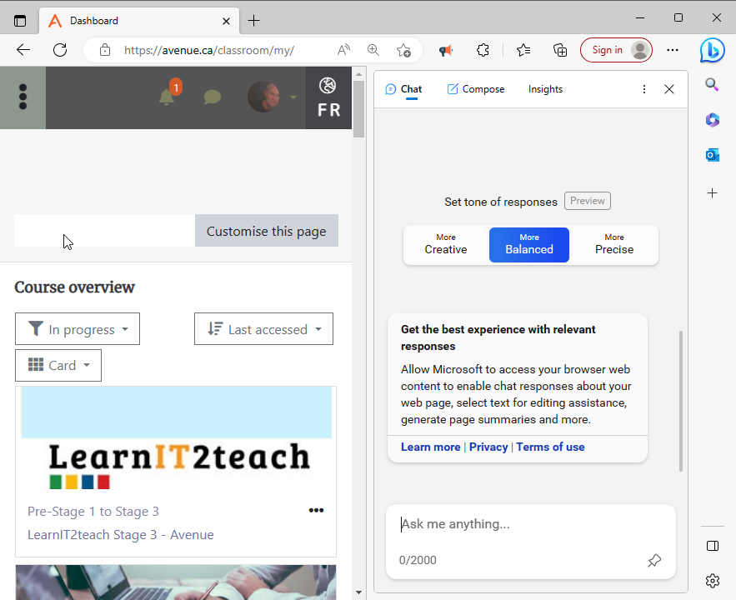

Edge/Bing’s Discover Panel’s Chat

Slide 35
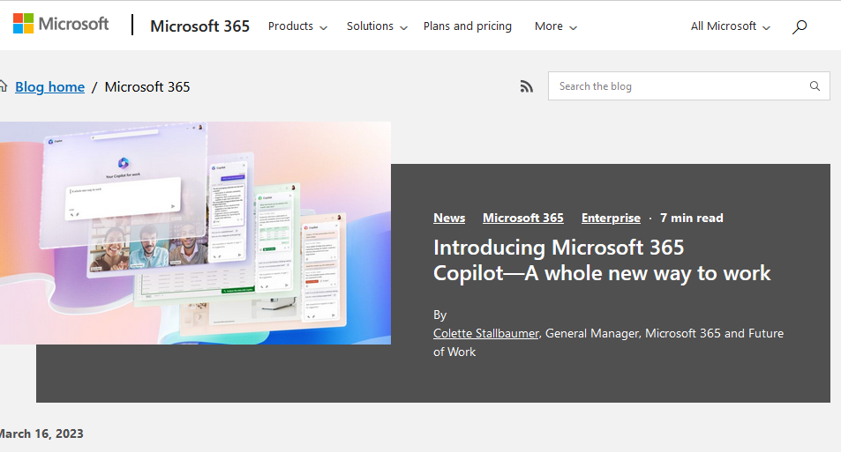

Slide 36
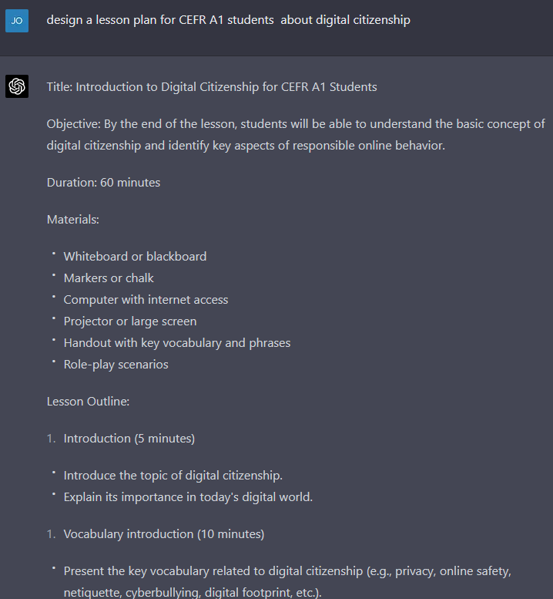
Efficiency - Planning
Unit outlines
Lesson plans
Slide shows
Simplify topics
Discussion questions

Slide 37

Your digital assistant
Joshua Sortino on Unsplash

Slide 38
Efficiency – Handouts & class materials
Develop instructions
Generate assignment directions
Create solved examples
Build a prereading or advance organizer by extracting critical and unfamiliar vocabulary from a chapter and listing keywords with their definitions.
Compose a syllabus that includes a course schedule, late-submission policies, and a description of how assignments will be graded.
Make flash cards
Produce posters

Slide 39
Customized content / assessments / activities
Tailor learning events to students’ interests
01
Include local culture
02
Use students' names and locations in learning objects
03

Slide 40
Efficiency – Streamline Communication
with parents, colleagues & administrators
  welcome-to-class letters
  newsletter content
  volunteer requests
  field trip proposals
  permission sheets

Slide 41
Efficiency – Writing
Prompt generator: The tool can compose writing prompts for any genre and include a corresponding rubric.
Essay improvement: Submit sections of student writing to ChatGPT, and it will suggest enhancements.
Grammar feedback: When students make grammar errors, teachers can direct ChatGPT to define, describe, and identify how to improve the error and provide examples.

Slide 42
Efficiency - Assessments
Quizzes: a test bank and answer key
Rubrics: for any type of student performance
Checklists: from observation checklists to To do’s
All question types: cloze, multiple choice, true or false, fill-in-the-blank, matching, short answer, essay, ordering, multiple answer, drag and drop, crosswords, scenario-based questions, …
Tests/exams: based on known content or levels

Slide 43
Assignments (teachers’ time saver)
Ask Chat GPT to
  Make an essay question/assignment brief
  Create rubric
  Produce an exemplar essay/assignment
  Grade student essays/assignments
  Provide feedback comments on student essays

Slide 44
More Educator Opportunities
Personal Assistant: Lesson/materials preparation, Assessments,
Slideshow presentations
Use Chat GPT as a teachable moments (limitations, ethics, citations)
Generates personalized study guides
Summarize bodies of text (research papers)

Slide 45
Even More Educator Opportunities
Explains concepts well and provides examples
Generates feedback on student work
Generates questions and prompts to facilitate discussion
Pre-reading vocabulary generator
Speeds up course or unit creation

Slide 46
Student Opportunities
Personalized learning
Language exchange partner (text chat)
Define vocabulary, grammar, parts of speech, …
Suggests reading materials at a suitable level
Provides instant answers
Research help: summarizes books, articles, data sources
Students can anticipate/predict ChatGPT responses to self-study

Slide 47

Want more AI for language educators? Coming up:
ChatGPT as a Language Teacher's Assistant
Apr 05, 2023 07:00 PM EDT

Slide 48

Want more AI for language educators? Coming up:
Apr 05, 2023 09:30 AM EDT
4 sessions
TESL Niagara

Slide 49

Solutions?
Photo by Thought Catalog on Unsplash

Slide 50
Resources
Podcastle: Makes computer based studio-quality recordings, https://podcastle.ai
Vidyo: Makes short-form videos from long-form content, https://vidyo.ai
Maverick: Generates personalized videos at scale, https://lnkd.in/eptCVijb
Soundraw: Creating original music, https://soundraw.io
Otter: Capturing and sharing insights from meetings, https://otter.ai

Slide 51
AI Tools
VoicePen AI: Converts audio content into blog posts, using AI, https://voicepen.ai
Krisp: Removes background voices, noises, and echo from calls, https://krisp.ai
Beatoven: Creating custom royalty-free music, https://www.beatoven.ai
Cleanvoice: Automatically edits podcast episodes, https://cleanvoice.ai
Podcastle: Studio-quality recording from your computer, https://podcastle.ai

Slide 52
AI Design Tools
Flair: Helps design branded content, https://flair.ai
Illustroke: Creates vector images from text prompts, https://illustroke.com
Stockimg: Generates the perfect stock photo, https://stockimg.ai
Looka: AI tool for designing your brand, https://looka.com
DALL-E2: Creates realistic images & art, https://openai.com/product/dall-e-2

Slide 53
Resources
Ledger Survey, https://tinyurl.com/2p97krpx

Slide 54
Detection Tools
Content at Scale, https://contentatscale.ai/ai-content-detector
Draft & Goal, https://detector.dng.ai
ZeroGPT, https://www.zerogpt.com

Slide 55
Plug-ins (Extensions)
ChatGPT Writer - https://chatgptwriter.ai
ChatGPT for search engines - https://chatonai.org
Promptheus - https://tinyurl.com/5n856yxf
YouTube Summary - https://tinyurl.com/2f7rdwv3
WebChatGPT - https://tinyurl.com/yt38kzju

Slide 56
Unanswered questions

Slide 57
Question 1
How to define academic integrity? Do drone/UAV flyers qualify as pilots? Do high-flying prompt whisperers qualify as scholars?
Yes, redefining academic integrity may be one of the first issues that our profession may have to examine in this turbulent time.

Slide 58
Question 2
Do you think use of ChatGPT will give rise to 'plagarism'?.
Yes, I think the attempts at plagiarism are increasing as these tools make generating all sorts of text responses too easy. It is our duty as educators to learn these technologies intimately to know how we can identify, communicate and prevent plagiarized submissions.

Slide 59
Question 3
Can Chat GPT be used for teaching CLB 1-4 learners?
Yes, it can be if LINC educators learn these technologies intimately to know how we can shape out learning objects to appropriate levels. .

Slide 60
Question 4
Can you ask ChatGPT to use different spelling i.e. American, British, Canadian?
Yes, you can.

Slide 61
Question 5
Will we have access to this slideshow?
Yes, you do , if you are reading this!

Slide 62
Question 6
Are the Plug ins links included in this slideshow?
Yes, they are – in the resources at the end.

Slide 63
Question 7
What program can I install on my computer to detect if a learner has used Chat GPT on a writing assignment?
Do not install software, use the freely available web pages listed in the resources of this PPT.

Slide 64
Question 8
We’re talking about how TEACHERS will use this - How do you think ADMIN will use it?
Administrators have a myriad of options to make their tasks more efficient. This can include communications, reports, recommendations, lists, and any other administrative documents.

Slide 65
Question 9
is it considered assistive technology for learning disabilities
AI can certainly be assistive as it can provide information. At this time, I am sure that software developers are creating enhancements on their apps and programs utilizing the ChatGPT AI. As for the tool itself, ChatGPT, one of the plug-ins introduced at this session allowed users to speak prompts rather than typing them. This is an example of a step towards digital accessibility.

Slide 66
Question 10
If we use Chatgpt to grade writing does the writing samples become part of the database
Yes, they would. That is why it is important to coach students not to use personal information.

Slide 67
Question 11
If Chat GPT makes stuff up, how can w etrustit to grade studnets' answers?
Yes, you cannot trust a machine. Anything that comes from AI technology should be vetted by humans with the relevant expertise.

Slide 68
Question 12
You described ChatGPT as a potential teacher's assistant. What are your thoughts about ChatGPT becoming the teacher? Could the human teacher role become less in demand?
At best, ChatGPT could be a tutor. It would not be able to read the student’s physical responses to indicate fatigue, success, disappointment…. Even as a tutor, AI is limited. However, for targeted objectives, it may be very useful, especially in the sciences and math

Slide 69
Question 13
How do teachers change their learning strategies so students have to actually retain what AI created?
ChatGPT generates all sorts of learning events. These can be segmented to prove learners with the basis for an independent project that they would incorporate generated information/data into a social-constructivist final project. In using the information to create something original, the students would have a good chance of retaining the concepts or data.

Slide 70
Question 14
What you'e saying is that we need to embrace ths change - right?
I think we can embrace it with our fingers crossed behind our back. We should learn opportunities and challenge so that we are not manipulated or fooled by the technology or our students. We can also take advantage of the myriad of potential that these tools offer us.

Slide 71
Question 15
So much of “Education” and “Higher Education” has become problemaic….because of the inflated access etc…loswered standards,McUniversity…standardised tests - there’s long been criticism…Don’t you think this will “disrupt” the whole of “education”……in a positive way?
Disruptions can be destructive or invigorative. I am sure that there are already and will be more problems caused by the more recent chat AI technologies. It is an opportunity for us to make this technology work for us and our learners in a responsible way.

Slide 72
Question 16
Would it be possible for you to do an online webinar with more details on the practical uses of CHaGPT - such as the ones that will be in person in Niagra on April 29th?
The Tutela.ca webinar on April 5th is very practical for language educators.

Slide 73
Question 17
Does it format or just provide text? for example would it produce a document complying with the accessibility standards?
At this time, only expect ChatGPT to generate text, although this is changing with plug ins and API created apps. Therefore, it would be unrealistic to expect text that will be used in other digital spaces to meet accessibility standards. These are the responsibility of the digital designer at this time.

Slide 74
Question 18
It could be Audio, Image, Linguistic - yes/
With API created apps many things are now possible. Look online t see the opportunities offered with these new tools. Over 200 new apps were published last week alone.

Slide 75
Question 19
Is is wise to heavily depend on something proprietary? Plus, who owns the content produced by ChatGPT?
ChatGPT isn’t exactly proprietary. It is an open technology. It will be the apps and software using its API that will make content proprietary. I am also interested to know, who really owns what in this new digital landscape. It think a few legal challenges will sort this out.

Slide 76
Question 20
You said ChatGPT can give students grammar answers and examples tailored to their level. How does it gauge
Language standards are already a part of the ChatGPT language model. Just refer to a CEFR or IELTs level to see the results. I think the CLBs are mapped to the pre-2012 CLBs. Which is a problem at the moment.

