Slide 1
Taking aim–getting meaningful results from your research
Gordon Moulden
Trinity Western University

Slide 2
Presenter
born and raised in Vancouver, BC
over twenty-years experience as an EFL/ESL teacher in Japan and Canada
taught mostly at college level in Japan teaching courses covering a range of skills (L, S. R. W)
taught settlement English courses in Metro Vancouver as well as after-school courses for ESL students and ESL for missionary trainees.
have served as instructor for research methods, assessment, and leadership courses in the MA TESOL Program at TWU for eleven years.
Professional interests: elements of credibility in assessment and in research, promoting professional development in teachers
Have a professional blog: https://tesol.solutions/

Slide 3
Research experience
Perceptual learning style preferences of Japanese university students
An evaluation of language policy in a bilingual school (Dissertation)
An Investigation into the effects of COVID-related school policies on the teaching and learning of English
A Survey of Volunteers working in church-based ESL Programs

Slide 4
As the instructor for the Research Methods course in the MA TESOL Program at TWU, I view research as a valuable tool for teachers.
The purpose of this webinar is to illustrate how to get meaningful results from research so as to illustrate its value.

Slide 5
Let’s begin with a poll:
"How many of you have experience doing classroom research?"

Slide 6
OK; some essential points.

Slide 7
As I do with my students, I would like to dispel some myths about research. I took my first course in research methods as an EFL teacher with no idea of what educational research involves.
It is very different from research in the sciences and business.

Slide 8
Research Myths
1. All research studies involve statistics.
2. I can’t do research because I’m lousy at math.
3. All good research involves a large group of participants.

Slide 9
Research truths (1)
Good research . . .
  has a clear focus and purpose
  fills a knowledge gap
  is well designed
  meets ethical guidelines
  involves careful selection of participants
  features careful data collection and analysis

Slide 10
Research truths (2)
Good research . . .
  meets quality criteria based on its design
  arrives at a logical conclusion
  includes a specific statement of caveats/limitations
  points to future research
  is thoroughly reported so that its content is understood
  and its procedures replicable if desired.

Slide 11
Educational Research
is unique because . . .

Slide 12
People
are NOT laboratory rats,
do NOT fit in test tubes,
and behave in unpredictable ways!
Learning
is likewise unpredictable and variable,
is affected by social, cognitive, and affective factors,
is beyond complete control of the researcher,
but can be investigated by a variety of means, making use of different approaches and designs.

Slide 13
So, how can research help teachers?
Webster’s Dictionary defines learn as follows: “To gain knowledge or information of; to ascertain by inquiry, study, or investigation”.¹
Such a definition allows us to view research as a learning activity.
¹Webster's 1913 Dictionary (2022, August 10). Learn definition. http://www.webster-dictionary.org/definition/learn

Slide 14
Research can thus be a valuable source of knowledge for teachers.
Here is my professional motto, which I share with my students:
Knowledge feeds practice.
Knowledge-based practice builds excellence.
Excellence breeds fruitfulness.

Slide 15
“I’m interested in doing some research.
How do I get started?”

Slide 16
The first question to ask is:
“How can I do research that will get meaningful results?”

Slide 17
Meaningful results are obtainable when:
1. they contribute to the professional development of the researcher(s) involved and those are impacted by them through
their application in the classroom.
their being shared with others in the professional community through workshops, conferences, webinars, and/or articles.
2. the research is conducted in a manner that gives it credibility (”believe” ability) in the eyes of the professional community,

Slide 18
Promoting professional development through research

Slide 19
The primary way in which research helps us as teachers is by fostering our professional development.

Slide 20
The other three benefits of research identified in the “knife” image–knowledge expansion, greater creativity, identification of solutions to learning problems–serve that general purpose (professional development).

Slide 21
Knowledge expansion
Doing research will always help in this area. For example, a good deal of SLA research has taken place in the classroom, focusing on a single learner or learner group. Currently, interest in the pedagogical effects of online instruction, both synchronous and asynchronous, has increased due to classroom-access restrictions during the COVID pandemic. This provides both an opportunity and a need for research.

Slide 22
Sample studies
A study in Jordan on the effects of online learning on the social and linguistic aspects of second language development .²
A Vietnamese study comparing students’ opinions of task-based teaching to traditional instruction in both online and in-person environments³
²Attiyat, N. M. A., Abu-Snoubar, T. K., Al-Shboul, Y., & Ismael, M. M. H. (2022). COVID-19 Outbreak, State of a Questionable Dilemma, or a Learning Escape: Second Language Acquisition Within Virtual Learning and Social Contact. Theory & Practice in Language Studies, 12(6), 1098–1106. https://doi-org.twu.idm.oclc.org/10.17507/tpls.1206.09
³Nguyễn Nhật Quang, Phạm Nhật Linh, & Nguyễn Thị Thu Hiền. (2022). Tasks, self-efficacy, and L2 motivational self system in an online emergency EFL speaking class: A mixed-methods study. Japan Association for Language Teaching Computer Assisted Language Learning Journal (JALT CALL Journal), 18(1), 1–33. https://doi-org.twu.idm.oclc.org/10.29140/jaltcall.v18n1.518

Slide 23
Pedagogical Creativity
Creativity is critical to teacher success, as a means of using more effective ways of enhancing learner engagement and skill development. Experimenting with materials and task ideas can be very helpful for helping teachers to increase their pedagogical skills.

Slide 24
Sample studies
a study of the impact of an online flipped learning approach on assessment and learning in a graduate nursing program in the U.S.⁴
a professor in a blended geography course at an English university used technology and a learning management system to promote effective interaction between online and in-class students⁵
⁴Murphy, N., Strong, C., & Jones, G. (2022). Flipped learning: A shift in graduate nursing education. Journal of the American Association of Nurse Practitioners, 34(1), 135–141. https://doi-org.twu.idm.oclc.org/10.1097/JXX.0000000000000581
⁵Thomas, M., & Bryson, J. R. (2021). Combining Proximate with Online Learning in Real-Time: Ambidextrous Teaching and Pathways towards Inclusion during COVID-19 Restrictions and Beyond. Journal of Geography in Higher Education, 45(3), 446–464.

Slide 25
Learning Solutions
Perhaps the best known benefit of classroom research is its potential at helping teachers find solutions to issues impacting learning in their classrooms. This form of research is generally referred to as “action research”. Rather than being knowledge focused, as most research is, it is solution oriented, as a teacher attempts to address an issue hindering learning in a particular class.

Slide 26
Sample studies
An Ecuadorian study revealed that exchanging letters with epals had a positive effect on the writing skills of EFL high-school students.⁶
A study of Thai high schoolers found that crossword puzzles were helpful for improving their knowledge of English vocabulary in the area of science.⁷
an Indonesian study of third grade EFL learners found that flash cards were useful for helping learners struggling to learn the simple present tense⁸
⁶ Quezada, K. V., & Santillán, J. J. (2021). Effects of epals practices on EFL writing. An action research study with Ecuadorian students.
Journal of Language & Linguistics Studies, 17, 1–17. https://doi-org.twu.idm.oclc.org/10.17263/jlls.903292
⁷ Kruawong, T., & Soontornwipast, K. (2021). The Development of Thai EFL Secondary School Students’ English Science Vocabulary Knowledge
through Science Vocabul
⁸Sartika, M. (2020). Increasing Third Grade’s Mastery of Simple Present Tense Using Flashcards. Journal of English Teaching, 6(1), 40–49.
ary Crossword Puzzle (SVCP) Practices: Action Research. Shanlax International Journal of Education, 9 (4), 44–54.

Slide 27
Having discussed the means by which research can contribute significantly (meaningfully) to a teacher’s professional development, I will now focus on the matter of research credibility, that is, the important of obtaining results that are believable to the minds of those evaluating the overall quality of a study.

Slide 28
Research credibility depends on the quality of the process: that is, on making the right choices when planning and carrying out a study, and on drawing the right conclusion(s) when reviewing the results.

Slide 29
Here are the criteria that need to be fulfilled–the steps to follow–for doing research that has high credibility
Criterion #1: selecting the right research approach
Criterion #2: selecting the right research design
Criterion #3: displaying knowledge of relevant theory, research, and research gap
Criterion #4: stating appropriate research questions/statements and hypotheses
Criterion #5: designing or adapting appropriate and well-constructed data-collection tools
Criterion #6: carrying out suitable and sound research procedures
Criterion #7: conducting appropriate data analyses
Criterion #8: making appropriate interpretations and conclusions

Slide 30
Criterion #1: selecting the right research approach
The researcher’s first question when planning a study must be:
“What do I want to do?”
This question leads to the approach, which may lend itself
to a qualitative or quantitative design. A mixed methods
design is also possible, depending on the study.

Slide 31
Research Approaches
What do you want to do?
Study a program or a group of learners as is:
This calls for a naturalistic approach.
Study relationships among factors affecting learning. This requires a correlational or multivariate approach.
Study the effects of a technique or educational material on learning. This requires an experimental approach.
Explore a possible solution to an issue affecting learning in your classroom. This calls for an action research approach.

Slide 32
Research Approaches
Each research approach has particular strengths.
Approach | Why choose this approach?
Naturalistic | Provides opportunity to observe learning as it happens and to understand it “as is”. As well, opportunity to gain an emic, insiders’ perspective to gain more insight Inductive process permits opportunity to allow the data, insiders’ perspectives to guide understanding Both ”big picture” and ”up close and personal” designs possible
Correlationnal/ Multivariate | Allows the researcher to exam relationships among multiple factors affecting learning Is not much affected by subjective views of informants Use of a large number of well-selected participants permits opportunity to make claims for generalizability in many cases.
Experimental | Useful for testing effectiveness of a particular technique or teaching material A large experiment with well-selected participants permits claims for generalizability Allows researcher(s) to test one or more hypotheses related to learning Many design options available
Action | Allows a teacher to explore a potential solution to a learning issue in their own classroom An experienced teacher is an expert about their classroom; knowledge a benefit to field

Slide 33
Sample Multivariate study
Moulden (2021)⁹
A survey examined teachers’ perspectives of the effects of campus-access restrictions imposed during the pandemic on English-language teaching and learning, considering how the effects varied by factors such as:
Learner age
Program type
Language skill focus (e.g. writing, speaking)
English proficiency level
⁹Moulden, G.A. (2021). An Investigation into the effects of COVID-related school policies on the teaching and learning of English as a second or foreign language. In Teaching Culturally and Linguistically Diverse International Students in Open or Online Learning Environments: A Research Symposium. University of Windsor.

Slide 34
Criterion #2: selecting the right research design
The research approach you select is based on what you want to do. Your research design indicates how you plan to carry out your study.

Slide 35
Approaches and Designs (1)
Approach | General Design(s)¹ | Options
Naturalistic | Qualitative, Mixed Methods | Ethnography, case study Descriptive study
Multivariate | Quantitative, Mixed Methods | Correlational study, Multivariate designs
Experimental | Quantitative, Mixed Methods | One-group, Quasi-, pure Experimental studies
Action Research | Qualitative, Quantitative, Mixed Methods | Various
¹By design, I refer here to the general research method, which involves collection and analysis of qualitative (textual,
digital, physical) data, quantitative (numeric) data, or a blend of the two.

Slide 36
Approaches and Designs (2)
Approach | Data collection and analysis
Naturalistic | Verbal, digital, and/or physical data is collected to aid description of context and draw conclusions.
Multivariate | Numeric data is gathered to provide statistical description and draw conclusions about the relationships among variables related to learning.
Experimental | Numeric data is gathered to determine effect(s) of treatment and draw conclusions.
Action Research | Numerical/verbal data is gathered to assess effectiveness of intervention and draw conclusions.
Notes:
¹Mackey & Gass, 2016

Slide 37
Approaches and Designs (3)
Ideas for teachers
Experiments
  A. One-group experiments: single class studies
  B. Quasi-experimental studies: one or more teachers
  Experimental studies provide opportunities for teachers to examine the effects of a teaching technique (e.g. online jigsaw groups) or material (e.g. an app for students to measure their pronunciation accuracy) with questionnaires and or a pre-test post-test scheme to evaluate effectiveness.
  Case studies
  A. Single individual or small group within a class
  B. Whole class
  Case studies are preferred for very small groups, six or fewer participants, since statistical analyses become
  less stable with extreme scores in such cases. Case studies can be data heavy in terms of text, but allow
  more in-depth analysis of the topic of interest (e.g. students’ experiences and impressions of a pronunciation app).

Slide 38
Criterion #3: displaying knowledge of relevant theory, research, and any research “gap”
High-quality research in any field is dependent on a good knowledge of the theory/ies and concepts related to your research topic (e.g., motivation) as well as an awareness of studies completed on that topic. Understanding of both the relevant theories and research gives the researcher(s) authority to conduct credible research and also informs the researcher or research team of what research has not been done–and is therefore needed–with respect to their topical focus.

Slide 39
Criterion #4: stating appropriate research questions/statements and hypotheses (1)
Any good research study is guided by a general purpose (naturalistic studies) or specific research questions (experimental, action-research studies in particular). It is important that the research by guided by an purpose or question(s) be sufficiently focused to be researchable.
Naturalistic study (Ethnography or case study)
Purpose: to understand how asynchronous and asynchronous instruction are being used in one’s program
Weak purpose statement (broad, unfocused): to study synchronous and asynchronous instruction in my department”.
Strong purpose statement (focused): ”to examine how individual teachers are using synchronous and asynchronous instruction to promote learning in our hybrid EAP program”. This statement helps the researcher make wise decisions about data collection in order to achieve a “thick description” of the program/group being studied.

Slide 40
Criterion #4: stating appropriate research questions/statements and hypotheses (2)
Experimental study
Experimental studies are more specific than naturalistic studies, since former are focused on the impact/effect of a specific pedagogical technique or material introduced to a specific group of participants, be they members of the same class or selected from a wider pool of potential participants (e.g. international students at a particular university). Being specific in nature, experiments are designed to answer one or more specific research questions. They are also intended to test one or more hypotheses, which are checked statistically.
Consider the example of a teacher dealing with weak student participation in a hybrid EAP speaking class.
Weak (unfocused) research question: ”Why don’t my students want to do anything in my EAP speaking class?” Such a question is not researchable since it does not suggest a possible treatment to remedy the issue.
Strong (specific, focused) research question: “What impact does the use of a collaborative problem-based learning approach have on student engagement in a hybrid EAP speaking class?” Such a question mentions a specific treatment intended to deal with the issue.
As well, a statistical hypothesis concerning the effectiveness of the treatment would be expected: “The default hypothesis would be that the treatment would have no statistically significant effect on learning. ”This is referred to as a null hypothesis: “the use of a collaborative problem-based learning approach has no significant impact on the level of student engagement in an EAP speaking class”; it would be either supported or rejected based on statistical analysis carried out after the treatment is complete.

Slide 41
Criterion #5: designing or adapting appropriate and well-constructed data-collection tools
It is important to design or select data-collection instruments that are best suited for the purposes of a particular study. Much classroom research involves the use of tests, tasks, or questionnaires.
tests: Many practice tests are available on test websites (IELTS, Cambridge, Pearson, for example). A test appropriate to your learners’ proficiency level can save considerable time, and are useful for studies in which a “pre-test post-test” design is used to measure the effect of a particular treatment on the skill (reading, for example, or speaking) in question, although some degree of tweaking may be order.
tasks: may be adopted from a textbook if something suitable is found; resources also exist online, and can used as is, or tweaked for research purposes. Experienced teachers may find designing their own task(s) to be a better option.
Questionnaires:, some well-known instruments do exist online (on motivation, for example), though need to be suitable and may require some tweaking. Questionnaires are handy for providing anonymous perspectives of your participants; bilingual questionnaires may be best for less proficient learners.

Slide 42
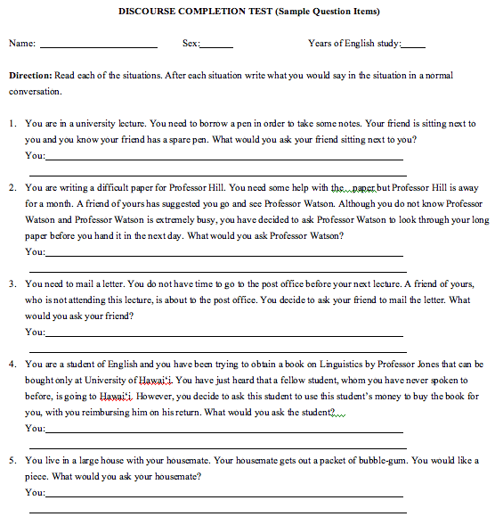

Slide 43


Slide 44


Slide 45
Criterion #6: carrying out suitable and sound research procedures
Conducting a research study using the right procedures is also critical for establishing credibility.
Ethical requirements¹⁰: confidentiality, anonymity, protection of minor, special needs learners, L2 learners; institutional policies
Using data collection procedures appropriate to your study’s design
Treatment procedures needs to be carefully planned and carried out; control group vs. treatment group for experiments; clear instructions for tests, tasks, and surveys/questionnaires
¹⁰ See the Tri-Council Policy Statement: Ethical Conduct for Research Involving Humans https://ethics.gc.ca/eng/policy-politique_tcps2-eptc2_2022.html

Slide 46
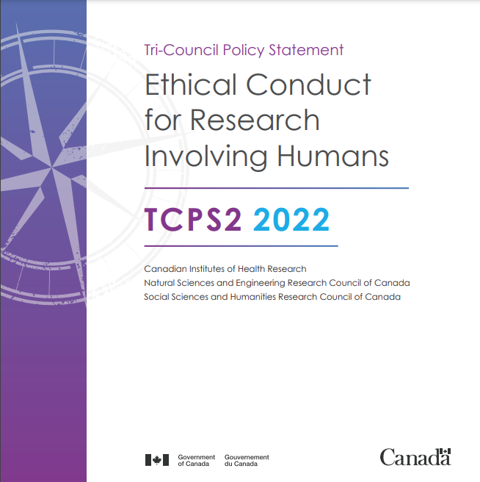

Slide 47
Criterion #7: conducting appropriate data analyses
This is perhaps the most intimidating aspect of research for many teachers since selecting the right analytic procedures does often involve knowledge of statistics. In truth, there are two branches of statistics used in educational research, descriptive and inferential.
descriptive statistics–mean, sum, medium, percentile, frequency; you are already familiar with some or all of these from school, and these are very central to interpreting results from tests and in-class questionnaires.
Inferential statistics, on the other hand, are most commonly used in large-scale studies which classroom teachers are unlikely to become involved in. That said, some statistics such as the t-test and ANOVA (for comparing sets of scores from tests or tasks) and test-reliability statistics are useful and worth investigating for teachers to understand them. For questionnaires and larger surveys, thankfully, servers such as Survey Monkey conduct and report statistical analyses, though it is important to know how to interpret the results. As well, Microsoft Excel can be used to compute descriptive statistics, as well as inferential analyses such as ANOVAs and t-tests.

Slide 50
Criterion #8: making appropriate interpretations and conclusions
Once data analyses have been completed, the final question becomes “What have I/we learned from this study?”, that is, what conclusions can be drawn based on the results of the data analyses? These will always take the researcher(s) back to the initial purpose, research questions, and relevant statistical hypotheses posed.
The credibility of our conclusions depends on
the design quality of our data-collection instruments
the thoroughness of our data collection procedures (naturalistic studies),
the accuracy of our data analyses and of our interpretations based of their results.
For experimental studies, this depends on making the correct conclusion for each statistical hypothesis being tested in the analyses
For survey and other multivariate studies, interpreting results from descriptive and inferential analyses.
For those teachers lacking a background in statistics, seeking input from a colleague or other professional with the requisite knowledge is highly recommended.
Finally, honest identification of the limitations of your study (the and background of subjects, the use of actual classes of students,, unforeseen problems during the data collection process) are appreciated by readers and often serve to strengthen the credibility of the researcher(s) in the eyes of the professional community. Every study has limitations.

Slide 51
In conclusion, . . .
Consider taking a course in educational research methods or educational statistics (if you have taken the former) if you have not done so and feel you need the knowledge.
Get advice from one or knowledgeable colleagues when planning a study and for conducting and interpreting analyses.
Make yourself familiar with your institution’s and governmental ethics policy if you are considering doing a study. Post-secondary institutions have strict guidelines and procedures. For research done on minors, in particular refugees and special needs learners, and it is important to understand their vulnerabilities and need to safeguard their interests.
Attend conferences and webinars; read research articles in your areas of interest
Don’t let an initial lack of knowledge keep you from getting your feet wet; you cannot learn to swim standing at the edge of the pool!

Slide 52
Why should teachers do research?
Because it is an excellent learning tool.
Knowledge feeds practice.
Knowledge-based practice builds excellence.
Excellence breeds fruitfulness.

Slide 53
Questions? Thoughts?
If you are interested in doing research and have questions, you can email me at Gordon.Moulden@twu.ca or gordmoulden@yahoo.com.
Otherwise, check out my professional blog (https://tesol.solutions/) or some of my posts on LinkedIn.
Thanks for coming!

