Slide 1

Assessment for learning: the road to improvement

Slide 2


I’m teaching this lesson but … are my students learning?
BIG QUESTION!

Slide 3
Assessment

Slide 4




Assessment OF Learning
Summative assessment
Assessment FOR Learning
Formative Assessment

Slide 5

End-of-term exams and standardised tests are examples of summative assessment.
Yes No
Exit tickets and impromptu quizzes are examples of formative assessment.
Yes No
Assessment

Slide 6
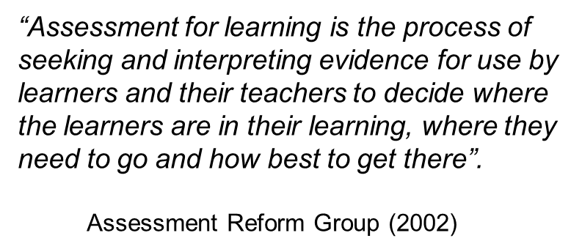
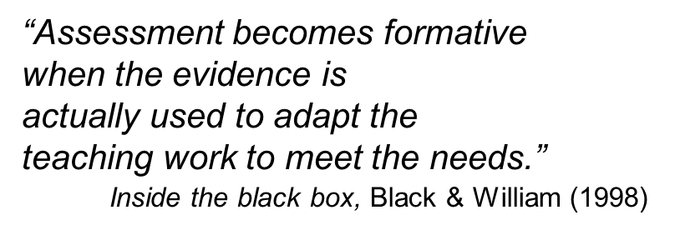

Slide 7
10 principles of Assessment for Learning
1. be part of effective planning
2. focus on how students learn
3. be central to classroom practice
4. be a key professional skill
5. be sensitive and constructive
6. foster student motivation
7. promote understanding of goals and criteria
8. give guidance on how to improve learning
9. develop the learners’ capacity for self-assessment
10. recognise the full range of educational achievement
Assessment for Learning Reform Group (2002)

Slide 8
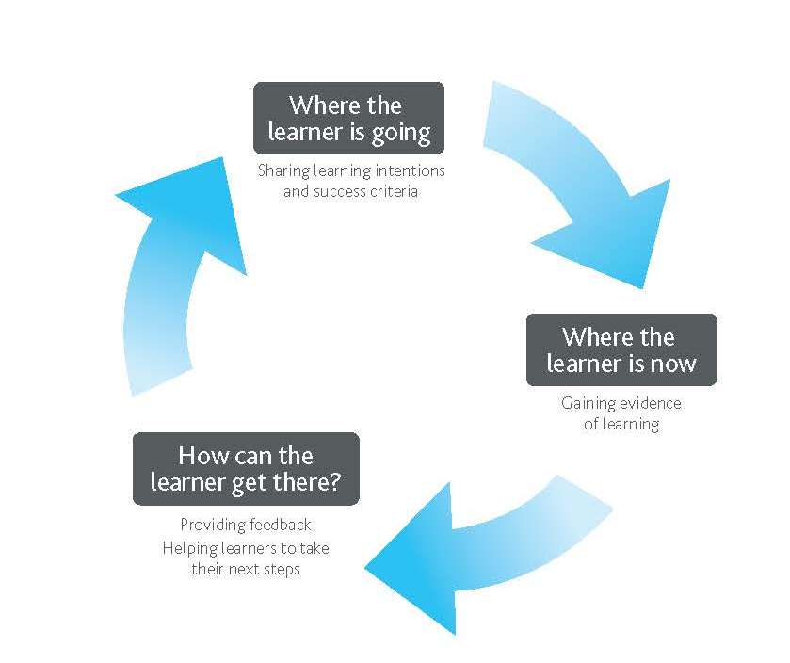
Assessment for learning in
the classroom

Slide 9
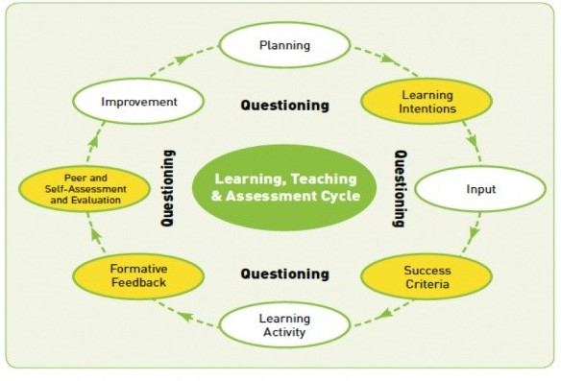
Council for the Curriculum Examinations and Assessment (2007)

Slide 10


Assessment for learning: main components
Learning intentions
Success criteria
Formative feedback
Effective questioning
Peer- and Self-assessment

Slide 11

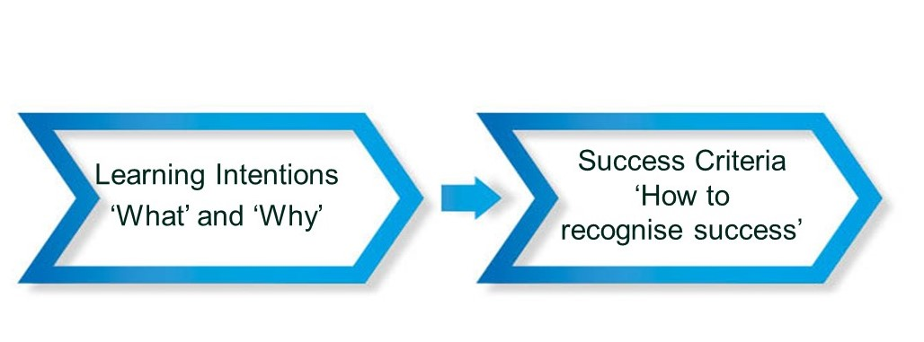
Learning intentions and success criteria
Students will understand the meaning of key vocabulary words and use the words correctly
Students will: - Select correct vocabulary words when given word meaning.
- Generate sentences that accurately include vocabulary terms.

Slide 12
Why are learning intentions and success criteria important?
What
Why
How

Slide 13
Which of these are examples of quality, formative feedback?
a. Beautiful, neat work.
b. Try one of these adjectives or one of your own instead of ‘bad’ …
c. You must try harder.
d. Develop these ideas further.
e. Very good start. Count how many times you have used ‘said’. What word might you have used instead?

Slide 14

Formative feedback
Understand what you said
How
What
Accept what is being said
Be willing to make a change
Implement change

Slide 15

Characteristics of effective formative feedback
Base feedback on the learning goal
Avoid comparing the student to other students.
Focus on only two or three critical feedback points at a time.
Provide concrete suggestions for improvement.
Directly communicate the strength or the gap to the student.
Suggest small manageable change.
Give immediate or timely feedback.
Give constant feedback.
Allows for students’ own feedback.
Ask for student commitment to change.

Slide 16


Planning questions
Decide on your goal for asking questions
Select the content for questioning
Ask questions that require an extended response
Write your main questions in advance
Think of additional questions
Avoid implied response questions
Try to anticipate possible student responses

Slide 17

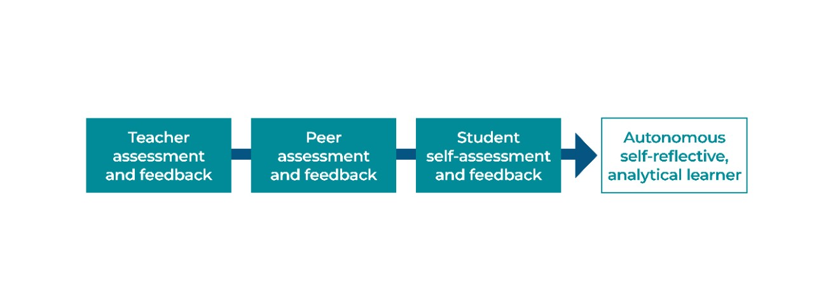
Peer- and self-assessment

Slide 18

How to introduce peer & self-assessment
Identify assignments or activities
Break a large assignment into smaller pieces
Involve students in defining/clarifying success criteria
Work with exemplars
Teach students how to apply success criteria
Provide guidance
Support students with prompts, sentence starters and forms

Slide 19


How to support peer assessment
Combine peer assessment with teacher feedback.
Develop and use peer assessment tools
Use the gradual release of responsibility model
Develop ground rules for giving effective feedback
Require evidence that peer assessment, feedback and improvements occur

Slide 20

Involve students in developing criteria
Have students
assess against the success criteria
identify successes
highlight an area for improvement
Remind students of the success criteria
Allow 5–10 minutes for students to make improvements

Slide 21

How to support self-assessment
Make self-assessment a regular part of the lesson
Explicitly teach, model and scaffold self-assessment
Ask students to highlight the best section of their work
Include some reflection time at the end of the lesson
Discuss and practise individual goal setting
Design self-assessment templates.
Introduce exit tickets

Slide 22

References
Black, P. and Wiliam, D. (1998a). Inside the Black Box: Raising Standards through Classroom Assessment. London: School of Education, King’s College.
Hattie J., Timperley, H., the power of feedback, in: Review of educational research, March 2007, vol. 77, No. 1, pp 81-112
Hattie, J. (2012). Visible Learning for teachers. Abingdon, UK: Routledge.
Hattie, J. and Clarke, S. (2019). Visible learning: Feedback. Abingdon, UK: Routledge.
Swaffield, S. (2008). Unlocking assessment: Understanding for reflection and application. London: Routledge.

Slide 23
Thank you!
Contact
annie.altamiranotrainer@gmail.com
annieteachertrainer.wordpress.com
https://www.linkedin.com/in/anniealtamirano/
https://twitter.com/AnnieAlta2012
https://www.instagram.com/annie.altamirano/
My You Tube channel: https://www.youtube.com/channel/UCFFw1k87LDbXMo-7JdJfXrw

