Slide 1

TESL Ontario Webinar
BRINGING MINDFULNESS TO
THE ESL CLASSROOM
presented by: Andreia Arai-Rissman

Slide 2

"Mindfulness is the basic human ability to be fully present, aware of where we are and what we’re doing, and not overly reactive or overwhelmed by what’s going on around us" (Mindfull, 2020)

Slide 3



Benefits of Mindfulness
Improves cognitive abilities (Karunananda, Goldin & Talagala, 2016).
Boosts concentration (Walsh & Shapiro, as cited in Davis & Hayes, 2012).
Improves working memory (Davis & Hayes, 2012).
Enhances visuospatial memory (Zeidan, Johnson, David & Goolkasian, 2010, as cited in Rechtschaffen, 2014, p. 27).
Fosters cognitive flexibility (Moore & Malinowski, 2009, as cited in Davis & Hayes, 2012).
Increases task efficiency (Lutz et al, 2009, as cited in Davis & Hayes, 2012).
Increases rate of learning (Moore & Malinowski, 2009, as cited in Davis & Hayes, 2012).
Decreases stress (Live Conscious, 2021).
Can decrease student conflict (Burrows, 2011).
Increases self-control instead of the reptilian reaction (Rechschaffen, 2014).

Slide 4




What are you grateful for?

Slide 5
What are you grateful for?
Grammar Skills
Adjectives and prepositions
Phrasal verbs
Verbs patterns
(infinitives and gerunds)
Collocations

Slide 6
Inspirational Quotes

Slide 7
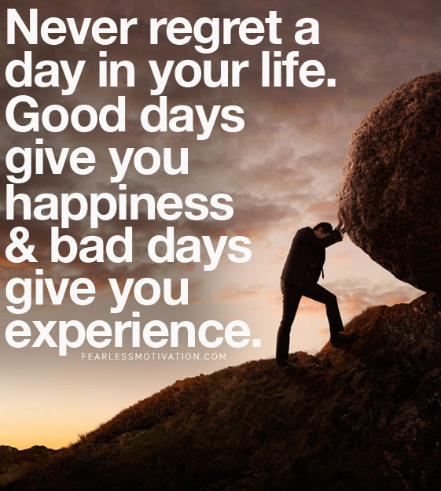
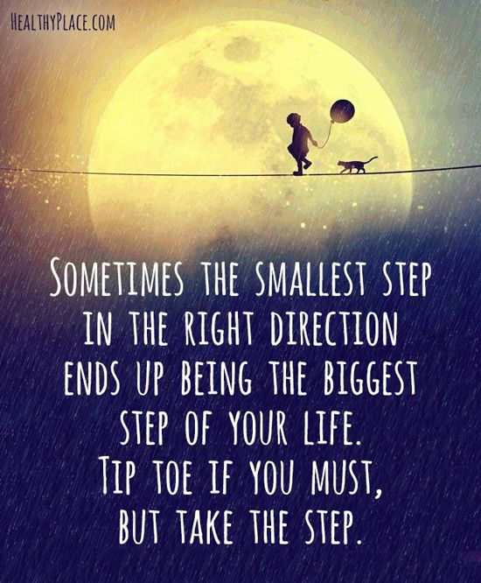
Inspirational Quotes
Quote A
Quote B
Fearless Soul, 2017
Quotes Humor, 2016

Slide 8
Inspirational Quotes
Skills
Learner's independence
Reading
Looking up words in a dictionary
Presentation skills

Slide 9
Bullet journal

Slide 10

Bullet journal
In a survey, almost 50% of Americans state that they are focusing on something else other than the current task
(Killingsworth & Gilbert (2010), as cited in Davidson, 2019)

Slide 11
Bullet journal
Skills
Writing skills
Organizational skills
Time management
Planning skills

Slide 12
Journal writing

Slide 13
Journal writing
Skills
Fluency writing
Relationship with self
Self-reflection
Break

Slide 14
Today's wins

Slide 15
Today's wins
Skills
Writing skills
Mindset shift
Positive feedback
Goal setting

Slide 16
Stop, start and continue
Regarding your well-being
What would you like to stop doing?
What would you like to start doing?
What would you like to continue doing?

Slide 17
Stop, start and continue
Skills
Self-regulation
Awareness
Accountability
Breaking down goals

Slide 18
WHAT COLOR ARE YOU FEELING TODAY?
Colors sometimes can feel like emotions. Think of how you are feeling right now, and think of what color it feels like. Using colors that show your feelings, draw a self-portrait.
(Canvas, 2021)

Slide 19
What color are you feeling today?
Skills
Vocabulary (feelings, animals, weather, toy, furniture, etc.)
Community Building
Universal Design for Learning (means of expression)
Technological skills

Slide 20
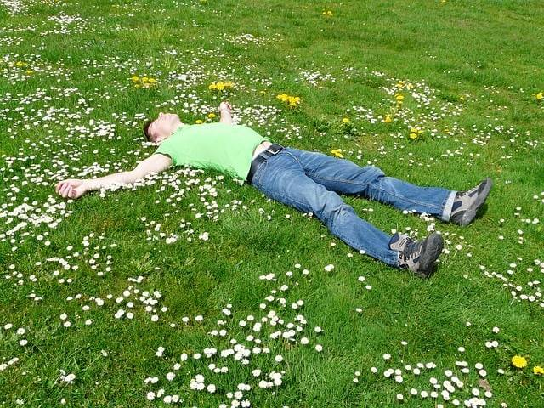
Body Scan
This Photo by Unknown Author is licensed under CC BY-NC-ND

Slide 21
Body Scan
Skills
Awareness
Self-regulation
Accountability
Voice needs and wants

Slide 22

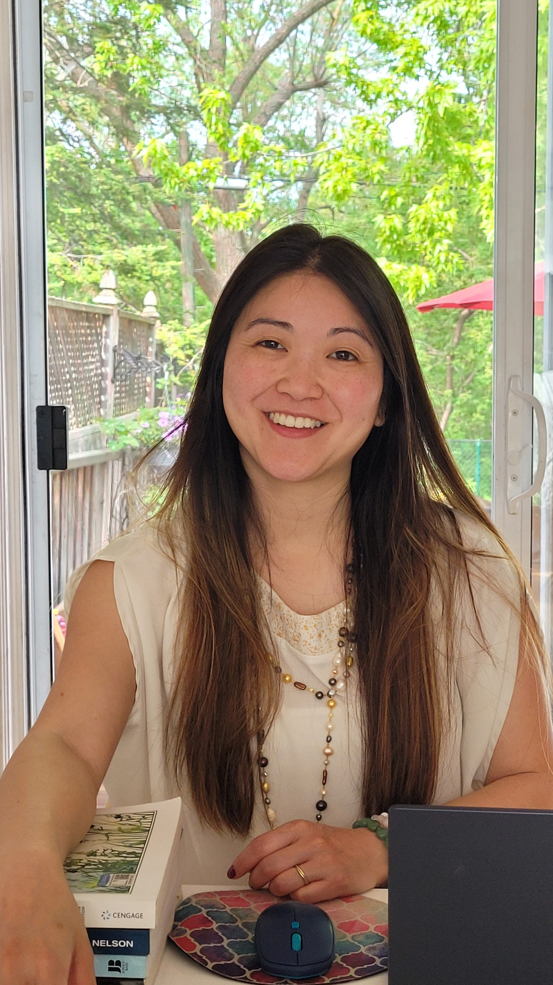

Questions
Andreia Arai-Rissman
email: andreia.arai-rissman@gmail.com
Let’s keep in touch

Slide 23
References
Burrows, L. (2011). Relational Mindfulness in Education. Encounter: Educational for Meaning and Social Justice. 24 (4), 1-6.
Broderick, P. (2019). Mindfulness in the Secondary Classroom. Norton & Company. New York.
Canvas. (2021). Feelings Check In. https://www.canva.com/design/DAEl4dDtCZw/-4BOR_-rSdWjIK-yYRCKtw/edit?layoutQuery=presentation
Davis, D. M. & Hayes, J. A. (2012). What are the benefits of mindfulness? American Psychological Association. 43 (7), 64
Davidson, R. J. (2019, Dec. 12). How mindfulness changes the emotional life or our brains. [Video]. https://www.youtube.com/watch?v=7CBfCW67xT8
Kabta-Zinn, J. (2010, Apr. 14). What is Mindfulness? [Video]. https://www.youtube.com/watch?v=xoLQ3qkh0w0
Fearless Soul. (2017, Aug. 1). 21 Most Inspirational Quotes on Life to Empower You to Succeed. https://www.fearlessmotivation.com/2017/08/01/inspirational-quotes-life/
Karunananda, S. A., Goldin, R. P. & Talagala, P. D. (2016). Examining Mindfulness in Education. I.J. Modern Education and Computer Science. 12, 23-30 10.5815/ijmecs.2016.12.04
Live Consciously. (2019, Oct. 10). Gratitude Journals: Worth the Hype or Wishful Thinking? https://weliveconscious.com/article/benefits-gratitude-journal
Quotes Humor. ( 2016, Jan. 29). Top 30 Deep Inspirational Quotes. https://quotesnhumor.com/top-30-deep-inspirational-quotes/
Rechtschaffen, D. (2014). The Way of Mindful Education. Cultivating Well-Being in Teachers and Students. Norton & Company. New York.

