Slide 1

Using and Licensing (OERs): Part I
Shahla Noor AL-Deen

Slide 2

Poll
Are you new to the world of Open Educational Resources(OERs)?
Yes No
Have you heard of OERs but feel unsure how they may be used?
Yes No
Are you wondering of how OERs may help you in a professional context?
Yes No
This Photo by Unknown Author is licensed under CC BY-SA

Slide 3

Agenda
What are OERs?
Principles of OERs
Types of OERs
Elements of Creative Commons Licenses
Benefits and Challenges of OERs
This Photo by Unknown Author is licensed under CC BY-SA

Slide 4

Objectives
Understand what OERs are and the purpose and structure of OERs
Identify the core principles of open educational resources(OERs) and the TASL technique
Describe the elements of creative commons licenses
Recognize the benefits, challenges, and limitations of OERs

Slide 5
Introduction
“ The term ‘open educational resources’ was coined by United Nations Educational, Scientific and Cultural Organization (UNESCO) in 2002.” (Caswell et al., 2008)
“Open Educational Resources (OER) are teaching, learning and research materials in any medium – digital or otherwise – that reside in the public domain or have been released under an open license that permits no-cost access, use, adaptation and redistribution by others with no or limited restrictions.”
UNESCO
“teaching, learning, and research resources that, through permissions granted by their creator, allow others to use, distribute, keep, or make changes to them.”
BCCampus

Slide 6
Creative Commons (CC)
“Creative Commons is a nonprofit organization that helps overcome legal obstacles to the sharing of knowledge and creativity to address the world’s pressing challenges.”
Creative Commons is a nonprofit organization dedicated to building a globally accessible public commons of knowledge and culture. We make it easier for people to share their creative and academic work, as well as to access and build upon the work of others. By helping people and organizations share knowledge and creativity, we aim to build a more equitable, accessible, and innovative world.
https://creativecommons.org/about/
”Wanna Work Together” by Creative Commons is licensed under CC BY 2.5

Slide 7
Things to consider:
Intellectual Property
Type of Open Licensing
Accuracy
Quality
Reliability
Perspective and Inclusivity
Best Practices

Slide 8
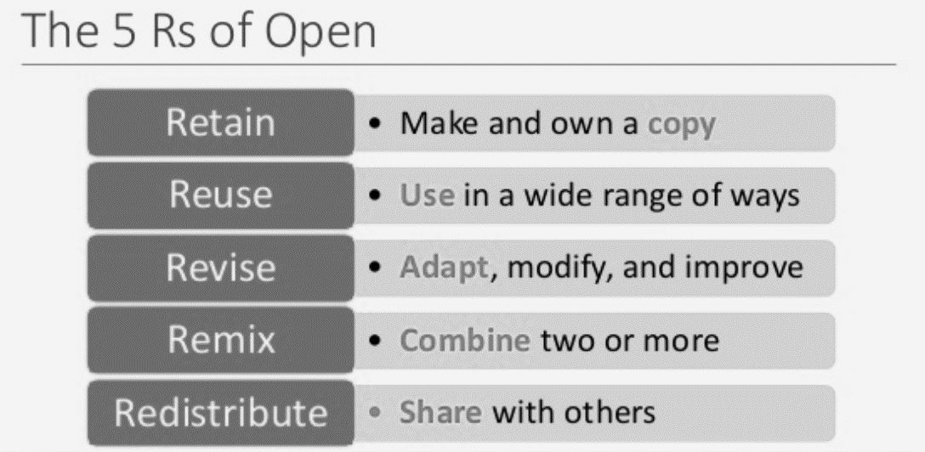
Principles of Open Educational Resources
Open education resources by Rosario Passos is licensed under CC BY 4.0

Slide 9
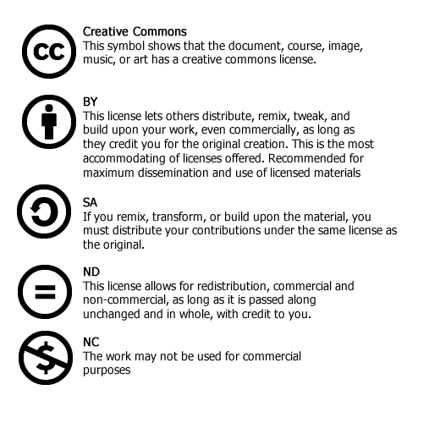
Creative Commons Licensing Symbols
Public Domain: CC
Attribution: By
Share Alike: SA
No Derivatives: ND
Non-commercial: NC
"Teach with Free & Open Educational Resources" by O.E.R. Module for the Online Learning Seminar is licensed under CC BY-NC 4.0

Slide 10
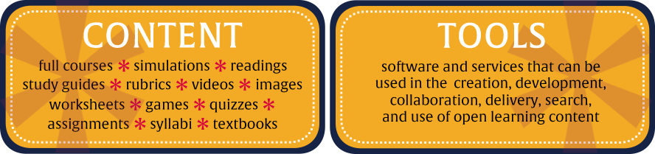
Types of OERs:
This Photo by Unknown Author is licensed under CC BY

Slide 11
The Benefits of OERs :
Increasing accessibility and affordability
Enhance the quality of teaching and learning and promote effective teaching and learning
Generate innovation through sharing and collaboration
Reduce faculty preparation time
Incorporate diversity of perspectives
Improving opportunities and outcomes for students and educators
Add new perspectives and continuously improving the content

Slide 12
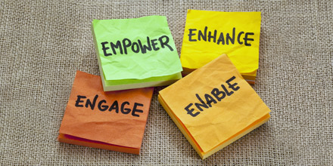
Other benefits:
Global access to leading experts in the field and
incorporate important updates
Customize curriculum and instructional design
Foster engagement, address various learning styles, and accommodate students with various needs (UDL)
This Photo by Unknown Author is licensed under CC BY-NC-ND

Slide 13
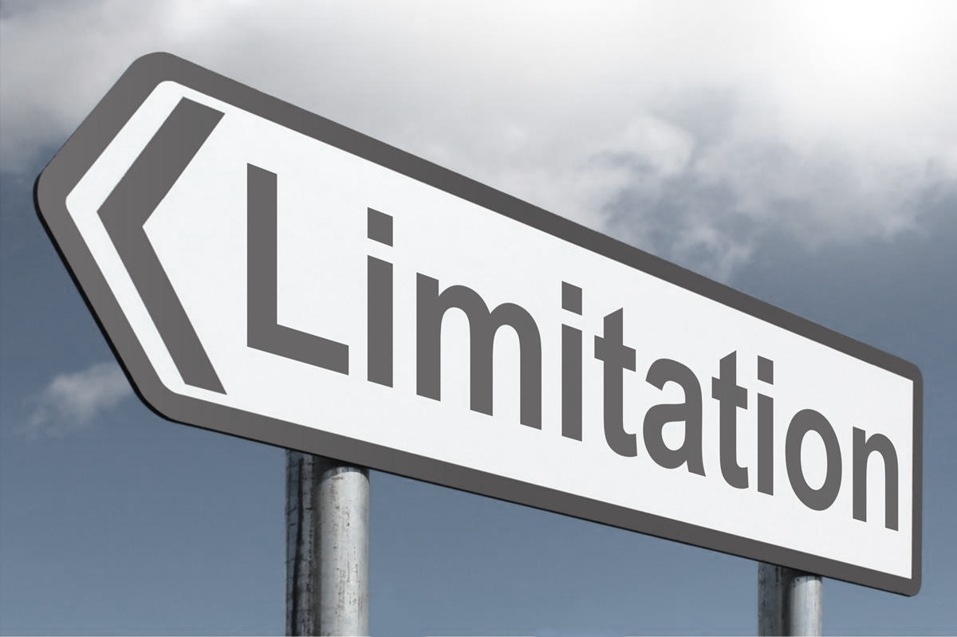
Challenges with OERs:
Dealing with intellectual property
Quality and appropriateness of the resource to a particular level, subject, or group of students
Equity problems if different institutions within the same province use materials of different levels of quality
OERs Limitations:
It is time-consuming to validate and evaluate open resources
Lack of knowledge on open licensing
No Derivatives (ND) License
Ethnocentrism and biases as they arise
This Photo by Unknown Author is licensed under CC BY-SA

Slide 14
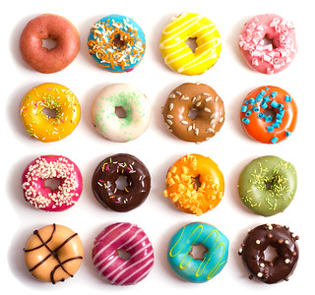
A. Attributing an OER without modifications:
Title - What is the name of the material? (links to the source page)
Author - Who owns the material? (Include the link to profile page)
Source - Where can I find it? (The URL of the original work)
License - What specific license is the work under? (Include the link)
A typical attribution would look like this: “Title” by “Author” is licensed under “CC License Type.”
Each element of the attribution links to the relevant page: the title links to the source page, the author’s name links to their profile page, and the license type links to license page.
E.g. “Donuts” by Ferry Sitompul is licensed under CC BY 2.0.
"OER for Faculty" by Algonquin College Library is licensed under CC BY-NC.

Slide 15
Another way to view the TASL technique:
“ _______________" (title and link to original source)
by ________________ (creator OR author name and link)
is licensed under “ ________________” (CC License and link).
"OER for Faculty" by Algonquin College Library is licensed under CC BY-NC

Slide 16
B. Attributing an OER with modifications:
When you modify content to create something new, you have created something called a derivative work. In addition to the original attribution, the attribution for your derivative work requires the following additional information:
The title of the new work.
That it is a derivative of the original.
The license under which you are sharing your work (some licenses require you to use the same as the original).
Your name.
An attribution for a derivative work would look like this: This work, “New Title” is a derivative of “Original Title” by Author and used under CC License Type. “New Title” is licensed under CC License Type by My Name.
E.g. This work, “Donut Faces”, is a derivative of “Donuts” by Ferry Sitompul is licensed under CC BY 2.0. “Donut Faces” is licensed under CC BY 2.0 by Shahla Noor AL-Deen.
"OER for Faculty" by Algonquin College Library is licensed under CC BY-NC.

Slide 17
Attribution Builder
http://www.openwa.org/attrib-builder/
https://www.flickr.com/photos/65991505@N08/8222939536
Example 1:
"Donuts" by Ferry Sitompul is licensed under CC BY 4.0
“Open Attribution Builder” is licensed under CC BY 4.0. Managed by WA SBCTC.

Slide 18
Attribution Builder
http://www.openwa.org/attrib-builder/
https://nool.ontariotechu.ca/
Example 2:
"Words That Sound Similar" by Ontario Tech University is licensed under CC BY-NC 4.0
“Open Attribution Builder” is licensed under CC BY 4.0. Managed by WA SBCTC.

Slide 19
Searching for and Finding and OERs:
OERs Repositories:
https://www.oercommons.org/
https://www.oercommons.org/search?batch_size=20&sort_by=search&view_mode=summary&f.search=ESL+Lesson+Plan&f.sublevel=adult-education&f.general_subject=education&f.sublevel=college-upper-division
https://search.ecampusontario.ca/?k=everyday%20esl&sourceWebsiteTypes=2&sortCol=1
https://open.bccampus.ca/what-is-open-education/canadas-open-education-initiatives/
https://open.bccampus.ca/browse-our-collection/find-open-textbooks/

Slide 20
References
United Nations Educational, Scientific and Cultural Organization (2019). Open Educational Resources.
Retrieved from https://en.unesco.org/themes/building-knowledge-societies/oer
BCCampus (2017). Open Education. Retrieved from
https://open.bccampus.ca/
Caswell, T., Henson, S., Jensen, M., & Wiley, D. (2008). Open Content and Open Educational Resources: Enabling universal education. The International Review of Research in Open and Distributed Learning, 9(1). https://doi.org/10.19173/irrodl.v
DeRosa, R. and Robison, S. (2017) From OER to Open Pedagogy: Harnessing the Power of Open in Jhangiani, R S. and Biswas-Diener, R. (2017 Open: The Philosophy and Practices that are Revolutionizing Education and Science London: Ubiquity Press.
Flor, A. (2013). Exploring the downside of open knowledge resources: The case of indigenous knowledge systems and practices in the Philippines. Open Praxis, 5(1), 75-80.
Willems, J., & Bossu, C. (2012). Equity considerations for open educational resources in the globalization of education. Distance Education, 33(2), 185-199.9i1.469

