Slide 1
MINDFULNESS
Anjum Karimi
LINC INSTRUCTOR- POLYCULTURAL
TESL Methodology instructor- Canadian college of educators
Author: an elt experience
Anjum.karimi@gmail.com

Slide 2
Ice – Breaker poll: Have you ever practised meditation
Never
A Little
Only with guidance
Never explored!
Other (Tell us in the chat!)

Slide 3
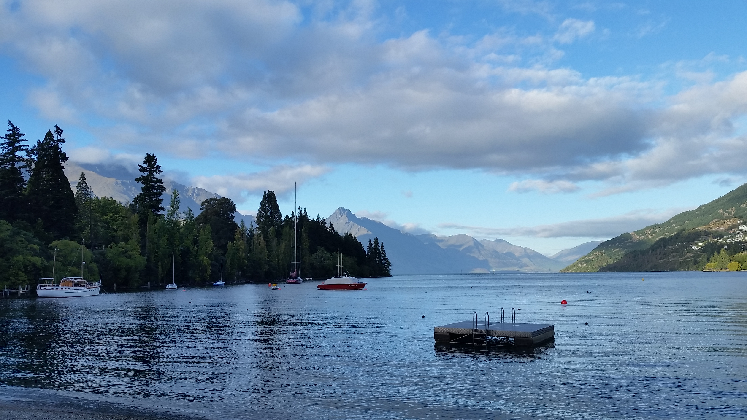
Beginners Mind
SEE THE PRESENT MOMENT IN A FRESH AND OPEN WAY

Slide 4
NoN-Judging
Don’t form opinions
We tend to judge ourselves, others and situations

Slide 5
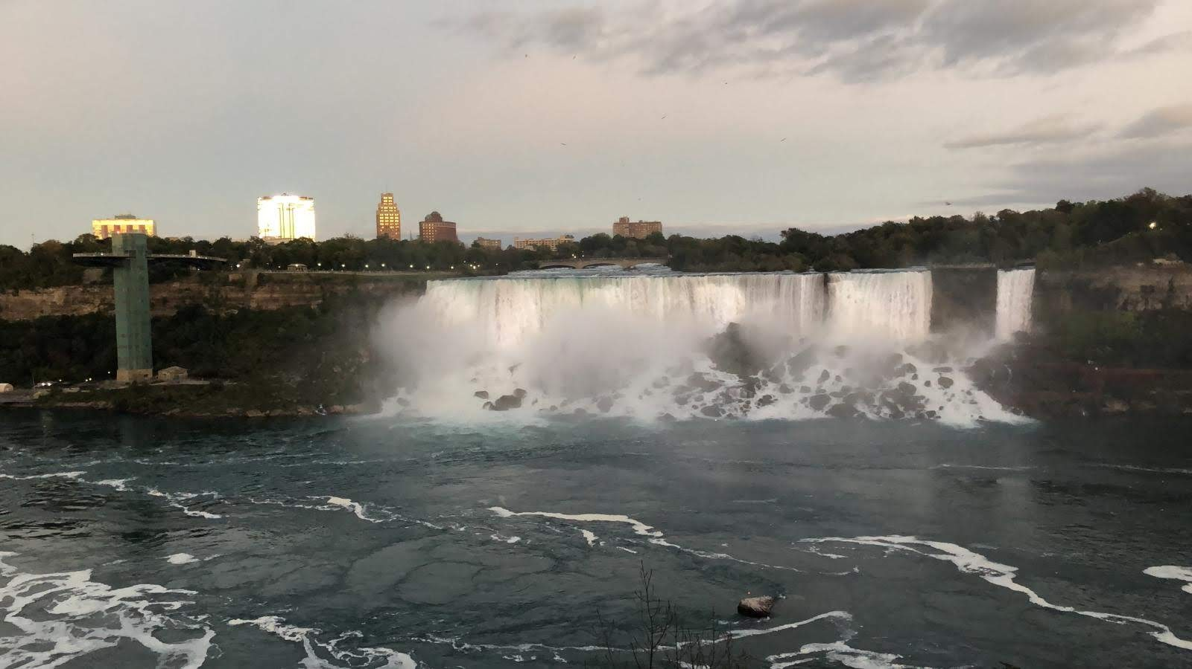
Acceptance
“May I be granted the serenity to accept the things I can’t change
Courage to change the things I can
And the wisdom to know the difference!”

Slide 6
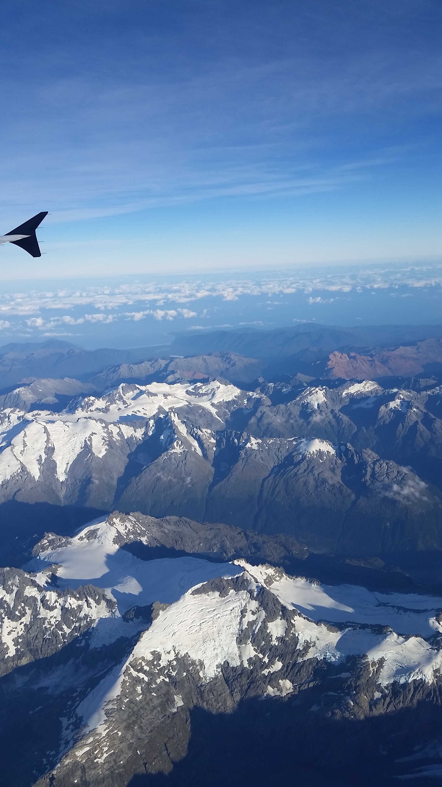
Letting Go
Accept life’s situations and don’t hold on to grudges and desires
Dreams come true with time, not with impatience

Slide 7
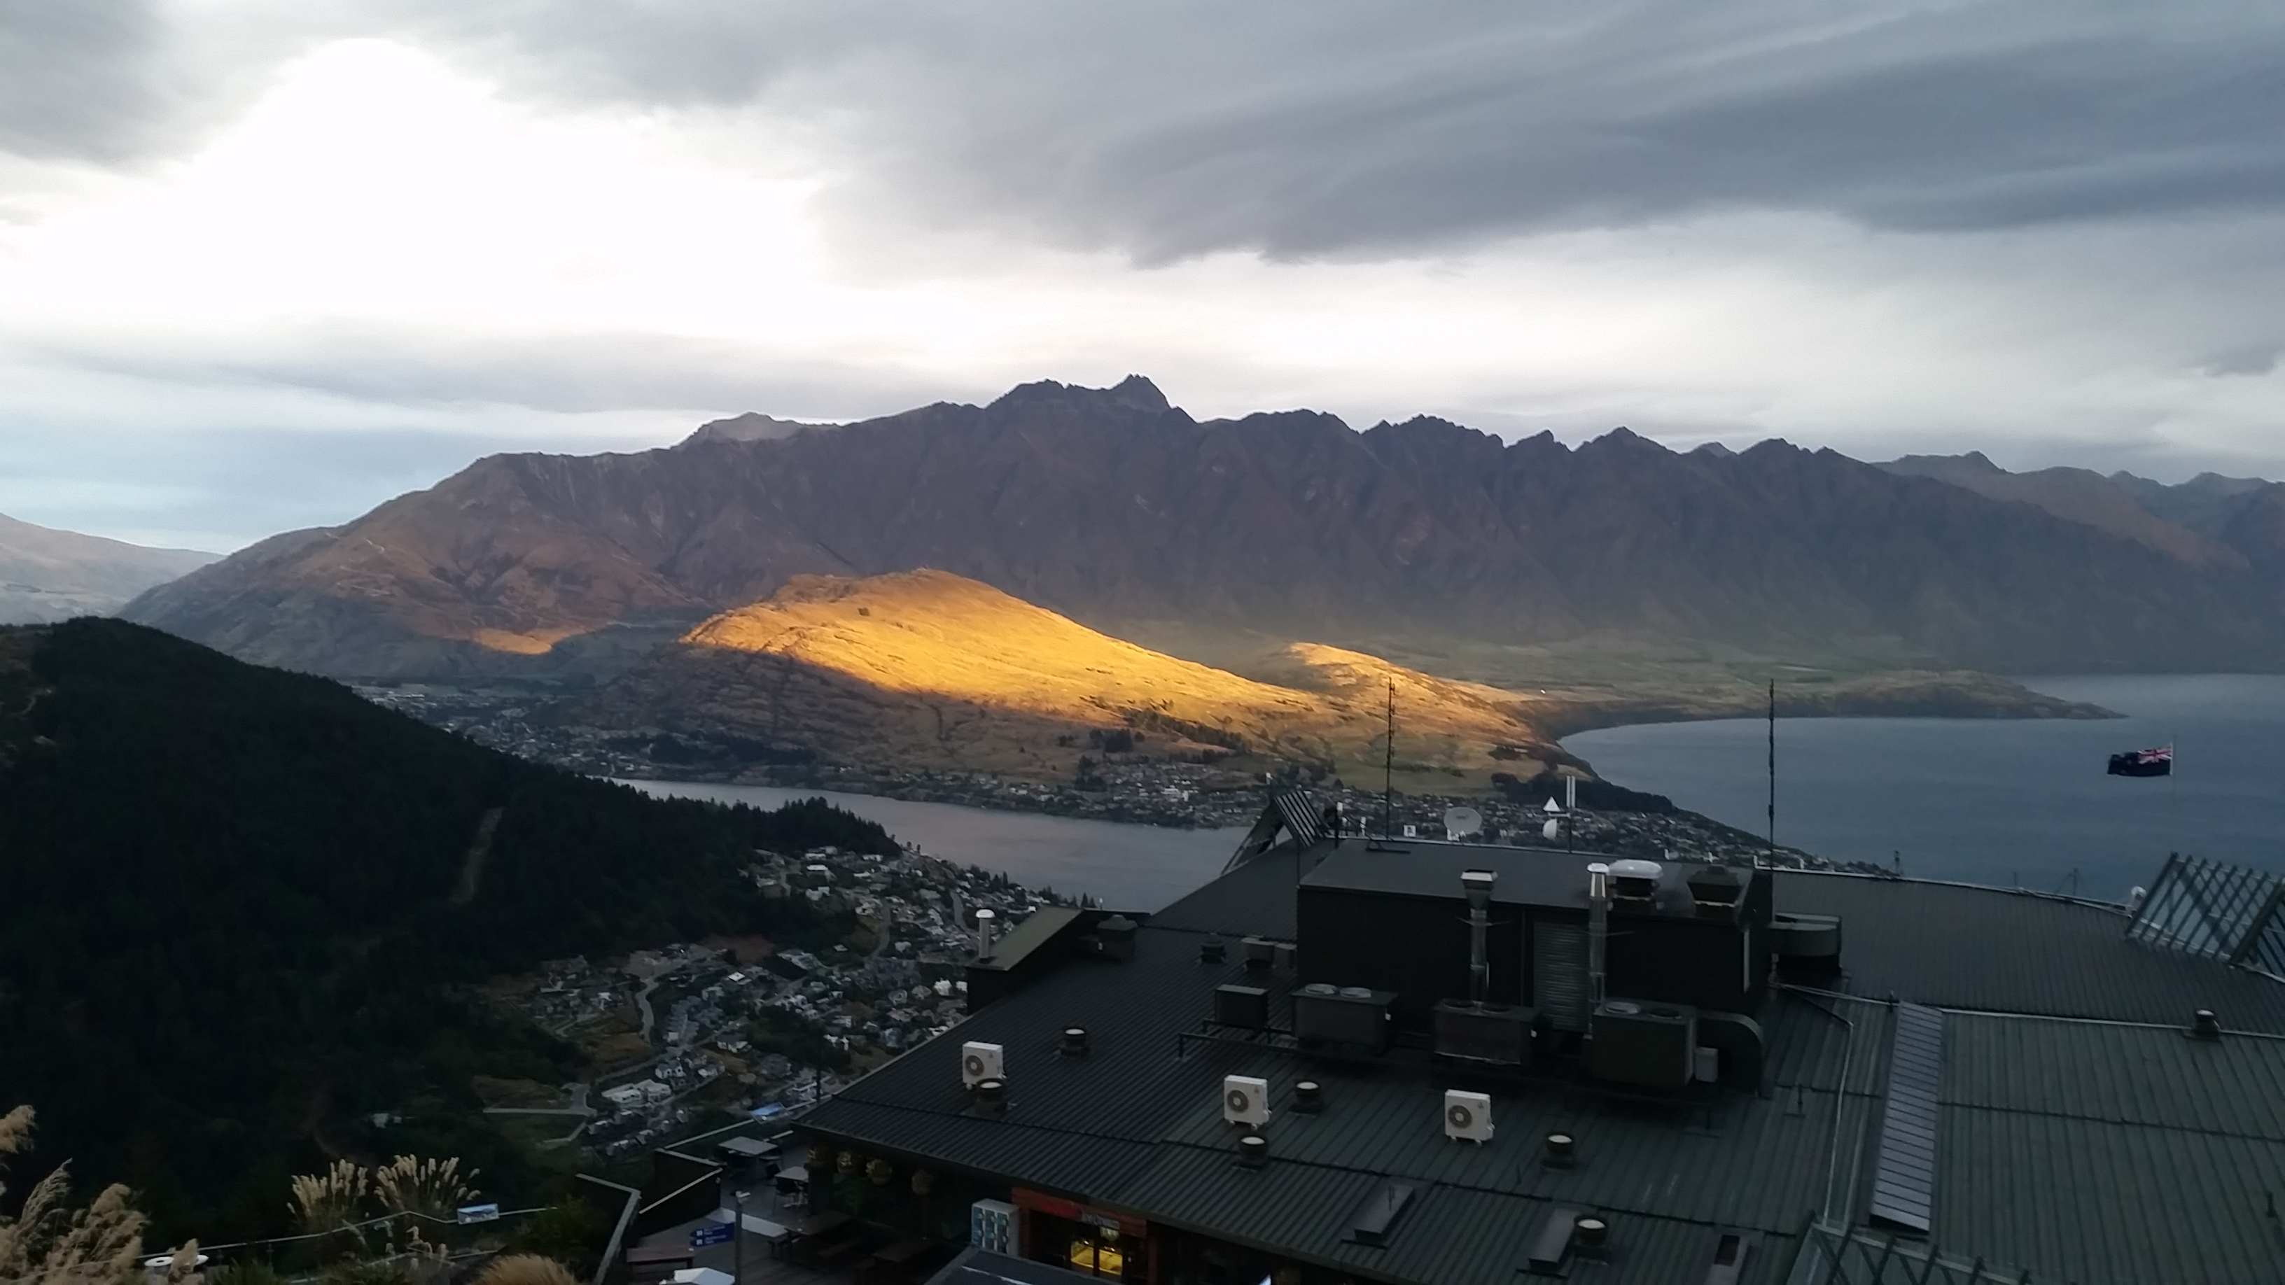
Trust
Trust your intuitions, listen to them carefully

Slide 8
Patience
Patience is wisdom
Patience in learning is not to give up, but keep trying till results are achieved

Slide 9
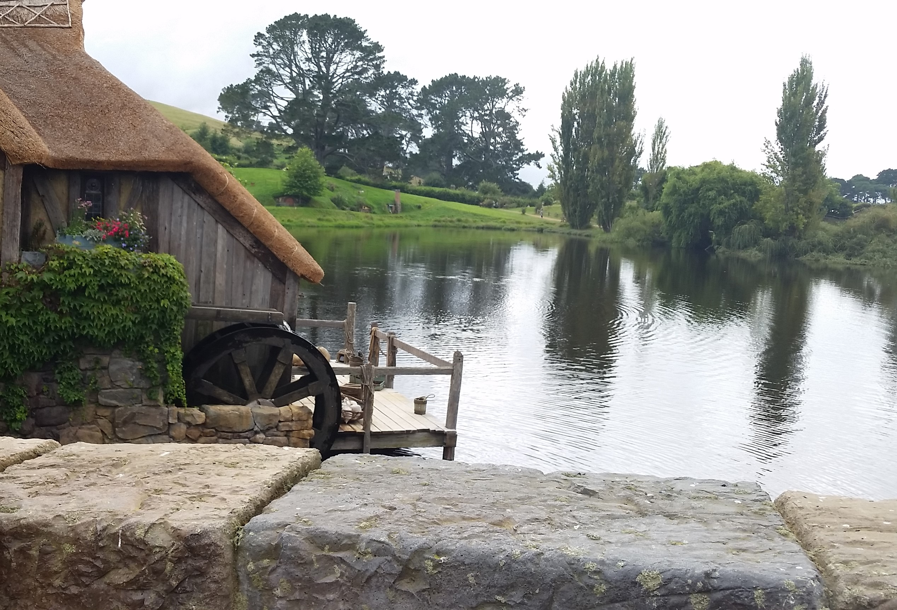
Non-Striving
Accept things as they are, keep focusing on the present and the results will unfold naturally

Slide 10
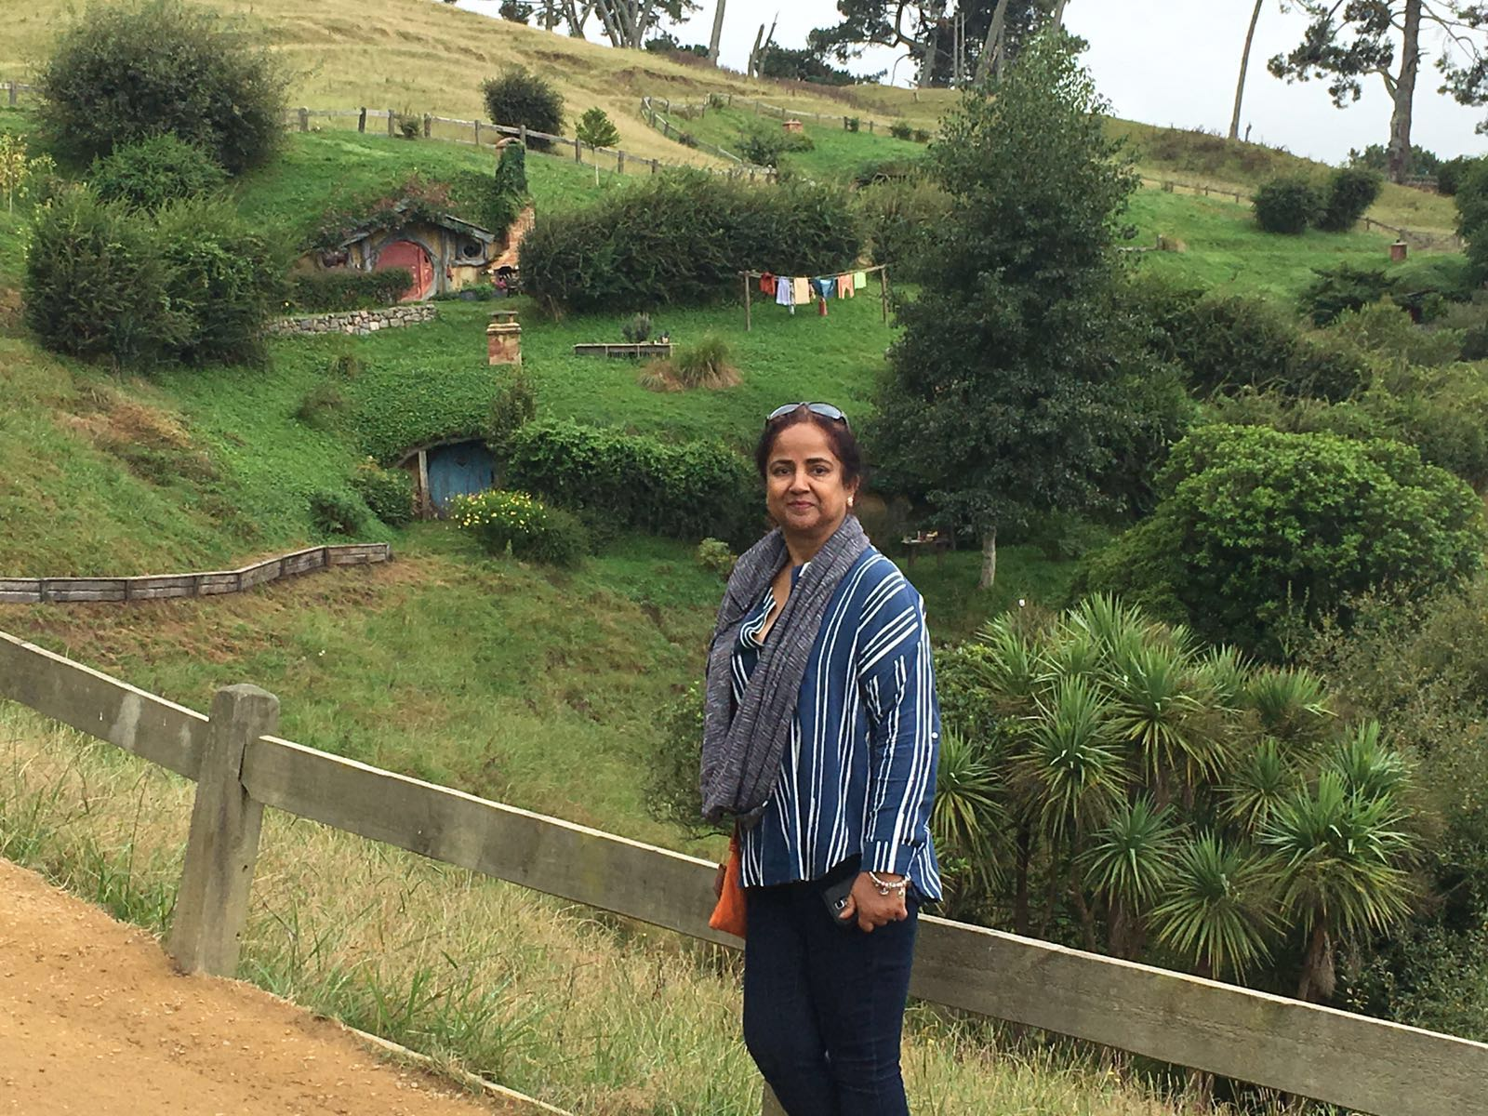
Gratitude
Gratitude attracts goodness and ease in life
It elevates spirits, gives peace, enhances alertness, enthusiasm, creativity and positivity

Slide 11
Generosity
When you show generosity, you focus on the need of someone else and forget about your own problems, it de-stresses you
GENEROUS PEOPLE ARE ENERGETIC, HUMBLE, OPTIMISTIC AND HAVE LEADERSHIP SKILLS

Slide 12
SOURCES
https://combatyourdepression.com/mindfulness-exercises-for-depression
https://mindfulnessbasedhappiness.com/the-9-attitudes-of-mindfulness-according-to-jon-kabat-zinn/
https://www.hopkinsmedicine.org/health/wellness-and-prevention/the-power-of-positive-thinking
https://abcnews.go.com/Health/increased-stress-lead-immune-system-disorders-study-finds/story?id=55999237
https://chopra.com/articles/10-powerful-mudras-and-how-to-use-them

Slide 13
Summary
Presentation – the nine attitudes of mindfulness
Hands on relaxation activities
Sharing with others

Slide 14
Feedback: Which part of the webinar was the most useful to you?
Presentation – the nine attitudes of mindfulness
Hands on relaxation activities
Sharing with others

Slide 15
Feedback: What is the value of the information, tools, and ideas you have received today?
Five stars
Four stars
Three stars
Two stars
One stars

