Slide 1
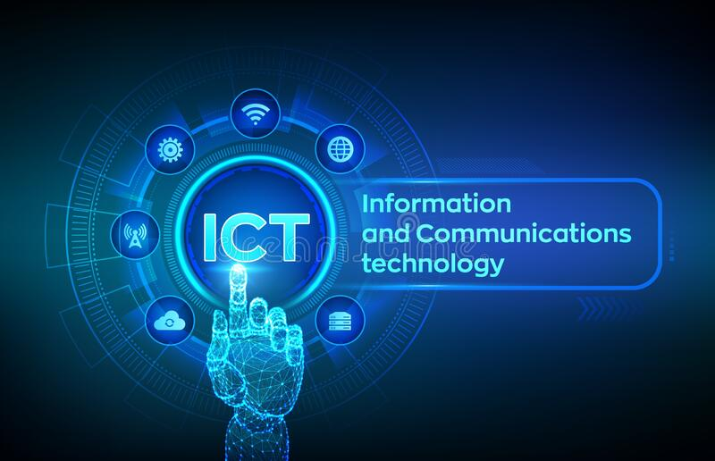
Asynchronous ICT
Overcoming ESL Learners’ Affective Barriers
Presented by Katina Deichsel, M.Ed, MA, OCELT
Contact: Katina.deichsel@ontariotechu.net
https://www.linkedin.com/in/katinadeichsel/
Mini-Toscon, June 6th, 2020

Slide 2
Ontario Tech U Faculty of Education Embodies 21st Century Education
Before M.Ed
Microsoft word, excel, PowerPoint
Gmail, hotmail, outlook
Google hangouts
Internet search
WhatsApp
Facebook, LinkedIn
During M.Ed
(Sept 2019 - Present)
G Suite: docs, hangouts, classroom, slides, forms, site, sheets
Wix, Word press
AdobeConnect, Zoom
Slack, WhatsApp
Padlet, Flipgrid, Answer Garden, Quizziz
Google Scholar
WebKF, Wikis
Fb, Twitter, Instagram, LinkedIn
And more..

Slide 3
Learning Objectives
Role of Affective Factors on learning
Synchronous vs. Asynchronous ICT
Covid-19 and Education
Identifying popular ICT
Benefits of Asynchronous ICT for all learners
Relevant learning theories for ELLs
    Krashen’s SLA – Affective Filter Hypothesis
    Hofstede’s Cultural Dimensions
    Bandura’s Triadic Reciprocal Determinism
    Thorndike’s Theory of Trial and Error
Incorporating ICT into Education
Tech trends in Education
Discussion

Slide 4
TERM | DEFINITION
ICT | Information Communication Technology
Asynchronous Communication | Without use of external clock or timing (padlet, google docs, youtube)
Synchronous Communication | Existing or occurring at the same time (zoom, adobe connect, whatsapp)
IEPs | Internationally educated professionals
BPs | Bridging programs, typically employment focused & can be general / sector-specific
ELLs | English language learners
SLA | Second Language Acquision

Slide 5
What are Affective Factors?
      Anxiety
      Inhibition
      Self-esteem
      Self-efficacy
      Willingness to learn
      Empathy
      Risk taking
      Extroversion / introversion
For more info about Affective Factors in SLA, click HERE.

Slide 6
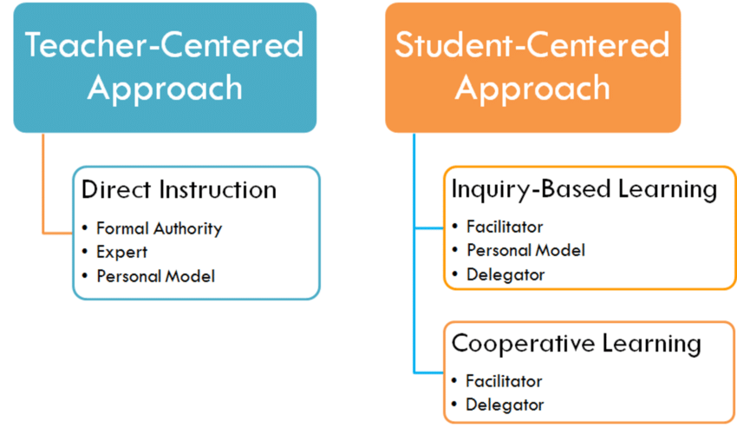
Teacher vs. Student-Centered

Slide 7
Time Lags and Cognition
Asynchronous
Synchronous
Receive materials and work through at own pace, responding when appropriate and able to, and given access to return, review, revise and repeat at will.
G-suite, Flipgrid, Padlet, Wordpress, Twitter
Receive materials at a specific time and must respond in the moment.
Virtual Lectures on Zoom, Google Hangouts, Whatsapp

Slide 8
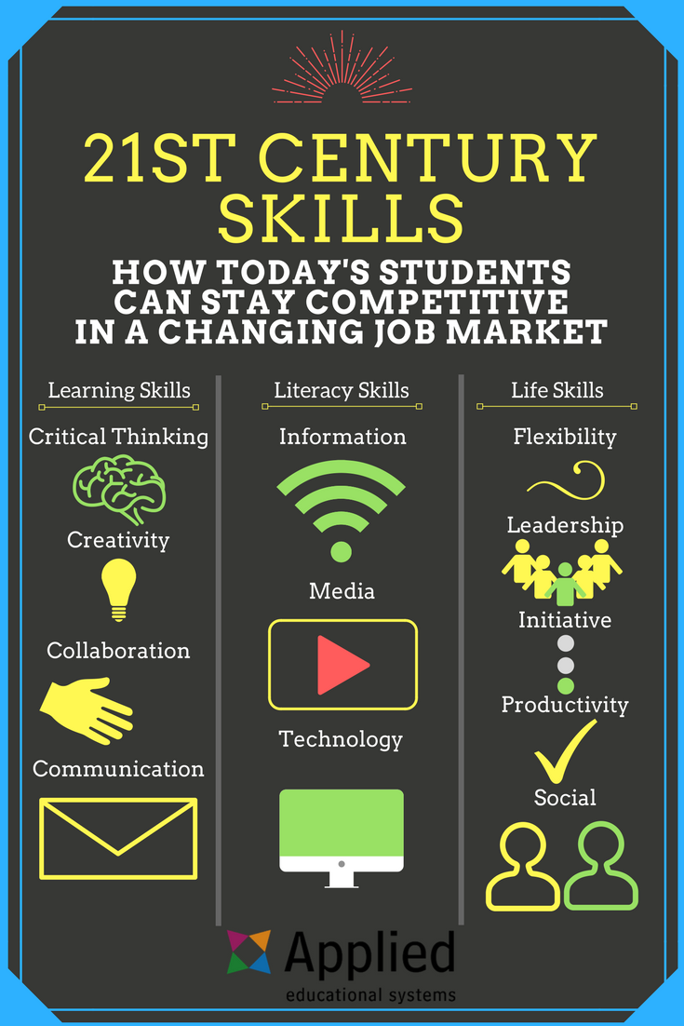
Essential Life/Work Skills

Slide 9

Covid-19 on Education
Time to put our money where our mouth is?

Slide 10
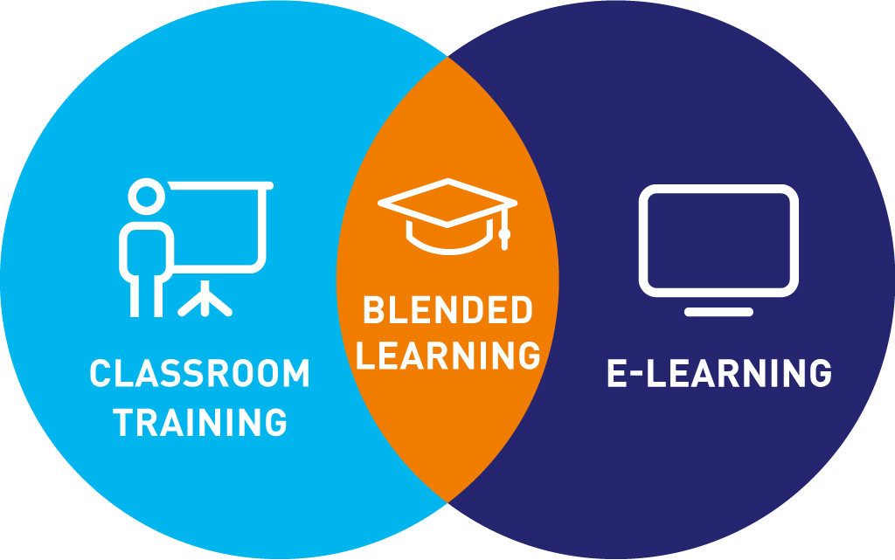
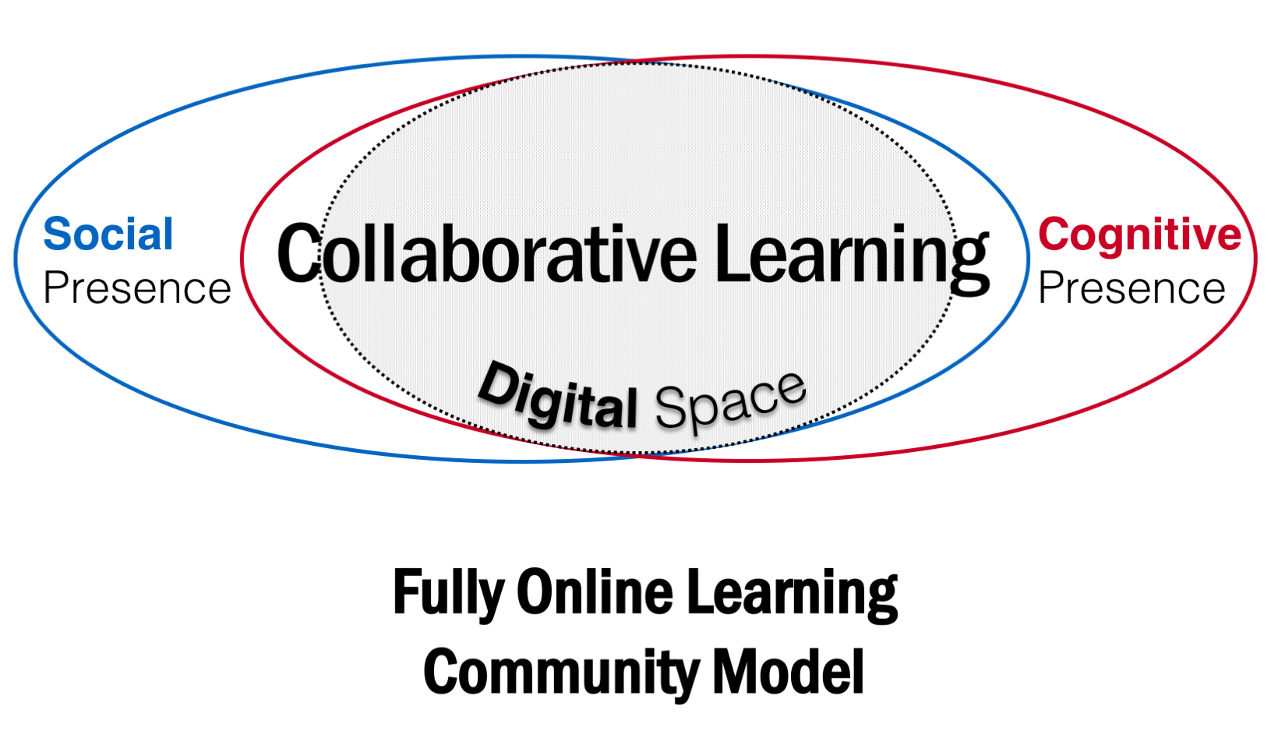
Evolving Learning Spaces

Slide 11












Name that ICT...???

Slide 12
Bridging Program Objectives
Developed by colleges, universities and ISS that support internationally-trained professionals to find work in their field.
Each program provides customized sector-specific training to orient clients to their sector in Canada.
Clients hold language profiles between CLB 2 – 10.
Multi-level classes create unique challenges for learners and facilitators.

Slide 13


Affordances of Asynch ICT
Learning Synchronously Anxiety, inhibition, introversion | Learning Asynchronously Motivation, confidence, self-esteem, risk taking

Slide 14
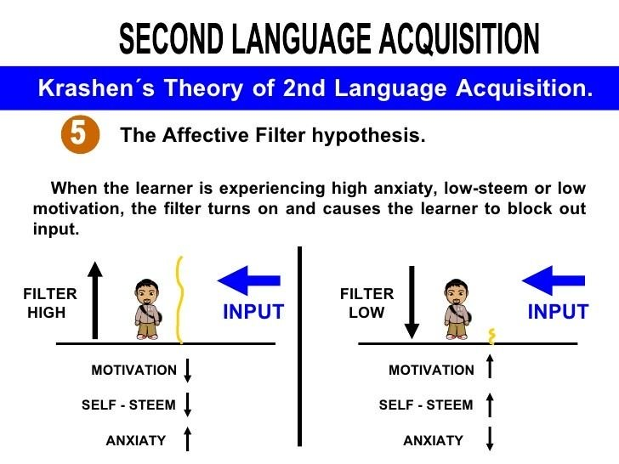
Relevant Learning Theory #1

Slide 15
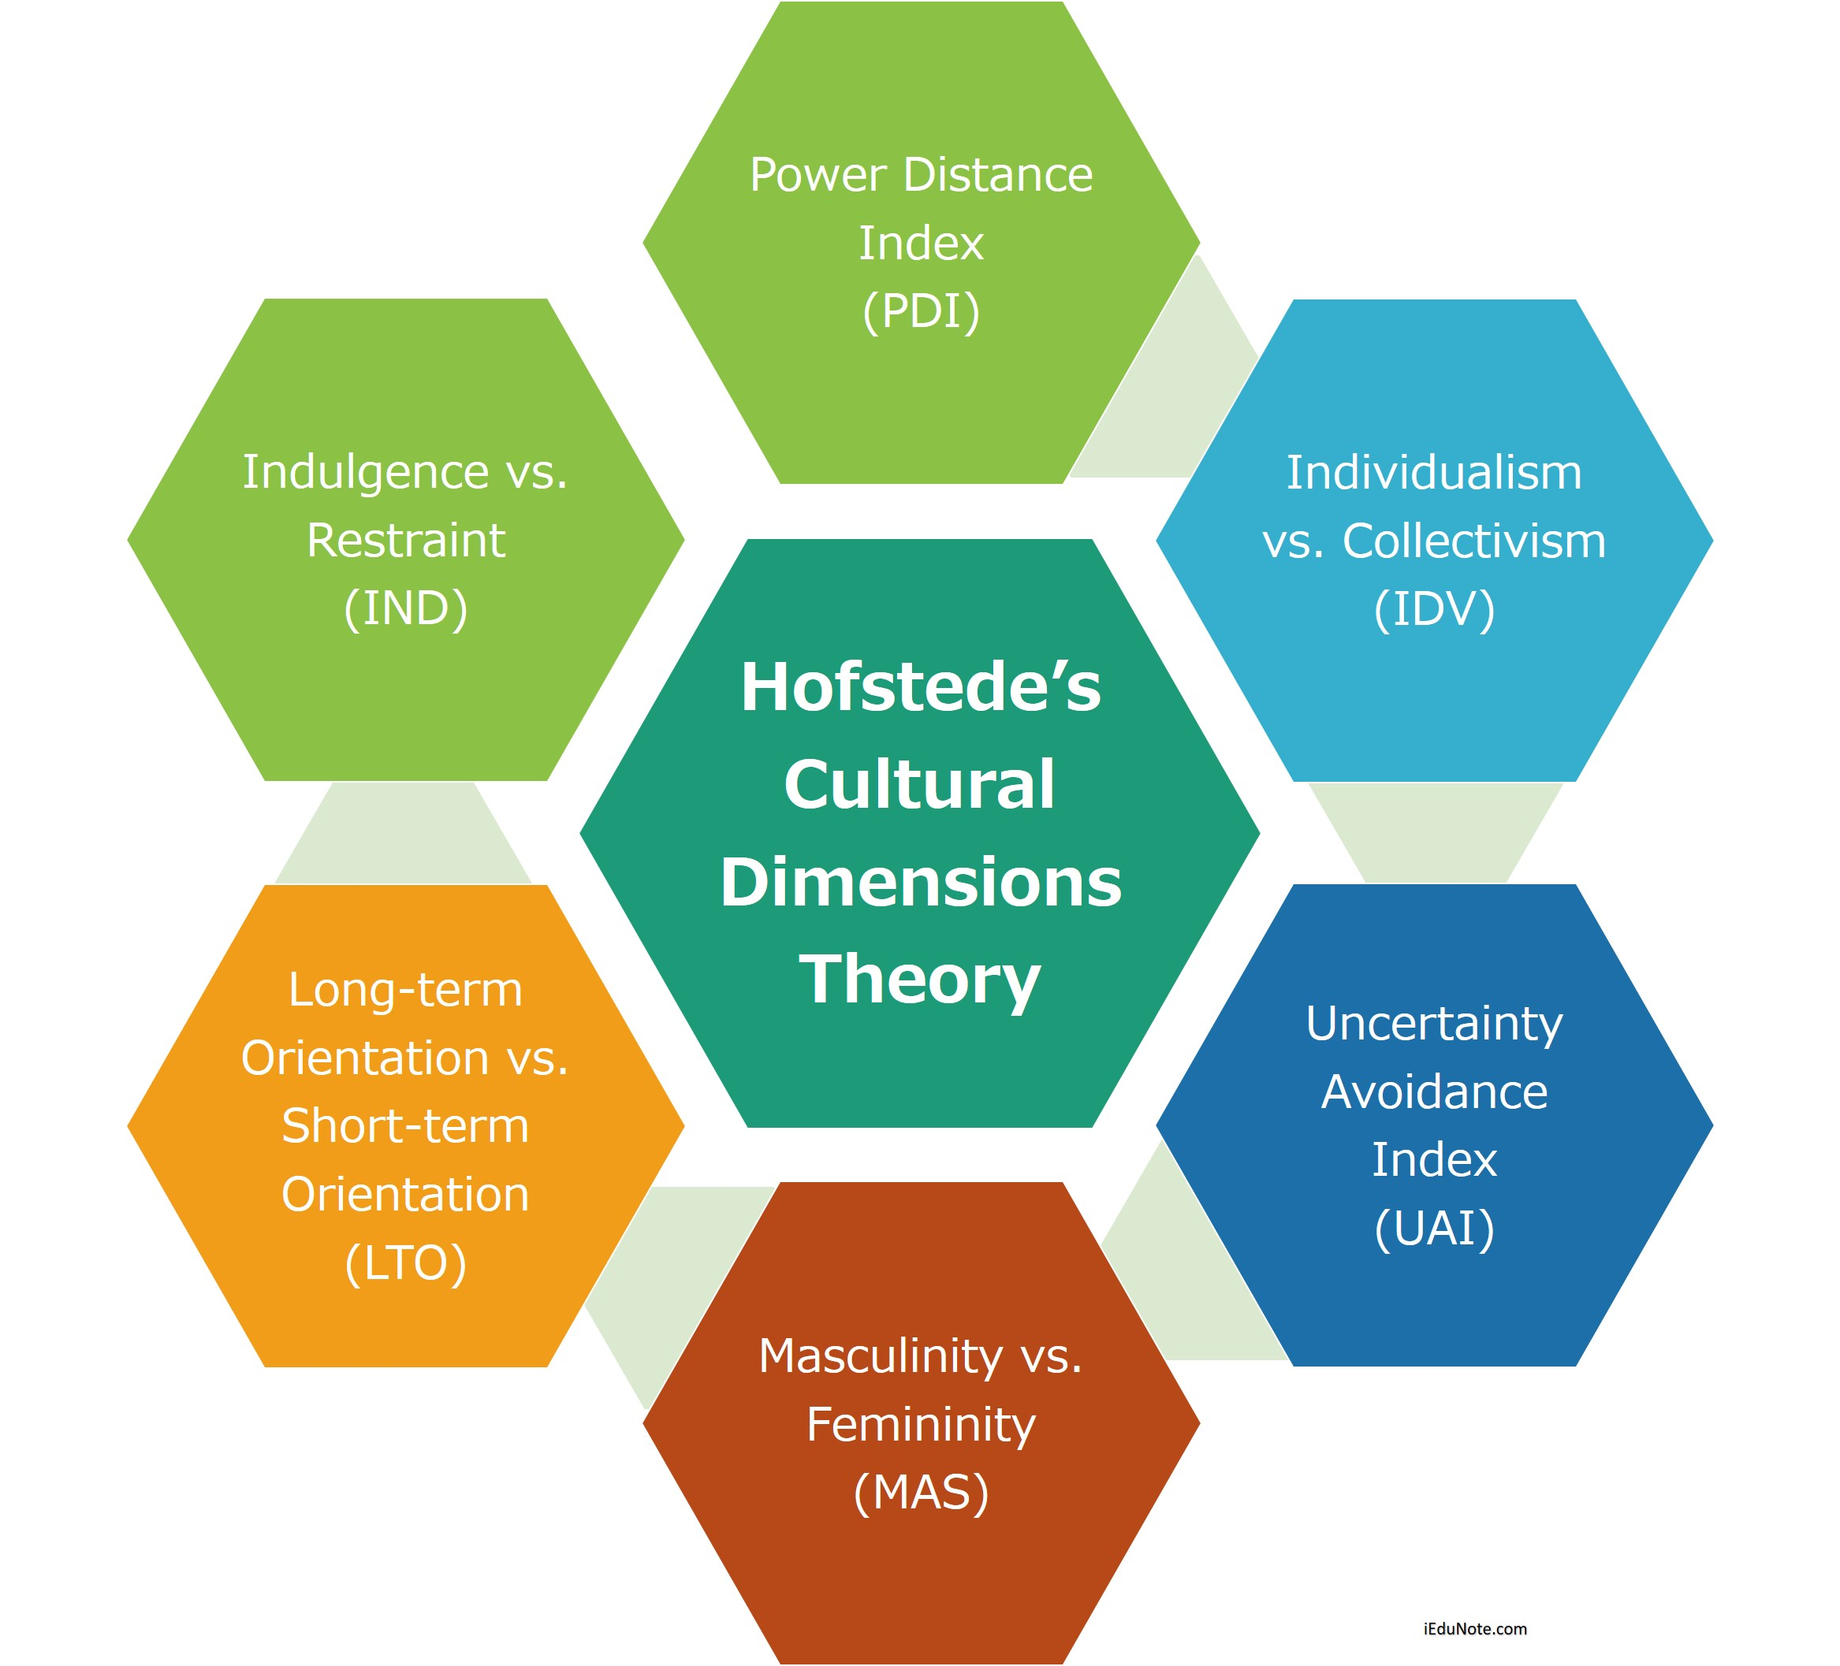
Relevant Learning Theory #2

Slide 16
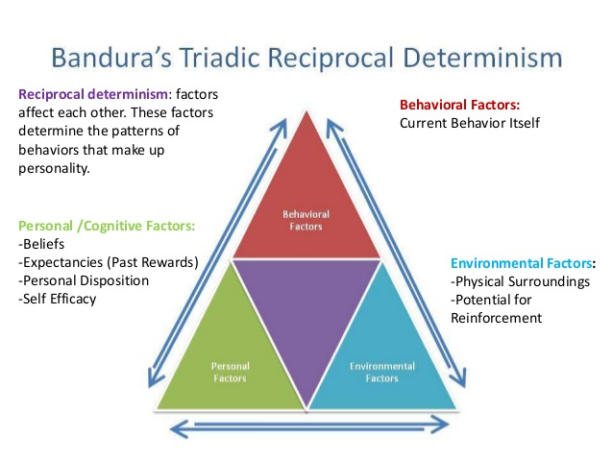
Relevant Learning Theory #3

Slide 17

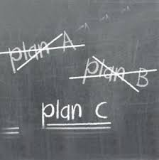

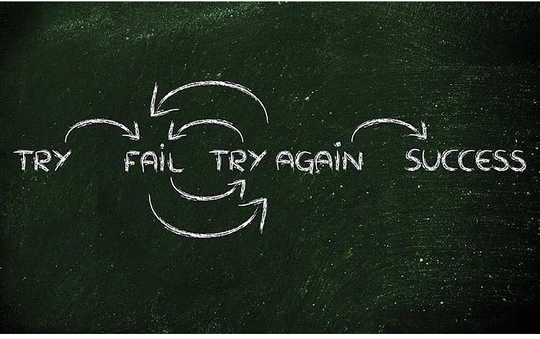
Thorndike’s Theory of Trial and Error
Why is it important for learning?

Slide 18
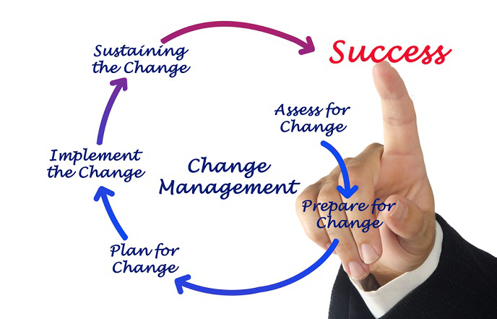
Improving ELL Outcomes
To improve learner outcomes by integrating appropriate tech, we must first change the institution.

Slide 19

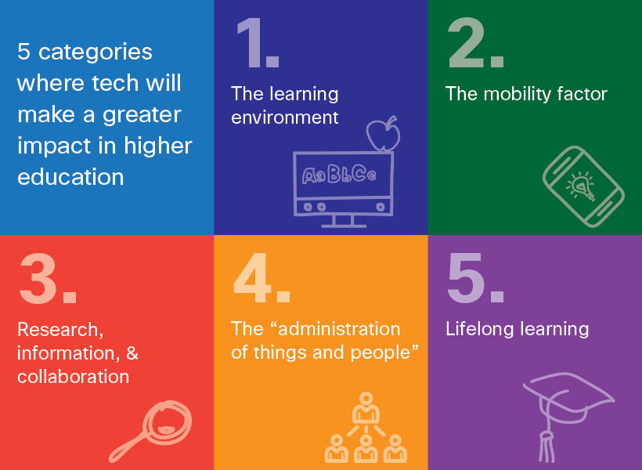

20th C Edu: Digital Tech = Complement vs.
21st C Edu + Digital Tech = Symbiotic

Slide 20
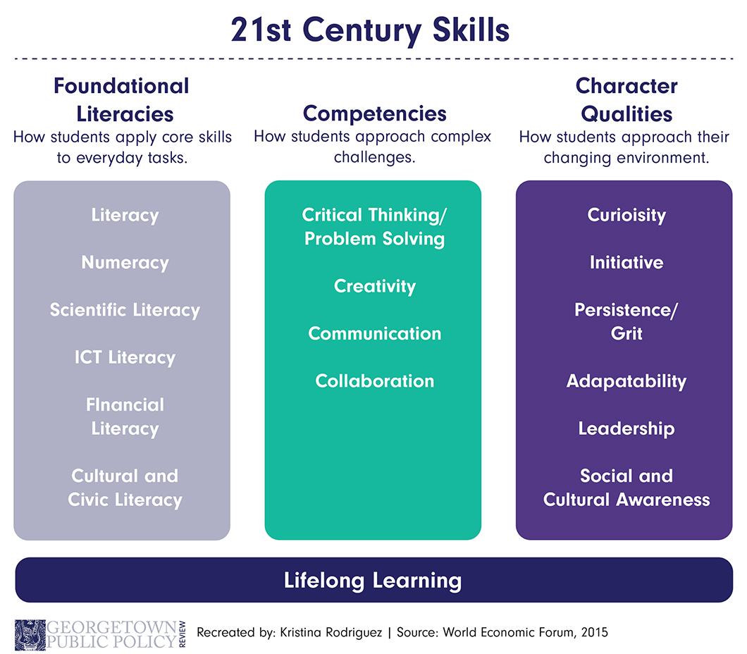

Slide 21
Needed Infrastructure in Educational Organizations
Holistic Approach | Explanation
Coordination | National ICT in education master plans to include all relevant stakeholders
Technical Support | SMEs to help train faculty/staff and troubleshoot
Differentiated / Individualized PD | Creating programs based on learning needs to make it meaningful / manageable
Pedagogical support | Creating channels to help teachers integrate ICT into curriculum
Systematic Monitoring and Evaluation | Frequent assessment about impact & value of ICT for achieving learning outcomes

Slide 22
Educators + Digital Literacy
Digital Literacy
Evaluate sources
Make inferences
Draw conclusions
Digital Citizenship
Creativity / Trial & Error
Differentiation
Cultural Awareness
Improving user experience

Slide 23
Technology in Education
improved communication
enhanced collaboration
cross-field research
real-world assessments
increased engagement
open education
digital simulations
individualized, personalized
not physically bound

Slide 24
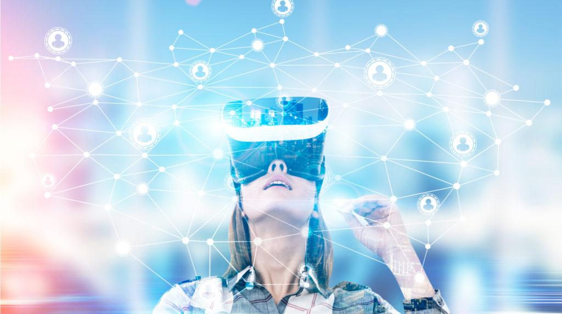
Educational Technology Trends
Customized Learning
3D Printing
Speech to text options (Siri)
Cloud Computing (anywhere, anytime)
Virtual Reality /
Artificial Intelligence
Learning Analytics
(program development, delivery, assessment, revision)

Slide 25

What did we learn?
Affective states (anxiety, inhibition, self-consciousness) negatively impact learning process and outcomes.
Asynchronous ICT offers ELLs with time lag and personalized learning to overcome negative affective states.
Certain learners may be more impacted by affective states or cultural factors.
Optimum learning environments involve an interplay between environmental, personal and cognitive factors.
ICT in education teaches essential 21st century skills, including digital literacy, collaboration, creativity, curiosity, tenacity, and effective communication
To prepare learners for 21st century workplace, appropriate infrastructure and staff/faculty training must be in place
ICT offers unique advantages to education including the freedom to study anywhere, any time, with anyone.

Slide 26
Let’s talk!
1. What benefits have ICT brought to teaching / learning?
2. What barriers do educators face when trying to improve their digital literacy?
3. How will Covid change our educational environment?
4. How should educators prepare for this post-Covid reality?

Slide 27


Questions
Thank you!

