Slide 1
Teaching Green Real World Tasks in the ESL Classroom
Webinar by Rajpreet Lotay
TESL Ontario Webinar via Tutela
May 24th, 2020

Slide 2
About Me + House Rules
Hi! Welcome to the webinar and thank you so much for attending ☺ My name is Rajpreet
I hope to make this a judgment-free zone and ask that you:
Respect and reflect
Be kind to yourself – notion of “being imperfectly eco-friendly”
Share / Ask / Participate where possible
Resources are available after the webinar. You can also email me at rajpreetlotay@gmail.com

Slide 3
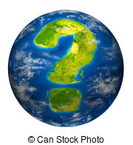
Poll Question # 1
How connected are you to the environment on a scale of 1-10?

Slide 4
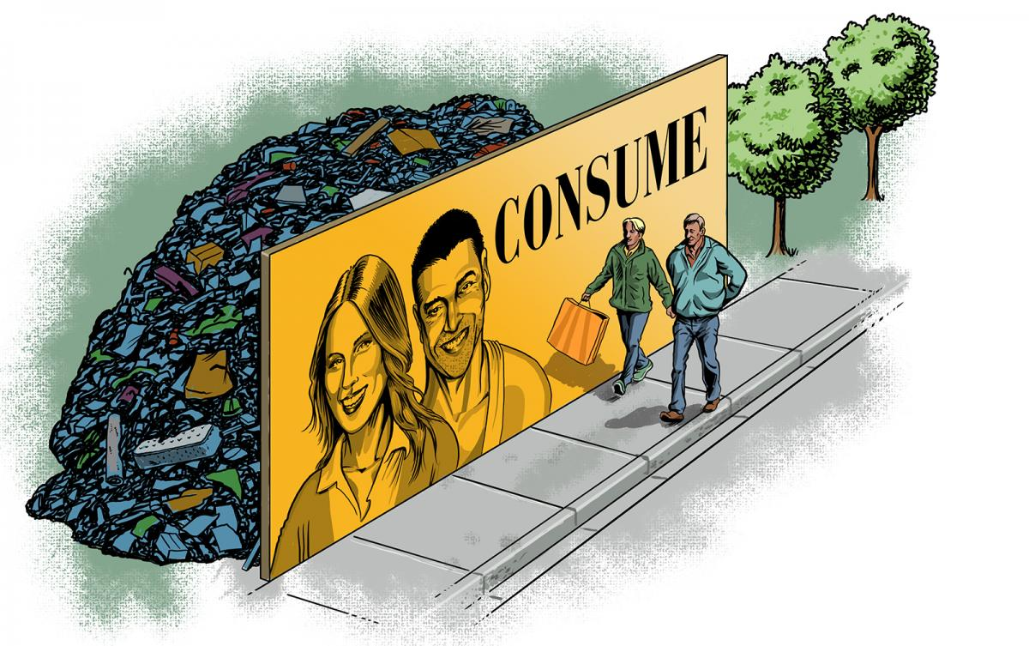
Guy Parsons / Canadian Geographic

Slide 5
Co-Vid 19 Pandemic + Impact
January 2020
February 2020
Credit: The Toronto Star

Slide 6
Our Ecological Crisis: Painting a Picture
Average wildlife populations have dropped by 60 per cent in just over 40 years.
The world’s tropical forests are shrinking at a staggering rate of about 36 football fields per minute.
Wildfires are increasing in frequency and severity over the past 100 years due to drier and hotter weather.
An estimated 1 billion animals were killed in Australia’s wildfires of 2019-2020.
Plastic is killing more than 1.1 million seabirds and animals every year.

Slide 7
Our Ecological Crisis: Painting a Picture
A million plastic bottles and about 2 million plastic bags are bought around the world every minute. Plastic bags on average are used for about 12 minutes.
If things don’t change, it is estimated that there will be more plastic than fish in the oceans by 2050.
The Earth has been progressively heating up for the last century, especially in the last 50 years.
800 million people (11% of the world’s population) is vulnerable to current climate change impacts such as droughts, flooding, heat waves, etc.
According to numerous studies, scientists believe that global warming is 100% the direct result of human activity.

Slide 10
Poll Question #2:
What % of all plastic waste does Canada recycle?

Slide 11
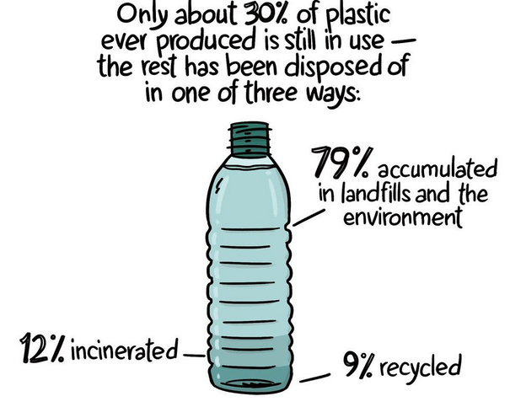
The Guardian (2019), Susan Cagle

Slide 12
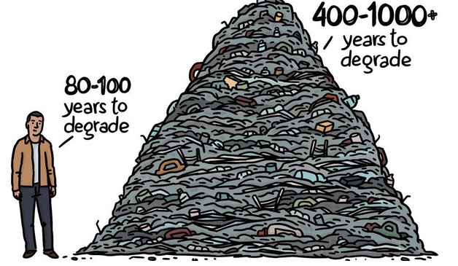
The Guardian (2019) Susan Cagle

Slide 13
What’s the most impactful “R”?

Slide 14
Why does environmental education in the adult ESL classroom matter?
Notes:
Inclusion. Innovation. David Suzuki, access, knowledge sharing, directly impacted, leaders, continuous intake

Slide 15
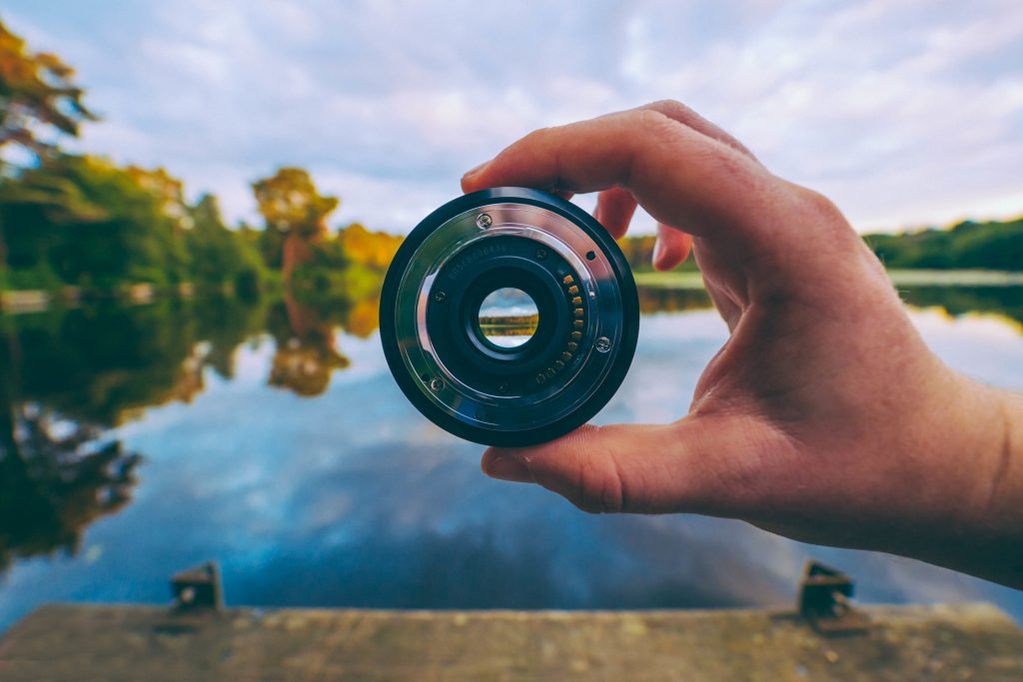
The Environmental Lens

Slide 16
The Environmental Lens
Environmental education should not be a theme that is exclusive to one topic, in one module, in one month in a year’s curriculum or one chapter in a textbook. It should be a lens through which we approach our day to day lives, our planning, and our execution of tasks in the classroom.
Notes:
Continuous intake real day to day life

Slide 17
Being a Green Teacher: Tips and Tricks
Double side your handouts
Ensure your school recycles
Put up sorting signage in your classroom by the garbage bins
Have a stationary recycling box at school
Assign a recycling monitor in the class and other leadership roles
Don’t overwhelm students with handouts
When using MS Word to create handouts, expand your margins so you can fit more onto one page
Utilize Google Classroom, Whatsapp, Google Drive, etc. when you can as a way of being paperless

Slide 18
Being a Green Teacher: Tips and Tricks continued
Make more use of the projector, whiteboard or blackboard for sharing content
Incorporate activities that don’t use paper or minimize the amount of copies you need (e.g. conversation circles, group work)
Give groups one paper to work from
Use reusable bottles and mugs in the classroom
Encourage boomerang lunches
Dictate listening questions where possible
Have a scrap paper box to use for small activities and for students to use
Have plants in your classroom
Go on a nature walk
Plan field trips to a local recycling plant, a water treatment plant, a community garden, a conservation area, etc.

Slide 19
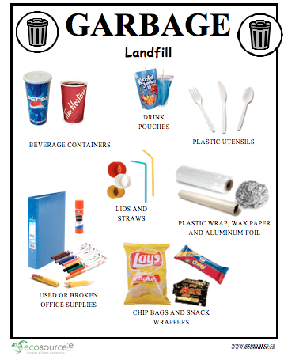
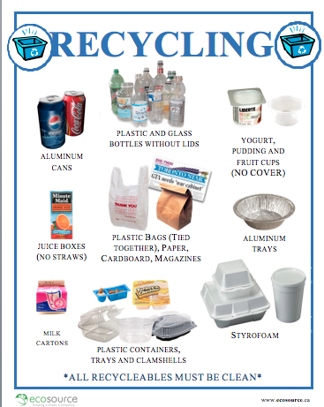
Sorting Signage

Slide 20
Green Real World Tasks in LINC Themes
Housing
Shopping
Health and Safety
Canadian Culture
Banking
Community
Canada
Education
Employment
Canadian Law
Family and Relationships
Travel and Transportation

Slide 21
CHAT QUESTION (5 minutes)
Can you think of a green real world task that could be a part of these module topics?
When you think of one, reflect on these questions: Which competency does it address? What target grammar could you teach? What kind of skill building would be required?
Answer in the chat:
The topic, the task, the competency it addresses.

Slide 22
Real World Task Competencies
Listening
Interacting with Others
Comprehending Instructions
Getting Things Done
Comprehending Information
Reading
Interacting with Others
Comprehending Instructions
Getting Things Done
Comprehending Information
Speaking
Interacting with Others
Giving Instructions
Getting Things Done
Sharing Information
Writing
Interacting with Others
Reproducing Information
Getting Things Done
Sharing Information
Notes:
+ Grammar items: modals of advice, future tense, modals of request, transition words, argumentative language, cause and effect phrases

Slide 23
Example: Banking and Green RWT
Listening
Interacting with Others
Listen to a conversation between a customer service representative and a customer where a customer asks to switch to paperless billing
Speaking
Interacting with Others
Call a credit card company and ask to switch to paperless billing
Open a bank account at the bank. Go paperless by asking for online statements.
Debate between in person and online banking, include environmental argument for online.

Slide 24
Example: Banking and Green RWT
Reading
Comprehending Information
Read about ways to reduce paper at the bank
Comprehending Instructions
Read and follow instructions on how to change to paperless bank statements from a bank website
Writing
Sharing Information
Write a paragraph of ways to reduce paper when banking
Write a paragraph on the benefits of online banking, touch on saving emissions
Giving Instructions
Write instructions of using ATM, write no for taking a receipt and explain why.

Slide 25
Distance Learning, Co-Vid and Environmental Education
Conversation Circles: Group video chats/conversation circles talking about topics around the environment, Co-Vid and the impact on the planet, Earth Day, littering, weekend news stories, etc.
YouTube Videos: Assign YouTube videos showing impact before and after co-vid and teach past tense and simple present and present continuous / language for compare and contrast / adjectives (feelings/descriptors) + comparative adjectives
Video Suggestions:
6 Things that Prove the Earth is Healing:
https://www.youtube.com/watch?v=R3M908TJG9M
The Sky is Clearing – An Inspirational Film:
https://www.youtube.com/watch?v=3J7dlRE2jxA
Wildlife comes out to play:
https://www.youtube.com/watch?v=ysGGIxxrwuk

Slide 26
Distance Learning, Co-Vid and Environmental Education continued
Reset/Reconnect: An opportunity to stop and smell the roses
Nature/Backyard Walk: Get learners to reconnect to nature with journaling / sketching what they see in their backyard or on their social distancing walk, Get them to explain what they hear, see, smell, feel. (A great grounding exercise: Co-vid and mental health)
Backyard/Porch chats: Videochat from your backyard / garden (show and tell)
Current News: Reflect on current events and weekend gatherings as teachable moments (e.g Trinity Bell Woods Park this past Saturday, people littering masks and gloves, panic buying)

Slide 27
Additional Resources
Intermediate to Advanced: YouTube video on Material Decomposition Rates:https://www.youtube.com/watch?v=iS4VDu98Qa8
EcoSource www.ecosource.ca
High Intermediate to Advanced: The Story of Stuff (book) + The Story of Stuff YouTube Channel
www.esllibrary.com: Green Companies, Environmental Problems, etc.
Low Beginner: Free Earth Day Lesson and Handouts: https://www.esljigsaws.com/blog/simple-earth-day-for-low-beginners/index.html
LINC 4: Alternative Transportation: http://www.moresettlement.org/LINC1-4/LINC4/travel.transportation/alternative.transpo/index.htm
Ventures 4: Unit on Daily Living about writing about environmental problems using cause and effect paragraphs
Farm to Table Picture Story: https://www.englishlanguage.org.nz/wp-content/uploads/2018/04/6.-Garden-to-Plate22Sept2016.pdf
Films: Chasing Coral, Tapped, Sea of Life, Chasing Ice
Updated Canada’s Food Guide: https://food-guide.canada.ca/en/
TED Talk: How to Use a Paper Towel: https://www.ted.com/talks/joe_smith_how_to_use_a_paper_towel/discussion?language=en
CBC Marketplace Episode:
Fashion’s Dirty Secret: https://www.cbc.ca/marketplace/m_episodes/2017-2018/clothing-waste-fashions-dirty-secret
Tracking Your Trash: https://www.cbc.ca/marketplace/episodes/2019-2020/tracking-your-trash-where-does-your-recycling-really-end-up

Slide 28
References
https://www.theguardian.com/us-news/2019/jun/23/all-the-plastic-ever-made-study-comic
https://www.saveonenergy.com/material-decomposition/
https://begreenpackagingstore.com/blogs/news/7873165-how-long-does-it-take-for-trash-to-decompose
https://www.thebalancesmb.com/how-long-does-it-take-garbage-to-decompose-2878033
http://www.earthlyissues.com/recycling.htm
https://www.wired.co.uk/article/climate-change-facts-2019
https://www.conservation.org/stories/11-climate-change-facts-you-need-to-know
https://www.cbc.ca/news/politics/ocean-plastic-liberals-fact-check-1.5212632
https://www.globalcitizen.org/en/content/plastic-pollution-facts/
https://www.conservation.org/stories/11-deforestation-facts-you-need-to-know
https://www.carbonbrief.org/analysis-why-scientists-think-100-of-global-warming-is-due-to-humans
https://climateatlas.ca/climate-change-basics

Slide 29
Contact Me!
I can send over:
Sorting Signage in MS Word
This PowerPoint presentation
Real World Task readings, listening handouts, worksheets, role-play guides
Green Real World Task suggestions list according to theme
Sorting PowerPoint to educate students about municipal guidelines
My workbook for students on co-vid and its environmental impact
Or if you have any questions, concerns, tips for me!
My email address: rajpreetlotay@gmail.com
“Do your little bit of good where you are; it’s those little bits of good put together that overwhelm the world.”
-Archbishop Desmond Tutu

